Slide 1
Welcome to the Department of Revenue’s
Truth in Millage (TRIM) Training
for School Districts

Slide 2
Overview
Introduction
TRIM Timetable
TRIM Certification Forms
TRIM Advertising Requirements
TRIM Hearing Requirements
Resolutions/Ordinances
Certifying Compliance to the Department
2021 Top Infractions and Violations
TRIM Compliance Contacts

Slide 3
Introduction
TRIM process and the public
Chapter 200, Florida Statutes

Slide 4
TRIM Timetable

Slide 5
TRIM Timetable
The property appraiser (PA) provides total assessed value of nonexempt property to taxing authorities by June 1 for budget planning purposes.
PA certifies the school district’s taxable value on Certification of School Taxable Value (Form DR-420S).

Slide 6
TRIM Timetable Day 1 = July 1
July
The first day of the TRIM process is July 1 or the date of certification of taxable value, whichever is later.
1 | 2 | 3 | 4 | 5 | 6 | 7
8 | 9 | 10 | 11 | 12 | 13 | 14
15 | 16 | 17 | 18 | 19 | 20 | 21
22 | 23 | 24 | 25 | 26 | 27 | 28
29 | 30 | 31
DAY
1

Slide 7
TRIM Timetable Day 24 = July 24
July
Within 24 days of date of certification of taxable value, the superintendent submits the budget to the board for approval.
1 | 2 | 3 | 4 | 5 | 6 | 7
8 | 9 | 10 | 11 | 12 | 13 | 14
15 | 16 | 17 | 18 | 19 | 20 | 21
22 | 23 | 24 | 25 | 26 | 27 | 28
29 | 30 | 31
DAY
24

Slide 8
TRIM Timetable Day 29 = July 29
July
Within 29 days of date of certification of taxable value, the school district shall advertise its intent to adopt a tentative budget and millage rates.
1 | 2 | 3 | 4 | 5 | 6 | 7
8 | 9 | 10 | 11 | 12 | 13 | 14
15 | 16 | 17 | 18 | 19 | 20 | 21
22 | 23 | 24 | 25 | 26 | 27 | 28
29 | 30 | 31
DAY
29

Slide 9
TRIM Timetable
Within two to five days of the advertisements publicizing the tentative budget hearing, each school district should hold a public hearing on the tentative budget and millage.

Slide 10
TRIM Timetable Day 35 = August 4
Within 35 days of certification of value, each school district must inform the PA of:
Prior year millage rate
Current year proposed millage rate
Current year rolled-back rate
The date, time, and meeting place of the final budget hearing for school districts
August
 |  |  | 1 | 2 | 3 | 4
5 | 6 | 7 | 8 | 9 | 10 | 11
12 | 13 | 14 | 15 | 16 | 17 | 18
19 | 20 | 21 | 22 | 23 | 24 | 25
26 | 27 | 28 | 29 | 30
DAY
35

Slide 11
TRIM Timetable
If a school district fails to provide the information required within 35 days, it will be prohibited from levying a millage rate greater than the rolled-back rate for the upcoming year.
The PA will compute the rolled-back rate and use it to prepare the Notice of Proposed Property Taxes.

Slide 12
TRIM Timetable Day 55 = August 24
The PA should mail the Notice of Proposed Property Taxes (TRIM notice) no later than 55 days after certification of value.
If the Department issues a review notice, the PA cannot send the TRIM notice until the Department has approved the assessment roll.
August
 |  |  | 1 | 2 | 3 | 4
5 | 6 | 7 | 8 | 9 | 10 | 11
12 | 13 | 14 | 15 | 16 | 17 | 18
19 | 20 | 21 | 22 | 23 | 24 | 25
26 | 27 | 28 | 29 | 30
DAY
55

Slide 13
TRIM Timetable Days 65-80 = Sept. 3-18
The school district should hold a public hearing on the final budget and final millage rates 65 to 80 days after certification of value.
This hearing is published on the TRIM notice the PA mails.

Slide 14
TRIM Timetable At the Final Hearing, the School District Will:
Amend the tentatively adopted budget and millage rates
Publicly announce the percentage increase in the re-computed millage over the rolled-back rate
Adopt final millage rates and final budget
- If the adopted millage rate exceeds the tentatively adopted rate, each taxpayer in the jurisdiction will be notified of the increase by first class mail at the taxing authority’s expense.

Slide 15
TRIM Timetable Within Three Days of the Final Hearing:
The school district will forward the resolution or ordinance adopting the final millage rate to the PA, tax collector, and Department of Revenue.
When the PA receives the resolution or ordinance, notification of the final millage rate is considered official.

Slide 16
TRIM Timetable
No taxing authority may levy a millage other than one approved by referendum until the taxing authority’s governing board approves the resolution or ordinance to levy and submits it to the PA, tax collector, and Department of Revenue.

Slide 17
TRIM Timetable
Before the extension of the rolls, the PA will notify each taxing authority of the aggregate change in the assessment roll on Form DR-422.

Slide 18
TRIM Timetable
Within three days after receiving Form DR-422, the school district will complete and certify the final millage rates to the PA.

Slide 19
TRIM Timetable Within 30 Days of the Final Hearing:
The school district must certify compliance to the Department of Revenue.
Do not wait to certify compliance if you have not received Form DR-422 from the property appraiser.
Complete Form DR-422 as soon as you receive it and submit it to the PA and to the Property Tax Oversight TRIM section.

Slide 20
TRIM Certification Forms

Slide 21
TRIM Certification Forms
Certification of School Taxable Value
(Form DR-420S)
Certification of Voted Debt Millage
(Form DR-420DEBT)

Slide 22
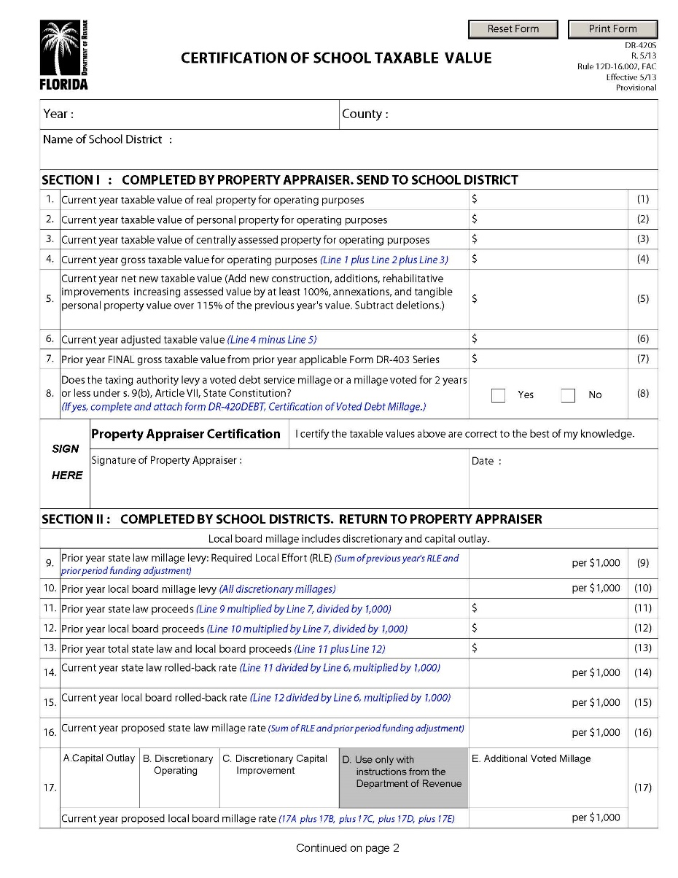
DR-420S

Slide 23
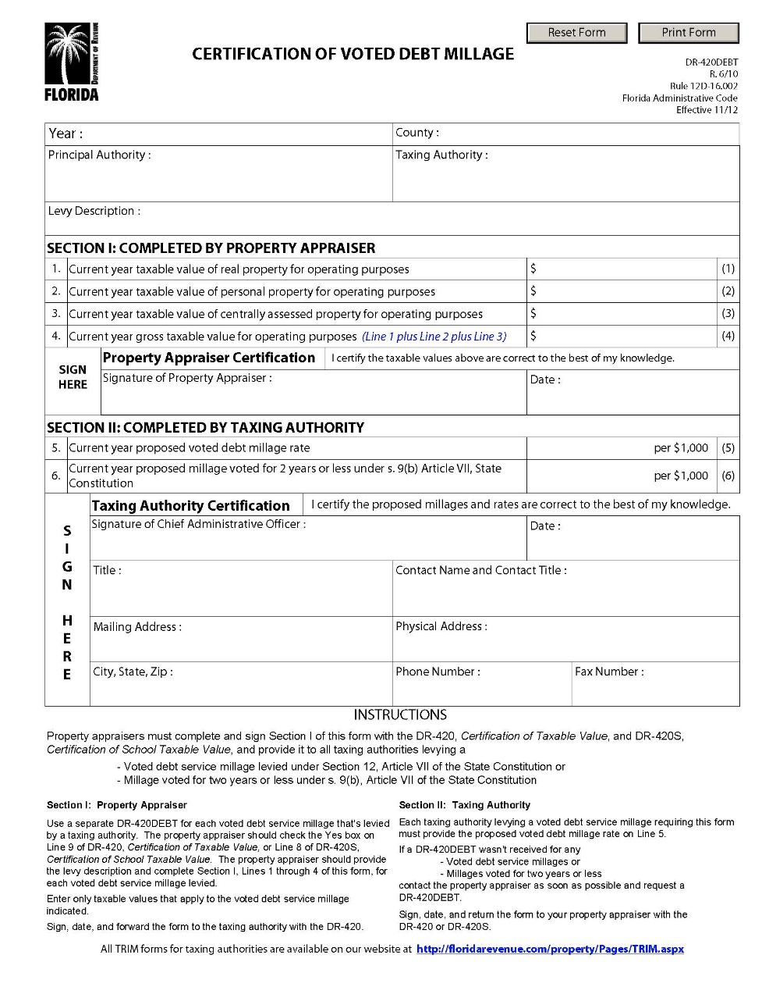
DR-420DEBT

Slide 24
TRIM Advertising Requirements

Slide 25
TRIM Advertising Requirements Types of TRIM Advertisements
Notice of Budget Hearing
Notice of Proposed Tax Increase
Notice of Tax for School Capital Outlay
Budget Summary
Amended Notice of Tax for School Capital Outlay
Notice of Continuation
Notice of Rescheduled Hearing

Slide 26
TRIM Advertising Requirements Newspaper Requirements
School districts must select the appropriate newspaper advertisement to announce the tentative TRIM hearing.
All TRIM advertisements must:
Be published as provided in chapter 50
Appear in a newspaper of general circulation in the county or in its geographically limited insert
Be adjacent to accompanying TRIM ads
Be submitted with proof of publication and the entire page of the newspaper on which they appear

Slide 27
TRIM Advertising Requirements Newspaper Requirements
TRIM newspaper advertisements cannot:
Appear in the legal or classified section
Deviate from the language specified in s. 200.065, F.S.
Be accompanied, preceded, or followed by other ads or notices which conflict with or contradict the required publications (s. 200.065(3)(h), F.S.)
Be combined. The ads must be separate and adjacent (s. 200.065(3)(l), F.S.)

Slide 28
“Adjacent to”
“Adjacent to,” when used in reference to newspaper advertisements, means next to, touching, or contiguous, either at the sides or at the corners. This term includes ads placed adjacent to one another, either on the same page or on adjoining pages with a crease separating them, so that a reader may view the ads simultaneously when the pages are open on a flat surface.

Slide 29
TRIM Advertising Requirements Internet Only Publication
Taxing authorities may opt for internet only publication of TRIM advertisements. A taxing authority that chooses this option must adhere to the following requirements (see s. 50.0211(5)(a)&(d), F.S.):
Hold a public hearing which is noticed in a print edition of a newspaper in accordance with chapter 50, F.S.
Make a determination by a majority of the members of the governing body that Internet publication of the taxing authority’s notices is in the public interest and that residents within the jurisdiction of the taxing authority have sufficient access to the Internet by broadband service

Slide 30
TRIM Advertising Requirements Internet Only Publication (continued)
Provide notice at least once per week in the print edition of a newspaper of general circulation within the region the taxing authority is located which states that legal notices pertaining to the taxing authority do not all appear in the print edition of the local newspaper and that additional legal notices may be accessed on the newspaper’s website at www.floridapublicnotices.com
Post a link on the taxing authority’s website homepage to a webpage that lists all the newspapers in which the taxing authority publishes legal notices

Slide 31
TRIM Advertising Requirements Notice of Budget Hearing Ad
The school district uses the Notice of Budget Hearing ad when the school district proposes a millage rate that is equal to or less than the current year’s rolled back rate.

Slide 32
TRIM Advertising Requirements The Notice of Budget Hearing ad must:
Be published within 29 days of certification of taxable value
Not deviate from the specified language
Have an adjacent Budget Summary ad and Notice of Capital Outlay ad, if applicable
The Notice of Budget Hearing ad doesn’t have a size requirement.
The taxing authority must hold the hearing two to five days after ads are published.

Slide 33
TRIM Advertising Requirements Notice of Budget Hearing Ad Example
NOTICE OF BUDGET HEARING
The (name of school district) will soon consider a budget for (fiscal year). A public hearing to make a DECISION on the budget AND TAXES will be held on
Date and Time
at
Meeting Place

Slide 34
TRIM Advertising Requirements Notice of Proposed Tax Increase Ad
The school district uses the Notice of Proposed Tax Increase ad if the school district proposes a millage rate greater than the current year’s rolled back rate.

Slide 35
TRIM Advertising Requirements Notice of Proposed Tax Increase ad must:
Be published within 29 days of certification of taxable value
Use 100% of tax levies
Be a quarter page of the newspaper
Have an adjacent Budget Summary ad and a Notice of Capital Outlay ad if applicable
Not deviate from the specified language
The taxing authority must hold the hearing two to five days after the ads are published.

Slide 36
TRIM Advertising Requirements Notice of Proposed Tax Increase Ad Example

Slide 37
TRIM Advertising Requirements Notice of Proposed Tax Increase Ad Example

Slide 38
TRIM Advertising Requirements Notice of Tax for School Capital Outlay
If a school district intends to levy capital outlay taxes, then the school district must advertise its intent in an advertisement headed “Notice of Tax for School Capital Outlay.”

Slide 39
TRIM Advertising Requirements The Notice of Tax for School Capital Outlay must:
Be a quarter page of the newspaper
Be adjacent to the Notice of Proposed Tax Increase or Budget Hearing and Budget Summary
Specify the projects and number of school buses the additional taxes will fund
Not deviate from the specified language

Slide 40
TRIM Advertising Requirements School Capital Outlay Categories
New Construction and Remodeling
Maintenance, Renovation, and Repair
Motor Vehicle Purchases (specify number of buses)
New and Replacement Equipment, Computer and Device Hardware and Operating System Software Necessary for Gaining Access to or Enhancing the Use of Electronic and Digital Instructional Content and Resources, and Enterprise Resource Software
Payments for Educational Facilities and Sites Due Under a Lease Purchase Agreement
Payments For Renting And Leasing Educational Facilities And Sites
Payments of Loans Approved Pursuant to ss. 1011.14 and 1011.15, F.S.

Slide 41
TRIM Advertising Requirements School Capital Outlay Categories, continued
Payment of Costs of Compliance with State and Federal Environmental Statutes, Rules, and Regulations
Payment Of Premiums For Property and Casualty Insurance Necessary to Insure The Educational and Ancillary Plants of The School District
Payment of Costs of Leasing Relocatable Educational Facilities
Payments to Private Entities to Offset the Cost of School Buses Pursuant to s. 1011(2)(i), Florida Statutes (specify number of buses)
Payment of Cost of Opening Day Collection for Library Media Center

Slide 42
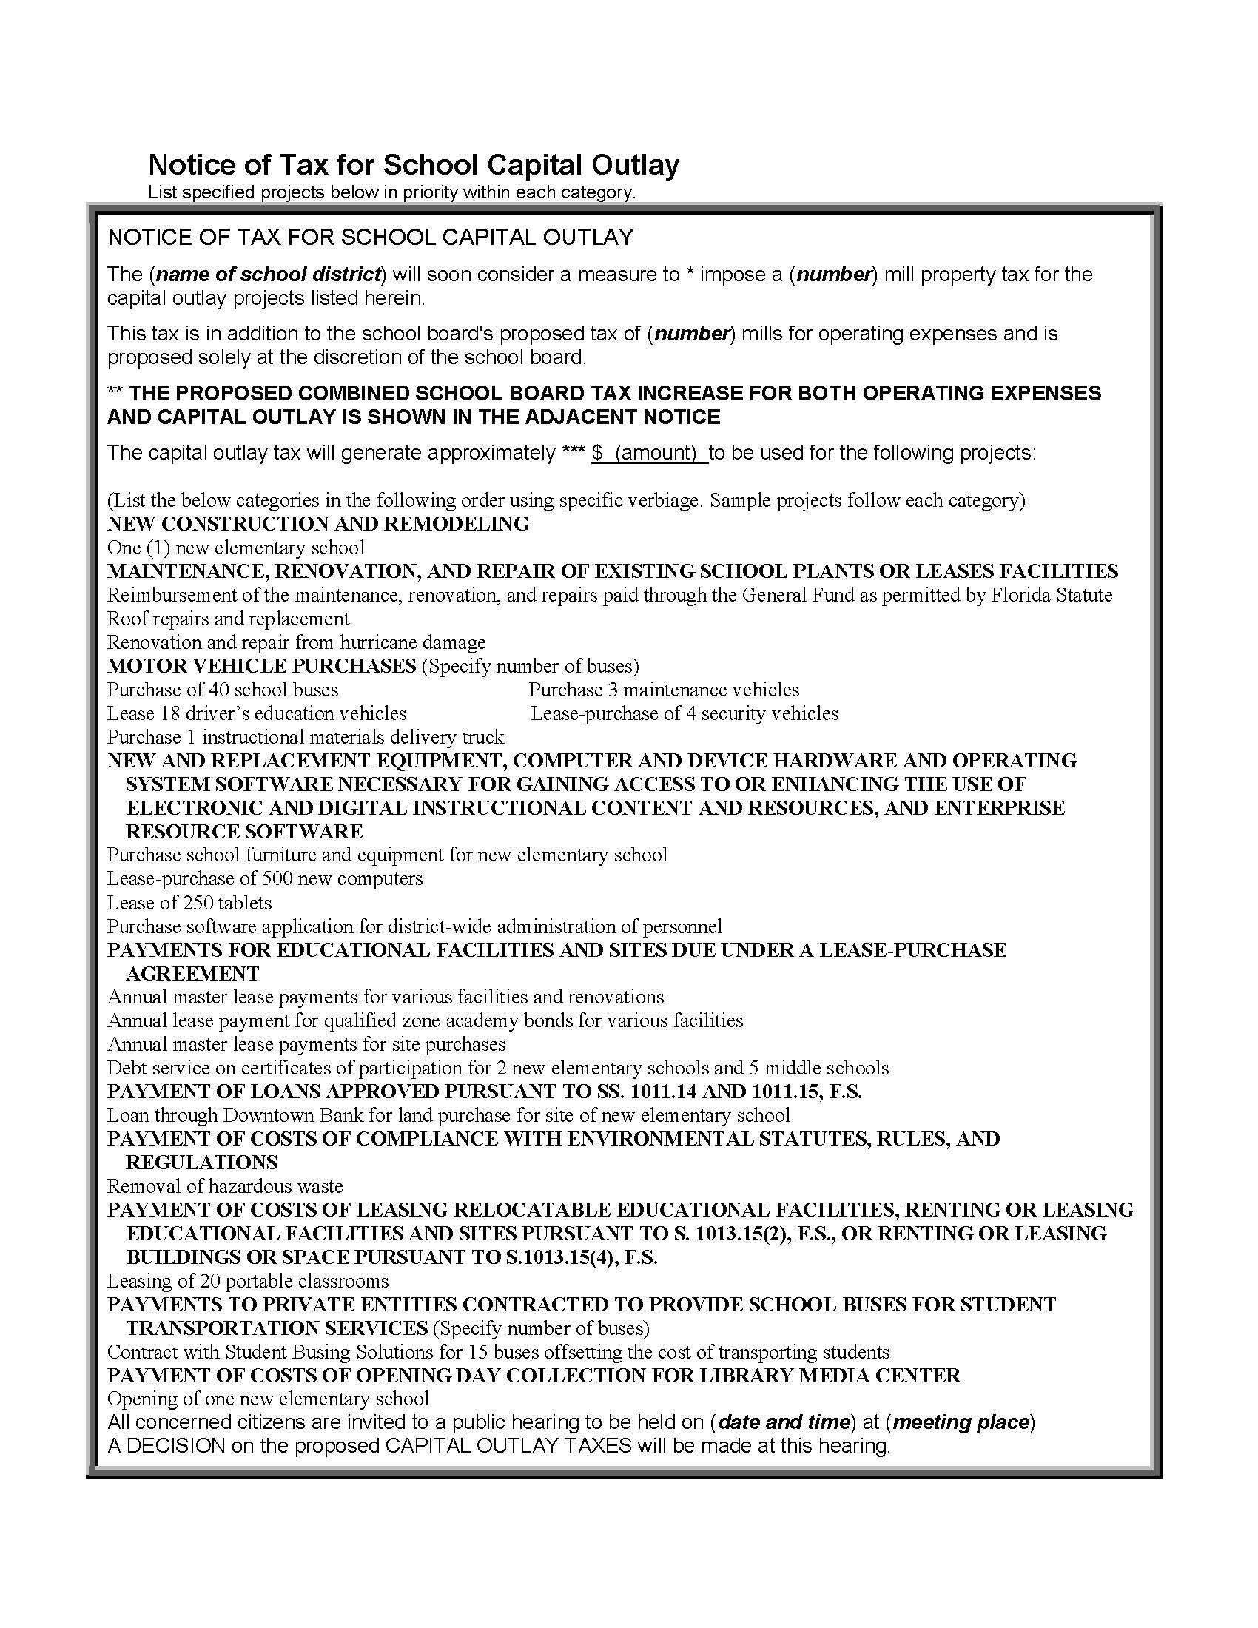
TRIM Advertising Requirements Notice of Tax for School Capital Outlay Example

Slide 43
TRIM Advertising Requirements Notice of Tax for School Capital Outlay Example, Continued

Slide 44
TRIM Advertising Requirements Budget Summary Advertisement
An adjacent Budget Summary advertisement must accompany all required TRIM advertisements. This summary must show the proposed tax millages, balances, reserves, and total of each major classification of receipts and expenditures.

Slide 45
TRIM Advertising Requirements The Budget Summary ad must:
Have an adjacent quarter page Notice of Proposed Tax Increase or Notice of Budget Hearing advertisement
Have an adjacent Notice of Tax for School Capital Outlay advertisement if applicable
Show all proposed millage rates applicable to school district:
Required Local Effort (RLE) including prior period funding adjustment
Capital Outlay
Discretionary Operating
Discretionary Capital Improvement
Additional Voted Millage
Voted Debt Service

Slide 46
TRIM Advertising Requirements The Budget Summary must:
Show all funds
Have a balanced budget; balance all funds and the total of all funds
Include the statement of increase in operating expenditures in bold type if the proposed operating budget expenditures for the upcoming year are greater than those of the current year

Slide 47
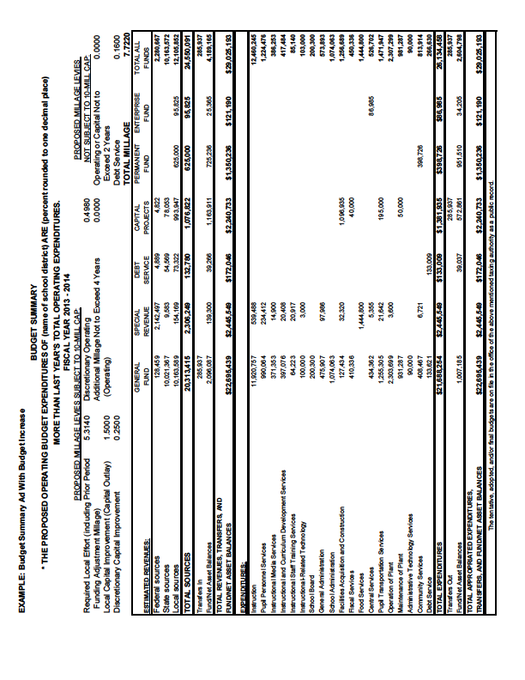
TRIM Advertising Requirements Budget Summary Example

Slide 48
TRIM Advertising Requirements Amended Notice of Tax for School Capital Outlay
If a school district needs to amend the list of capital outlay projects it previously advertised or adopted, the school district must publish an Amended Notice of Tax for School Capital Outlay ad.

Slide 49
TRIM Advertising Requirements Amended Notice of Tax for School Capital Outlay ad must:
Be published any time the school district proposes an amendment to the previously advertised and adopted Notice of Tax for School Capital Outlay. Projects must be listed under each category of new, amended, or deleted. Categories/projects without a change may be omitted.
Be a quarter page of the newspaper

Slide 50
TRIM Advertising Requirements Amended Notice of Tax for School Capital Outlay Ad Example

Slide 51
TRIM Advertising Requirements Notice of Continuation Ad
If circumstances beyond the school district’s control cause the hearing to be recessed, the school district must publish a Notice of Continuation.
The hearing should be recessed, not adjourned.

Slide 52
TRIM Advertising Requirements Notice of Continuation Ad
Must not deviate from the specified language
Has no size requirement
Requires no accompanying ads
The school district must hold the hearing two to five days after the ad is published.

Slide 53
TRIM Advertising Requirements Notice of Continuation Ad Example
NOTICE OF CONTINUATION
The tentative/final budget hearing held on (Date of hearing)
For the (name of school district) was recessed and will be continued on
(Date, time, and location of new hearing).
(Include name of town)

Slide 54
TRIM Advertising Requirements Notice of Rescheduled Hearing Ad
If a hearing is postponed or rescheduled due to circumstances beyond its control, the school district should publish a Notice of Rescheduled Hearing in a newspaper of general circulation in the county.
The notice will state the time, date, and location of the rescheduled hearing.

Slide 55
TRIM Advertising Requirements Notice of Rescheduled Hearing Ad:
Must not deviate from the specified language
Has no size requirement
Requires no accompanying ads
The school district should post an 8.5 X 11 inch copy of the notice at the place of the original hearing
The school district must hold the hearing two to five days after the ad appears in a newspaper.

Slide 56
TRIM Advertising Requirements Notice of Rescheduled Hearing Example
NOTICE OF RESCHEDULED HEARING
The tentative/final hearing adopting a millage and budget on (hearing date)
for the (name of school district) is being rescheduled due to (named storm)
A rescheduled (tentative/final) budget hearing will be held on:
(Date, time, and meeting place)
(Include name of town)

Slide 57
TRIM Hearing Requirements

Slide 58
TRIM Hearing Requirements
Two to five days after publishing the ads for the tentative budget hearing, each school district holds a public hearing on the tentative budget and millage.
At the hearing, the school district adopts the tentative millage rates and tentative budget.

Slide 59
TRIM Hearing Requirements Scheduling Hearings
The school board may schedule the hearing for a time Monday through Friday after 5:00 p.m. or anytime on Saturday, but never for a Sunday.
The board of county commissioners (BOCC) cannot schedule its hearings on days a school board has hearings scheduled.
No other taxing authority in the county may hold a public hearing on the same date as the school board or BOCC.

Slide 60
TRIM Hearing Requirements At the Hearings
The first issues discussed will be:
Percentage increase in millage over the rolled-back rate necessary to fund the budget, if any
Specific purposes for which ad valorem tax revenues are increasing

Slide 61
TRIM Hearing Requirements At the Hearings
The governing body will hear comments regarding a proposed increase in millage and explain the reasons for the proposed increase over the rolled-back rate.
The general public may speak and ask questions before the governing body adopts any measures.
The governing body must adopt its tentative or final millage rate before adopting its tentative or final budget. Adopt millage first; adopt budget second.

Slide 62
TRIM Hearing Requirements At the Final Hearings
The taxing authority must adopt the millage rate first by resolution or ordinance. The resolution or ordinance will state the adopted millage rate and the percent, if any, by which it exceeds the rolled-back rate.
The taxing authority will adopt the millage rate and the budget by separate votes at the final hearing.

Slide 63
TRIM Hearing Requirements At the Final Hearing
The millage rate the school district adopts at the final budget hearing cannot exceed the rate the board tentatively adopted at the first hearing unless the PA sends each taxpayer a revised Notice of Proposed Property Taxes before the final hearing.
The school district may not levy any millage other than the one it approved by referendum until the school district’s governing board approves the resolution or ordinance to levy and submits it in a timely manner to the PA and the tax collector.
If the fall term for a school district begins before adoption of the final budget, the school district may expend monies in accordance
with the adopted tentative budget until a final budget is adopted.

Slide 64
TRIM Hearing Requirements Recessed Hearings
The board can recess the tentative or final hearing.
The board should not adjourn the hearing; the hearing will need to be recessed.
If the hearing is recessed, the taxing authority must publish a notice in a newspaper of general circulation in the county.

Slide 65
Executive Order for State of Emergency
School districts should be cognizant of any executive order issued by the governor declaring a state of emergency because of an imminent tropical storm, hurricane, or other calamity. The executive order will provide pertinent information and guidance such as:
Listing counties or areas impacted by the emergency event
Suspending the effect of any statute, rule, or order that would prevent, hinder, or delay any action necessary to cope with the emergency

Slide 66
Executive Order for State of Emergency
The executive director of the Department of Revenue may in turn issue an emergency order with specific guidance with regard to the TRIM process, such as:
A list of the counties impacted
An extension of TRIM timelines
A temporarily waiver of TRIM compliance requirements
Specific guidance related to TRIM hearing and advertising requirements

Slide 67
TRIM Resolutions/Ordinances

Slide 68
TRIM Resolution/Ordinance Millage Resolution/Ordinance
School districts will forward the resolution or ordinance adopting the final millage to the PA, tax collector, and Department of Revenue within three days after the final budget hearing.
When submitting an electronic copy of the final millage resolution or ordinance to the Department please use the following email address: trim@floridarevenue.com.
The PA’s receipt of the resolution or ordinance will be official notice of the millage rate the school district approved.

Slide 69
TRIM Resolution/Ordinance Millage Resolution/Ordinance
The tentative and final resolution/ordinance adopting millage rates must include:
The school district’s name
The percentage increase over the rolled-back rate
Each adopted millage rate
The rolled-back rate

Slide 70
TRIM Resolution/Ordinance Budget Resolution/Ordinance
Must be adopted by separate vote after the millage adoption
If the order of millage and budget adoption cannot be determined, the school board will need to provide the meeting minutes.

Slide 71
Certifying Compliance to the Department

Slide 72
Certifying Compliance to the Department
School districts must submit their TRIM compliance package within 30 days of the final budget hearing using these forms:
Certification of Compliance (Form DR-487)
Certification of Final Taxable Value (Form DR-422)

Slide 73
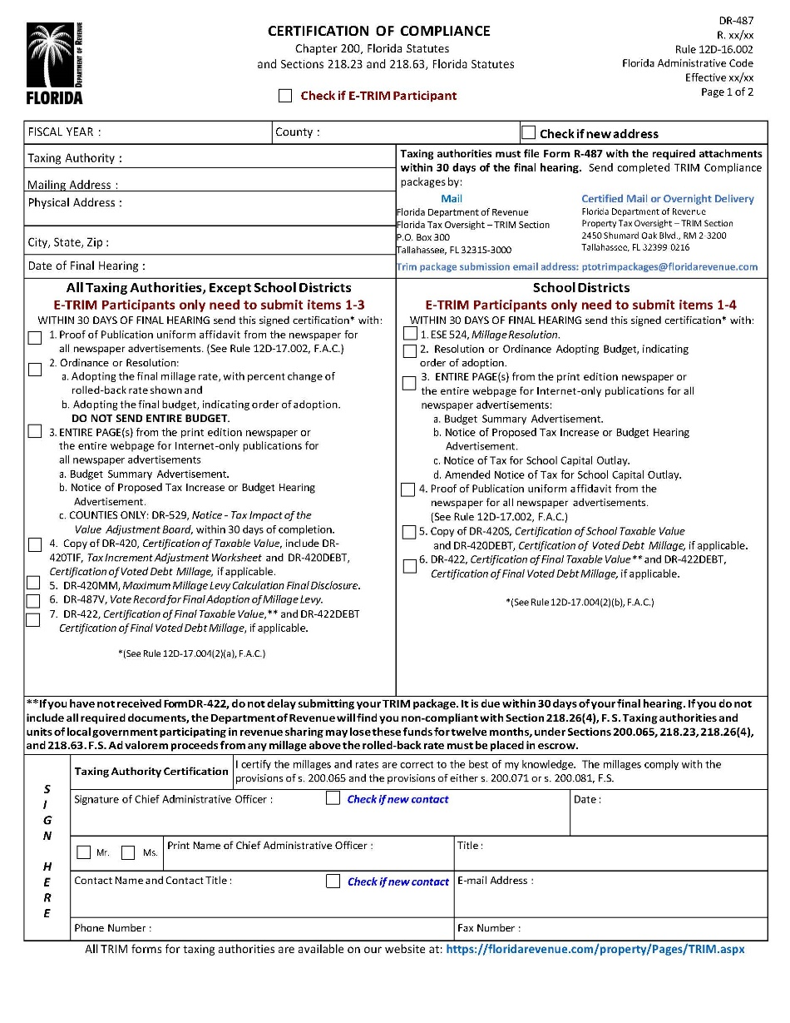
DR-487

Slide 74
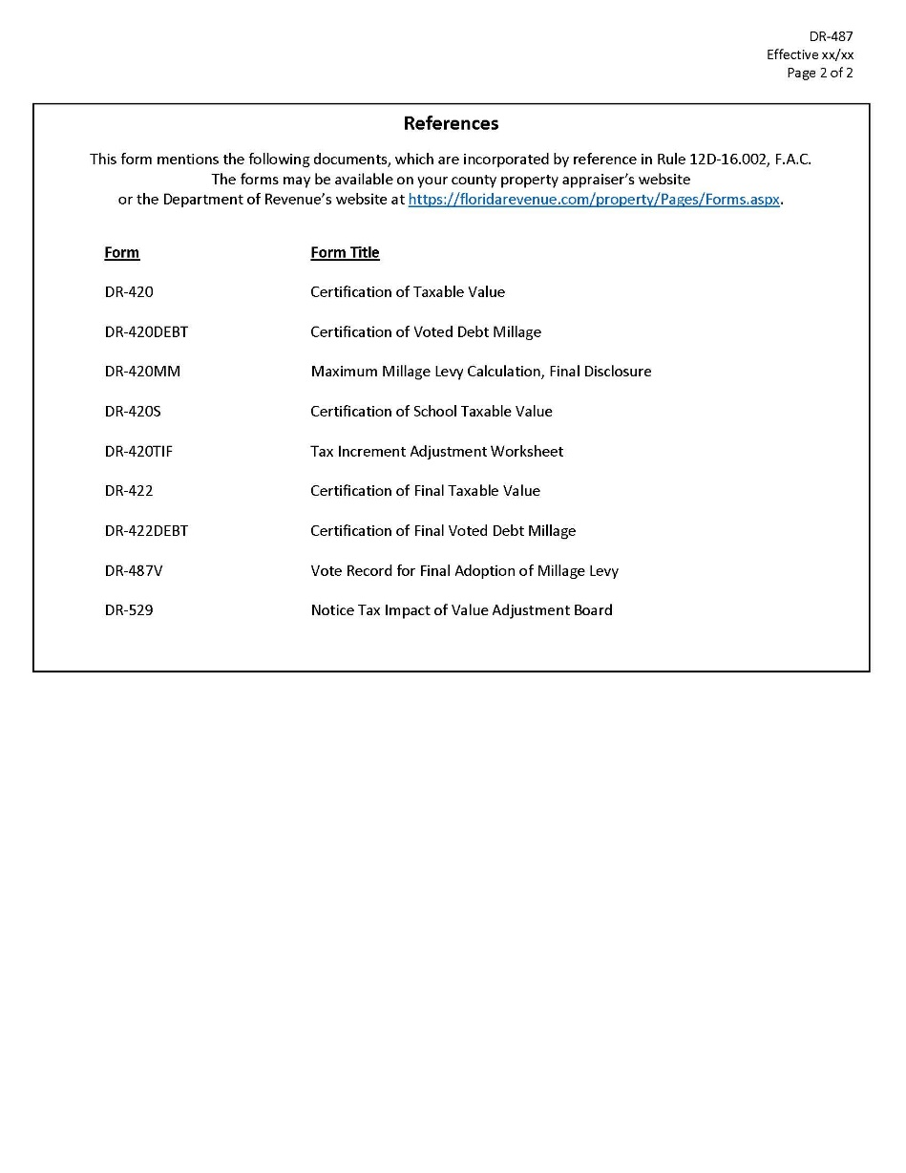
DR-487 page 2

Slide 75
Electronic Submission
When submitting the TRIM compliance package to the TRIM section electronically, you must:
Include the Taxing Authority Number (provided by the TRIM section), Taxing Authority Name, and “TRIM Compliance Package” consisting of:
Certification of School Taxable Value (Form DR-420S)
Resolution Determining Millage (ESE-524)
Resolution/ordinance adopting budget
Entire newspaper page or include a copy of the published internet ad.
Proofs of publication for all ads
Certification of Final Taxable Value (Form DR-422)
Email address for electronic submission is: ptotrimpackages@floridarevenue.com

Slide 76
2021 Top TRIM Infractions/Violations
Incorrect verbiage in advertisement
Tax levy incorrect/percent increase incorrect
Percent increase over the rolled-back rate not shown/incorrect (ord./res.)
Late package
Ad valorem proceeds not shown or incorrect/Published Incorrect Advertisement

Slide 77
TRIM Compliance Contacts
TRIM STAFF | PHONE NUMBER
Wyatt Peters | (850) 617-8921
Kendall Tolbert | (850) 617-8861
Breauna Hines | (850) 617-8923
Roberta Epp | (850) 617-8890
Dianne Porter | (850)617-8920
Fax Number | (850) 617-6115
TRIM Email Address eTRIM Email Address TRIM Package Submission Email | TRIM@floridarevenue.com eTRIM@floridarevenue.com ptotrimpackages@floridarevenue.com

Slide 78
Thank you!

