Slide 1


Slide 2

Understanding the State Plan

Slide 3

Agenda
Background
State Plan Documents
Oversight and Amendment Submission
OCSS Review and Approval
Resources

Slide 4

Background

Slide 5
History
Title IV-D of the Social Security Act established by the Social Security Amendments of 1974, Public Law 93-647, January 4, 1975
Sections 452, 454 & 456 of the Act describe requirements for the IV-D state plan
State plan regulations published June 26, 1975, with Federal Regulations 40 FR 27147
  45 CFR Part 301 – State Plan Approval and Grant Procedures
  45 CFR Part 302 – State Plan Requirements

Slide 6
Definition of State Plan
Comprehensive statement describing the nature and scope of the state IV-D program
Assures IV-D program will be administered in conformity with the statutory and regulatory requirements
Contains all information necessary for OCSS to determine whether the plan can be approved

Slide 7
Legislative & Regulatory Impacts
Various legislation has prompted changes to the IV-D state plan
Omnibus Reconciliation Act of 1981
Social Security Disability Amendment of 1980
Child Support Amendments of 1984
Family Support Act of 1988
Personal Responsibility and Work Opportunity Reconciliation Act of 1996

Slide 8
Legislative & Regulatory Impacts (cont’d)
Child Support Performance and Incentive Act of 1998
Deficit Reduction Act of 2005
Preventing Sex Trafficking and Strengthening Families Act of 2014
Ratification of Hague Child Support Convention in 2016

Slide 9
Legislative & Regulatory Impacts (cont’d)
Various regulation have also prompted changes to the IV-D state plan
Final Rule: Flexibility, Efficiency, and Modernization in Child Support Enforcement Programs (FEM) - 2016
Final Rule: Child Support Technical Corrections - 2020

Slide 10
Federal Funding Application
45 CFR Part 302 defines the state plan provisions required for an approved plan under title IV-D of the Act
Approved plan allows federal financial participation in operating a title IV-D child support program
IV-D state plan is updated through plan amendments
Mandatory grant programs must submit the SF-424M annually through OLDC
  Not required to attach any state plan documents

Slide 11
OCSS State Plan System
Allows for submission and review of plan amendments
Reduces paperwork burden on states and federal government
Provides a public view option

Slide 12
State Plan Documents

Slide 13
IV-D State Plan Material
State plan amendments are reviewed every three years per Paperwork Reduction Act of 1995 and include the following materials:
State Plan Table of Contents
OCSS 21-U4 Form
State Plan Cover Sheet

Slide 14
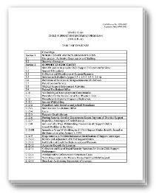
State Plan Table of Contents
Section 1 – Single State Agency Organization
Section 2 – Support Enforcement
Section 3 – General Program Administration
Section 4 – Financial Administration
Section 5 – State Plan Administration

Slide 15
Transmittal page (OCSS 21-U4 Form)
This page includes the following:
Section of the state plan being amended and the type of amendment
Transmittal number designated by the state
Proposed effective date
Transmittal number of the superseded plan or amendment
Submitter
Information on the governor’s review, if applicable

Slide 16
Plan Page
The state plan page contains:
Affirmative statements that indicate the state will comply with the specific requirements in the statute and regulations
Citations from the statute or regulation
Check boxes for the state to indicate the implementation of optional provisions or requirements, when applicable

Slide 17
Plan Page (cont’d)
Data entry fields to input requested information, when applicable
Approval and effective dates
OCSS Action Transmittal number and date
Attachments that demonstrate compliance with the requirements, when applicable

Slide 18
Oversight and Amendment Submission

Slide 19
Oversight of the IV-D State Plan
OCSS recommends:
Reviewing the state plan to ensure it accurately reflects current laws, policies, procedures, and practices
Updating plan pages and attachments when they become outdated
Determining whether changes at the state or local level impact the IV-D state plan and whether a plan amendments is needed
Contacting OCSS Regional Office if questions arise

Slide 20
Plan Amendment Triggers
OCSS may require states to amend their IV-D state plan
  OCSS will issue an Action Transmittal requesting a revision to the state plan for new or amended requirements

Slide 21
Plan Amendment Triggers (cont’d)
Changes at the state level may require amendments to the IV-D state plan
  State law changes that impact IV-D state plan requirements
  New list of revised Cooperative Agreements
  Updates to 3.3A State Statutes
  Significant organization changes
  Revisions to indicate an approved or expired exemption
  New Governor (See AT -16-01)

Slide 22
Plan Amendments
All relevant changes to the IV-D state plan must be submitted to OCSS for review and approval
States may consult with OCSS Regional Office when preparing plan amendments
Submit through the automated state plan system per AT-15-02
The automated submission includes
  Transmittal Details
  Plan Page (Plan Requirements)
  Attachments(s)

Slide 23
Governor’s Review
Plan amendments are sent first to the State Governor of his/her designee for review per 45 CFR 302.12
  Long range program planning projection
  Other periodic reports
  Does not apply to periodic statistical or budget and other fiscal reports
Any comments made by the Governor must be transmitted to OCSS
Ensure that OCSS has a copy of the delegation of authority letter, if applicable

Slide 24
Transmittal Details
Identifies the section of the state plan being amended and the type of amendment
Includes a unique transmittal number assigned by the state
Proposes an effective date, which may not be earlier that the first day of the calendar quarter in which an approval plan is submitted (See 45 CFR 301.13(g))
Identifies the submitter and provides information on the Governor’s review (if applicable)

Slide 25
Required vs Supporting Attachments
Required Attachments
Supporting Documents
Described on specific plan pages as a requirement
Requested by an OCSS Action Transmittal to demonstrate compliance with new requirements
Submitted by the state as part of the plan amendment, although not required
Requested by the regional office to help them review the plan amendment

Slide 26
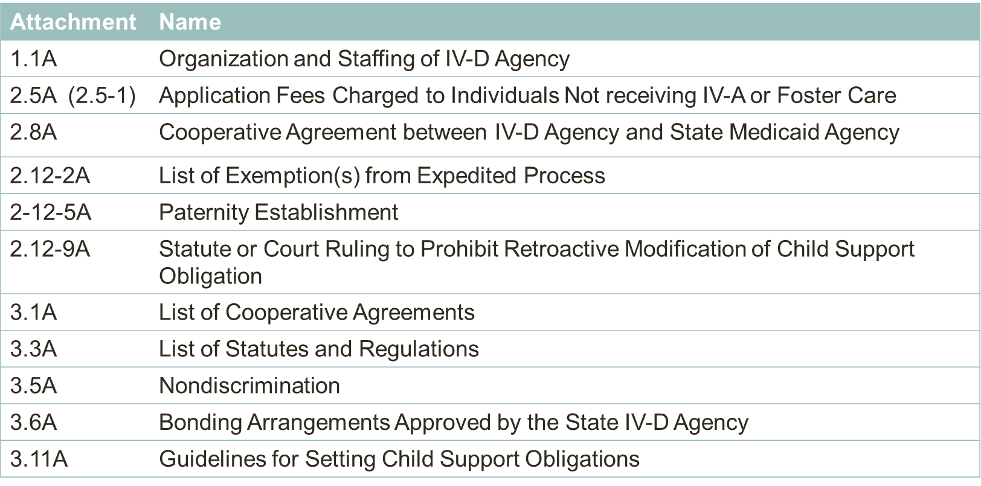
Transmittal Details

Slide 27
Plan Page Attestation
Were developed in the early years of the program and some contain dates as old as 1983
Provide evidence that states will comply with the title IV-D requirements specified on the plan page
Include the primary statutory and regulatory citations, not an exhaustive list or summary of all the requirements
For some plan pages, states are not required to resubmit them to confirm continued compliance (such as plan pages 2.15, 3.7, and 4.2) when the federal requirements have not changed

Slide 28
PDF Attachments & Hyperlink Attachments
Required attachments and supporting documents can be uploaded in two ways:
  PDF
  URL Hyperlinks
Required attachments must contain information that demonstrate compliance
Hyperlinks must be active links
DCL-16-04 provides guidance on the state plan system accepting hyperlinks (See Question 8)

Slide 29
OCSS Review and Approval

Slide 30
OCSS Regional Review
Under 45 CFR 301.13, OCSS Regional Office has the delegated authority to approve state plans, OCSS Regional Office authority includes:
  Carefully reviewing state plan materials
  Using the Legislative/Regulatory Analysis Checklist
  Reviewing the responses to the questions on the plan page and the attachments
  Determining if the required information has been furnished and complies with the requirements
  Asking for additional information or clarification when needed

Slide 31
Approval
OCSS Regional Office must decide no later than the 90th day following the date that they received the plan submittal
OCSS Regional Office may request an extension

Slide 32
Disapproval
Notice of intent to disapprove IV-D state plan
  States will be permitted the opportunity to waive reconsideration of OCSS’s final decision and to exercise, prior to state plan approval/disapproval decision, the right to a hearing under the procedures set forth in 45 CFR Part 213
  When the state pursues its hearing rights prior to issuance of OCSS’s decision, no further administrative appeal will be allowed
Disapproval of IV-D state plan [see AT-97-05]

Slide 33
Administrative Review
45 CFR 301.14 describes the process for making a request to reconsider a determination on the IV-D state plan or plan amendment

Slide 34
Resources

Slide 35
Resources
Research
  Title IV-D of the Social Security Act
  Child support regulations
  Essentials for Attorneys in Child Support Enforcement
State plan system
  Public view

Slide 36
Resources (cont’d)
State plan forms
  OCSE 21-U4 Form
  Cover sheet
  Table of Contents

Slide 37
Resources (cont’d)
State plan guidance
  AT-20-08 Submit Revised State IV-D Plan Page 3.8-3 to Comply with Technical Corrections Final Rule
  AT-20-02 Resubmission of State Plan Cover Page and 3.16
  AT-20-01 Reinvesting Child Support Incentive Payments
  AT-19-07 Exemption Requests from Mandatory Laws and Procedures

Slide 38
Resources (cont’d)
  AT-18-06 Compliance with Medical Support Final Rule Requirements
  AT-18-02 Modernizing Child Support Enforcement Fees
  AT-17-03 Revisions to and Resubmission of State IV-D Plan Pages to Comply with FEM
  DCL-16-04 State Plan System Frequently Asked Questions

Slide 39
Resources (cont’d)
  AT-16-01 Plan Page 5.2 and State Plan Amendments
  AT-15-01 Amendment of State Plan Preprint Page 2.12-20, Adoption of Uniform State Laws
  AT-15-02 Automated State Plan Submission and Review Process
  AT-14-12 E-IWO Implementation and Amendment of Title IV-D State Plan Preprint Page 3.8-3

Slide 40
Resources (cont’d)
  AT-14-07 Notice of SF-424M Annual Submission Requirement
  AT-13-01 Notice of State Plan Preprint Pages Electronic Forms
  AT-97-05 Procedures for Determining That a State IV-D Plan is Disapproved

Slide 41
For More Information
Division of Policy and Training
OCSS.DPT@acf.hhs.gov
www.acf.gov/css

