Slide 1


Slide 2

Peeling Back Progress
Incremental System Modernization in Child Support
Raghavan Varadachari, OCSS Director, Division of State and Tribal Systems
Heather Noble, Arizona IV-D Director
Amanda Esquivel, Texas Director of Operational Readiness
Notes:
Session Title: Peeling Back Progress: Incremental System Modernization in Child Support
Session Date/Time: Wednesday August 20th - Morning (first session of the last day) / 75 minutes
Session Description: Modernizing a child support system isn’t about squeezing everything into one massive overhaul—it’s about peeling back the layers, one segment at a time, to deliver fresh value with every step. Much like Florida’s iconic orange, the sweetest results come from thoughtful cultivation and patience—slice by slice, not all at once. In celebration of 50 years of partnership, this session explores how state and federal child support programs are embracing incremental modernization to stay responsive, reduce risk, and continuously improve services for families. From modular upgrades to agile implementation strategies, you’ll hear how programs are modernizing legacy systems while keeping daily operations running smoothly. Join us for insights into best practices, key decision points, and tools that support a phased approach to innovation. Whether you’re early in your modernization journey or midstream, this session will leave you with practical ideas—and maybe a little citrus-inspired optimism—for the road ahead.

Slide 3

This session highlights the resources available from NCCSD and OCSS and how states have embraced incremental modernization to stay responsive, reduce risk, and continuously improve services for families during the system modernization journey.

Slide 4
NCCSD Systems and Data Committee

Slide 5

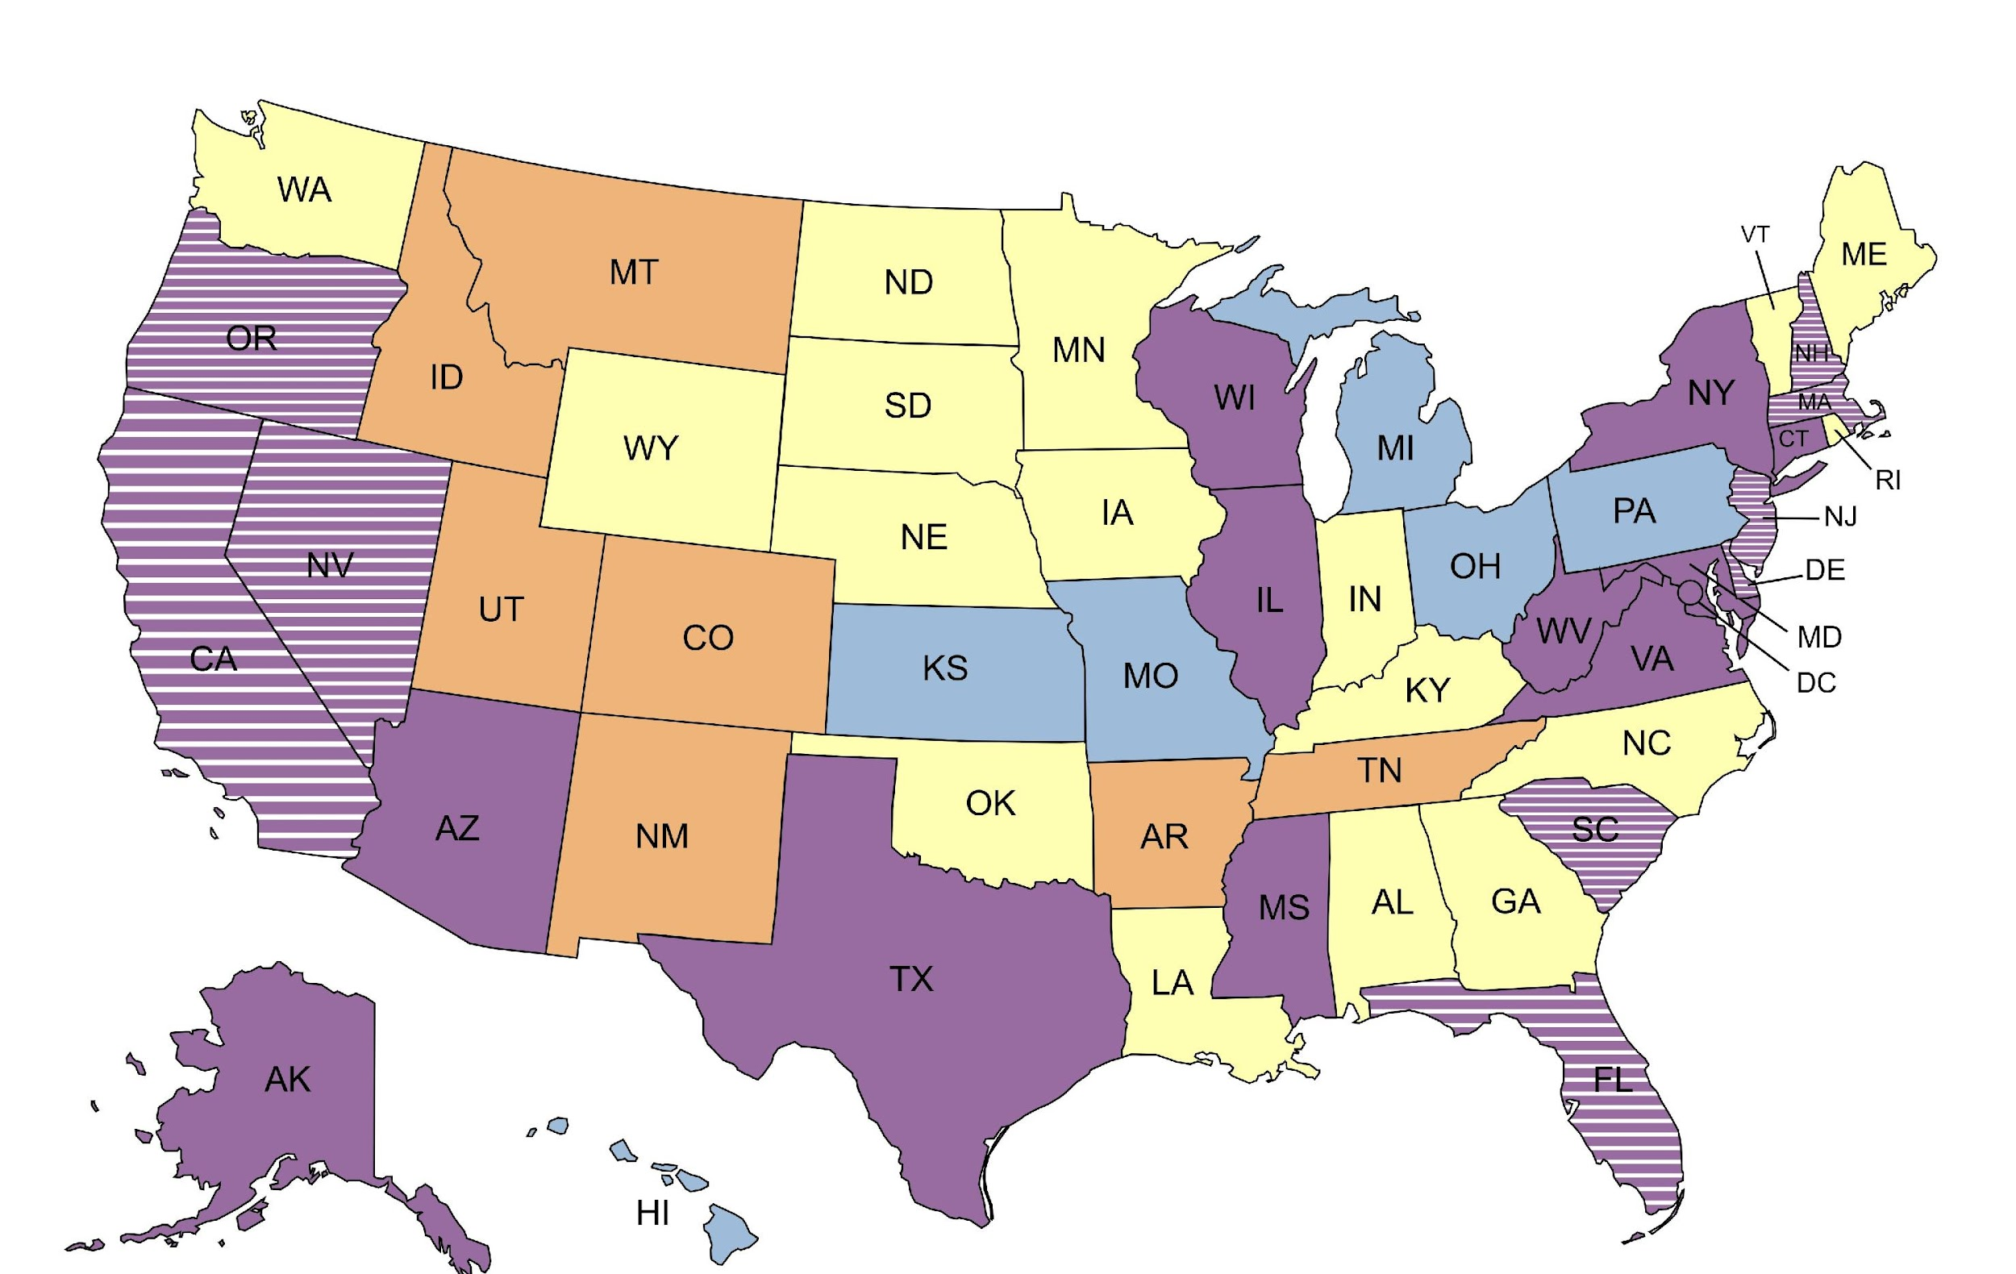


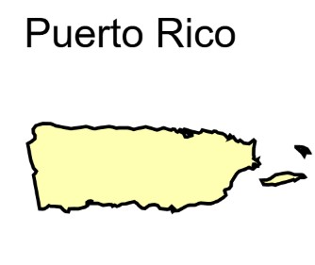
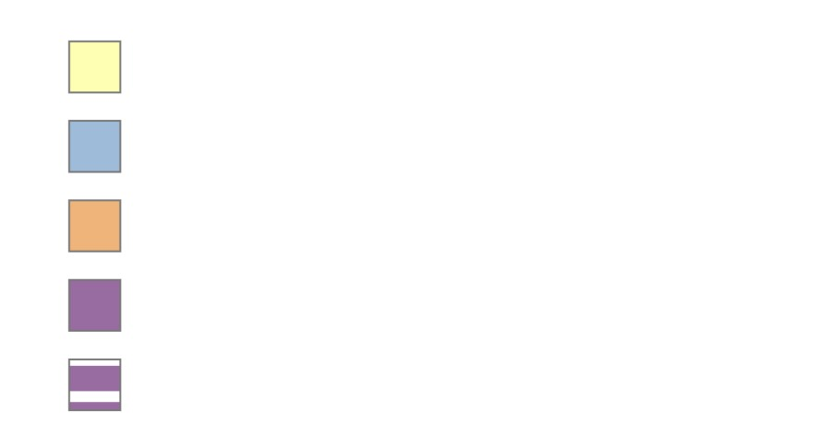
State Journey At-A-Glance
Exploring
Refactor/Replatform
Post Refactor/Replatform Mod.
Full Replacement (Traditional, Hybrid, Transfer, etc.)
Newer System Certified (since 2008)
This map represents a point in time, with the best information that the NCCSD Systems Modernization Committee has available States modernization journeys vary, not always clearly defined with the traditional approaches.

Slide 6
NCCSD Resource Summary Table
Resource | Where Found | Purpose
NCCSD Vendor Webinars (Fall 2019) Summaries and PowerPoints | NCCSD Website - Committee page | Vendor presentations on Low Code/COTS and Replatforming/Refactoring solutions.
NCCSD Distribution At-A-Glance | NCCSD Website - Committee page | Assist non-child support decision makers to understand complexity of distribution in statewide systems.
NCCSD State Systems Lessons Learned webinars (Fall 2021) Summaries and PowerPoints | NCCSD Website – Committee page | State presentations on lessons learned in pre-planning, planning, procurement, DDI and certification for systems replacement projects.
NCCSD State Systems Topics – Questions to Consider Checklist | OCSS Collaboration Tool – State Systems site (NCCSD Committee Materials Folder) | Full list of questions for Directors to consider/answer before launching a systems modernization project.
State Specific Modernization Resource Materials | OCSS Collaboration Tool – State Systems site (NCCSD Committee Materials Folder) | Committee members have volunteered a few non-confidential resource materials such as a planning guide and example RASCI matrix.
OCSS State Characteristics Matrix (SCM) | OCSS Collaboration Tool – both sites | Assist in identifying states with similar characteristics for systems modernization and data analytics purposes.
OCSS DSTS Training Webinar Resources | OCSS Collaboration Tool – State Systems site | Recordings, PowerPoints, transcripts from OCSS DSTS webinars on Streamlined Feasibility Study, APD 101-201, Certification, IV&V, Procurement/Quality and COTS/Saas/PaaS.

Slide 7
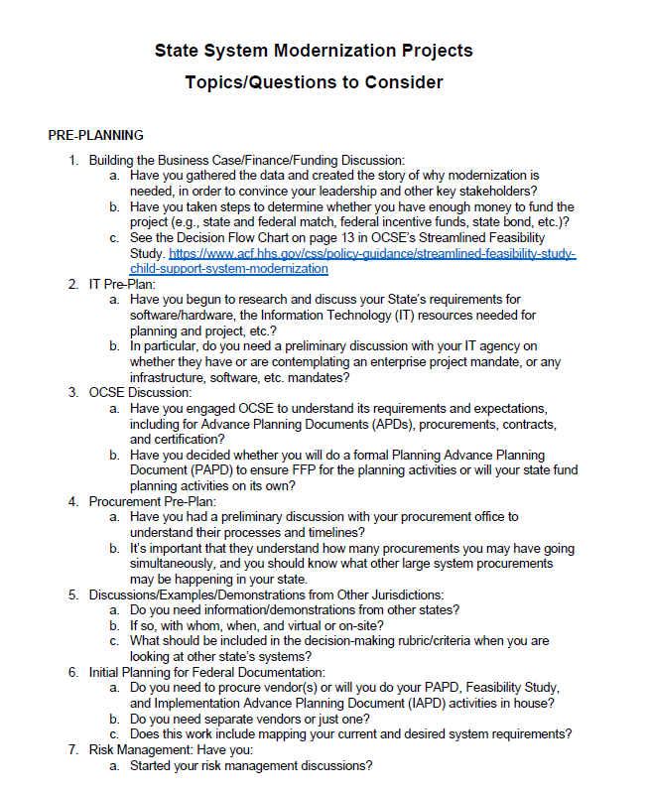
NCCSD Committee Modernization Checklist
Developed April 2022
Five Topics:
Pre-Planning
Planning
Procurement
Design, Development, and Implementation
Certification

Slide 8
OCSS Division of State and Tribal Systems Resources

Slide 9

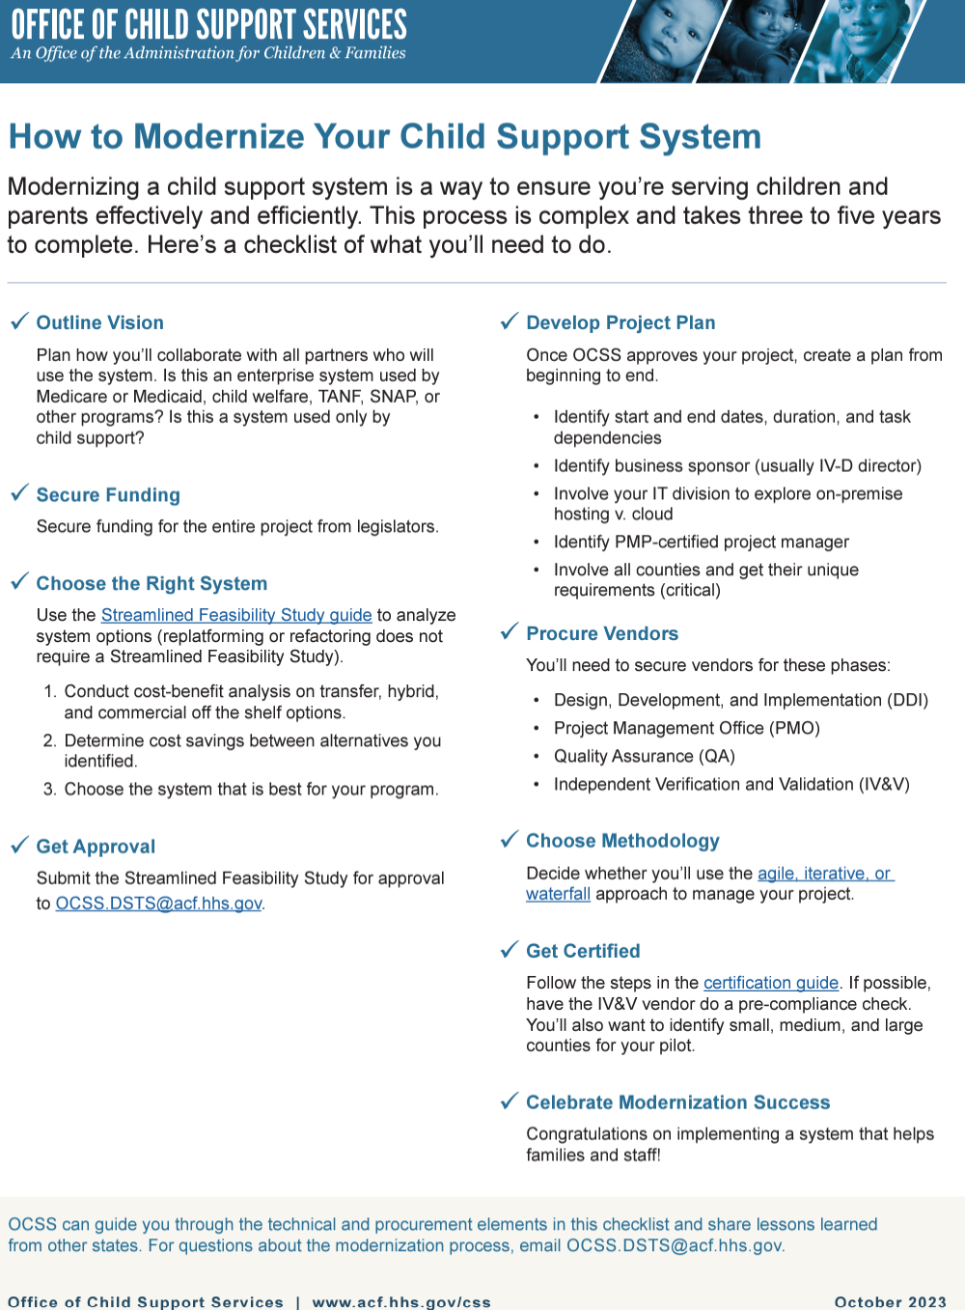
OCSS Resources
OCSS Modernization Checklist
This resource can be found in the March 2024 Child Support Report
March 2024 Child Support Report
Podcast:
The Future of Systems with Child Support - NCSEA on Location
Webinars
Streamlined Feasibility Study (SFS)
Advance Planning Document (APD) 101/201
Independent Verification and Validation (IV&V)
Procurement and Quality Management
Federal Certification
Text
Text
Text

Slide 10
Other Key OCSS Resources
Planning APD Template (2002): https://www.acf.hhs.gov/css/training-technical-assistance/planning-apd-template
Streamlined Feasibility Study (2020): https://www.acf.hhs.gov/css/policy-guidance/streamlined-feasibility-study-child-support-system-modernization
Waiver Process for the Use of Federal Funding for Commercial Off-the-Shelf (COTS) Software Products (2013): https://www.acf.hhs.gov/sites/default/files/documents/cb/acf_oa_pi_13_01.pdf
State Systems APD Guide (2010): https://www.acf.hhs.gov/css/training-technical-assistance/state-systems-apd-guide
Certification Guide (2017): https://www.acf.hhs.gov/css/training-technical-assistance/automated-systems-child-support-enforcement-guide-states
Independent Verification & Validation (IV&V) Assessment Options and Statement of Work Template (2012)
  https://www.acf.hhs.gov/css/training-technical-assistance/ivv-assessment-options
  https://www.acf.hhs.gov/css/training-technical-assistance/ivv-statement-work-template

Slide 11
State Characteristics Matrix
OCSS Analysis to Determine Characteristics of the States (2018)
  Goal: help states determine who was similar in key areas for transfers
  Gather factors such as organizational structure, administrative vs. judicial establishment, public assistance referral types and interfaces, distribution choices, court structure and interfaces, etc.
Result: “State Characteristics Matrix (SCM)” Excel workbook
  Originally published in 2021 / version 7.1 published May 8, 2025
  50+ data points
  54 jurisdictions
Resource intended only for state IV-D Directors & their executive level staff.
  Available on the OCSS Collaboration Tool- restricted to few state personnel
Used in today's session to prepare our State Journey At-A-Glance
Multiple Uses: Identifying states similarities and differences to guide outreach, information sharing, and more

Slide 12
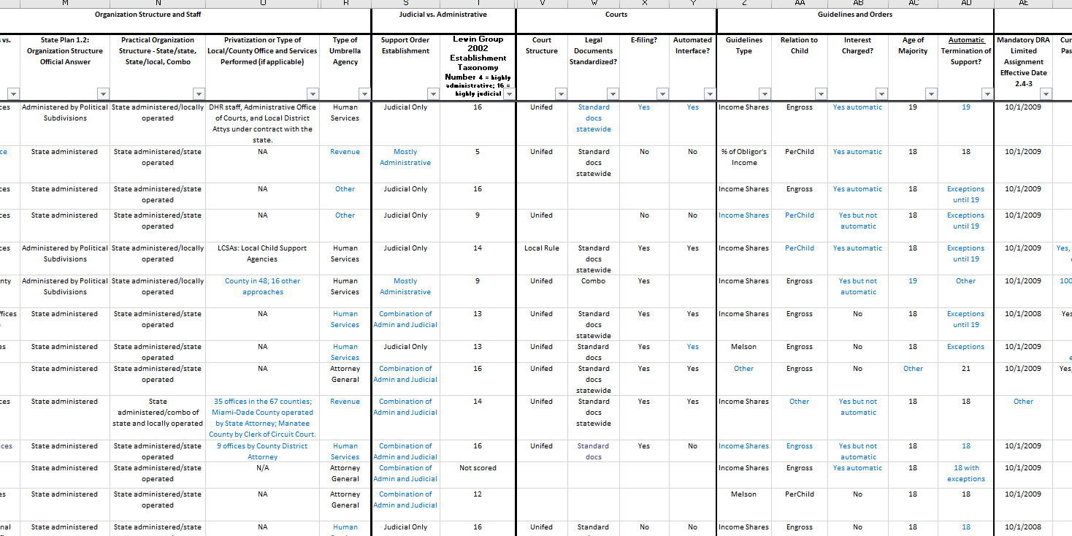
State Characteristics Matrix

Slide 13
Best Practices: Apply Strategies for Success

Slide 14
Challenges of Large-scale Legacy System Overhauls
Organizational Challenges
Technical Challenges
Financial Challenges
Risk Management Challenges
Strategic and Architectural Challenges

Slide 15
What is Incremental Modernization
Delivers value in small, frequent steps
Continuous integration and feedback
Avoids risky “big bang” deployments
Texas’ approach to modernization

Slide 16
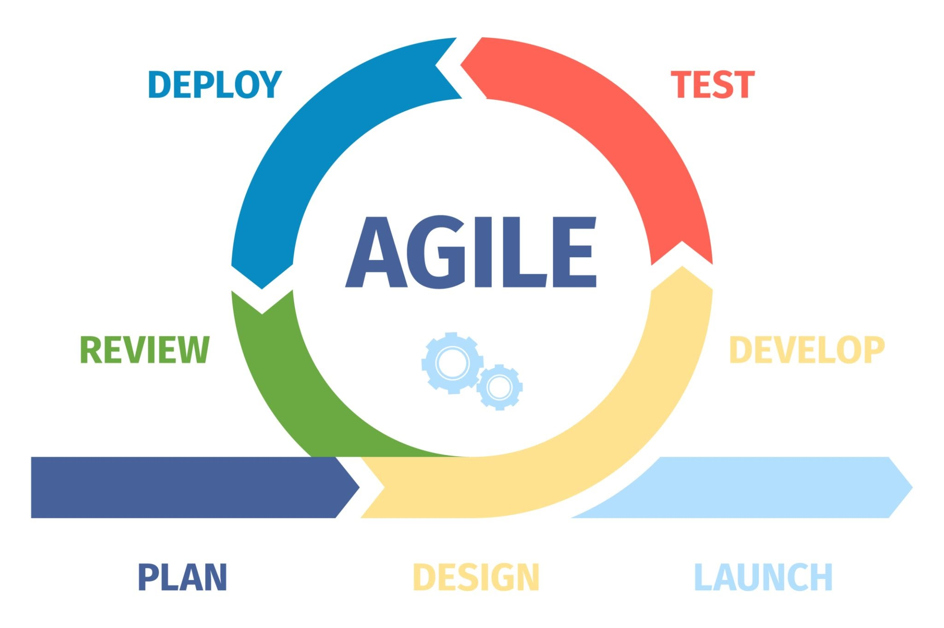
Agile Approach
  Industry Standard
  End-users Familiarity
  Agile Certification

Slide 17
Early and Continuous User Involvement
Engage users from the beginning
Validate design decisions early
Gather ongoing feedback

Slide 18
Deliver Value in Steps
Prioritize high-value functionality
  Functional Process: e.g. Customer Portal, Case Intake
  Business impact vs. policy mandates vs. technical feasibility
Release in small, functional slices
  Each release teaches us something new about how the system will perform in the real world.
Build and learn iteratively

Slide 19

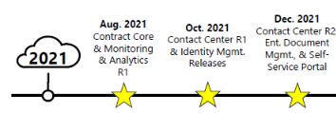






Slide 20
Piloting and Incremental Releases
Start small (e.g., one county or office)
Measure and refine before scaling
Used phased rollouts for stability
Deliver working functionality in stages

Slide 21
Benefits of an Incremental Approach
Reduce risk of failure
Accelerates value delivery
Supports policy and technical agility
Improves stakeholder confidence

Slide 22
Best Practices for Incremental Modernization
Process, People and Culture
Use agile and “DevOps” practices and tools
Establish metrics and feedback loops
Prioritize change management, training and end-user input

Slide 23
Refactor / Replatform
Several states have used incremental approaches
Success depends on leadership and planning
Avoid over-customization and scope creep

Slide 24
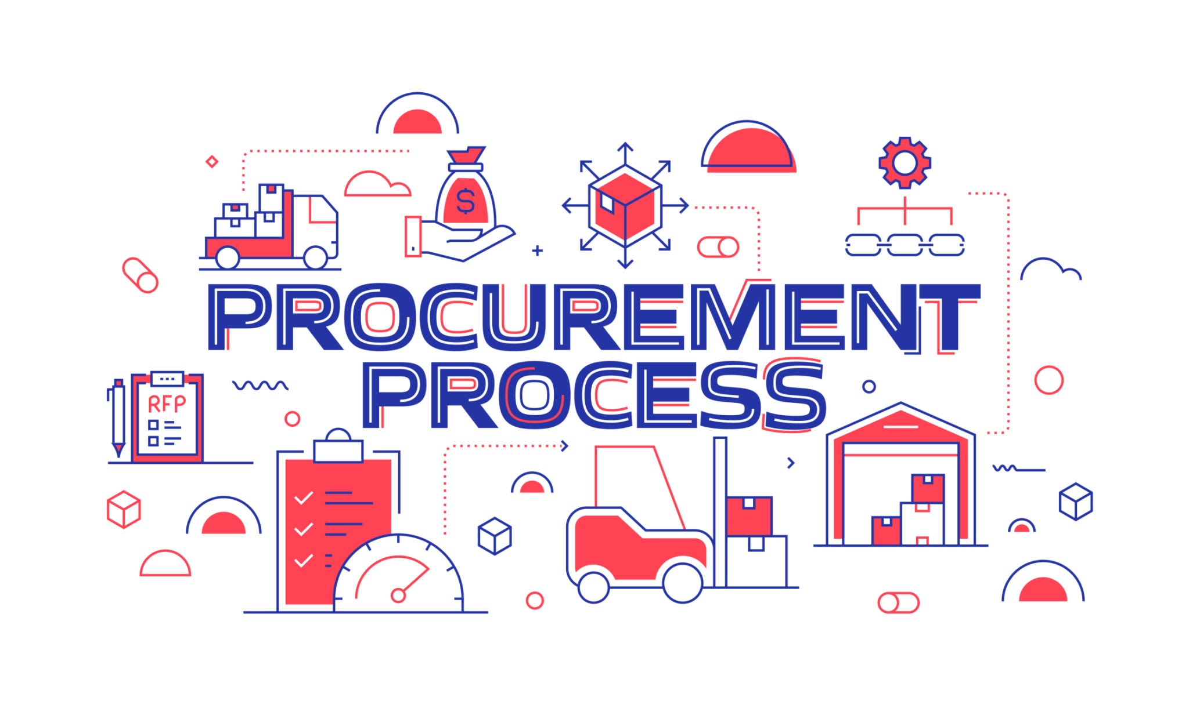
Procurement
From large monolithic contracts to modular procurement
Agile-friendly contracts and vendors
Encourages competition and innovation

Slide 25
Call to Action - Summary of Takeaways
Incremental delivery reduces risk and accelerates value and adaptability
Real users must be part of your journey - involvement is critical
Shift in mindset; how we think about modernization
  Modern approach enables modern systems
  Long-term value, delivered often

Slide 26
Questions

