Slide 1


Slide 2

Partnerships for Employment & Training Programs
Presenters:
Robert Duck – Tennessee
Kristi Stone – Georgia
Moderator:
Dawn Marquardt – Oregon

Slide 3
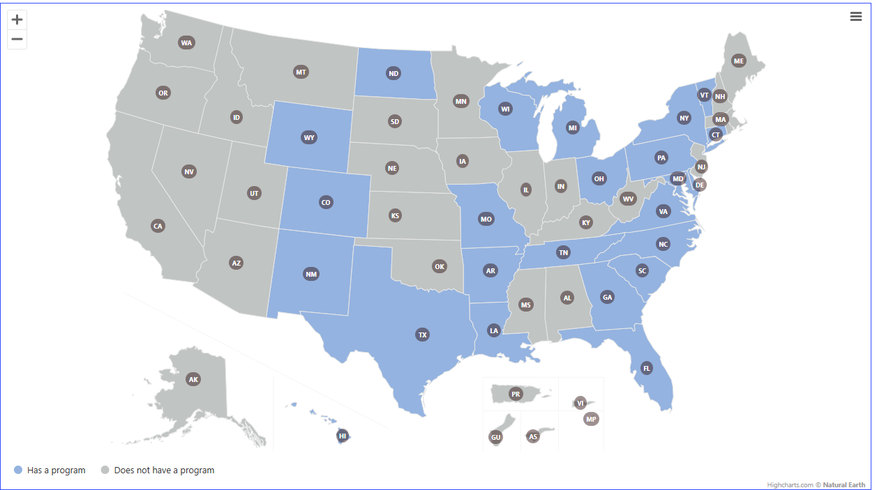
Child Support-Led Employment Programs by State
As of September 2024

Slide 4
Funding Options
IV-D Incentive funds through use of an exemption request
  See AT-20-01
1115 Waiver
  See Knowledge WORKS! Funding Model – Section 1115 Waiver)
  See IM-24-05 Section 1115 Waivers – Update
TANF funds through partnerships
  See Knowledge WORKS! Using TANF for Noncustodial Parent Employment Services
Workforce related funds
FFP (…maybe)
  See DCL 24-15

Slide 5

Federal Resources
Knowledge Works! Resources for Child Support-Led Employment Services
Planning Tools, Policy Resources, and Funding Guidance
Existing Program Models
  Mandatory — court ordered participation
  Voluntary — accepting referrals and allowing self-enrollment
  Comprehensive — both mandatory and voluntary participation

Slide 6
Tennessee Child Support Employment and Parenting Program
Robert Duck
Director of Operations, Child Support
Tennessee Department of Human Services

Slide 7

TCSEPP History
Partnership with UT Knoxville’s Social Work Office of Research and Public Service since 2004
Originally only served 6th Judicial District (Knoxville) but currently serves 16 of our 32 JD’s with long term plan to cover entire state
Serves non-custodial parents who are unemployed or underemployed by providing case assessment, employment preparation, job search assistance and wraparound services
Served 1,473 parents in FY 2024 with a total of $1,527,089.22 in collections from enrollees
Funded with TANF dollars

Slide 8
DHS Fatherhood Initiative
Procured private vendor beginning December 2021 to assist the Department in developing a Fatherhood Initiative
Delivered an Environmental Scan, 5 Year Strategic Plan, planning and executing 3 day Amplifying Fatherhood Conference (September 2023), designing direct service grant program with ongoing technical assistance provided via grantee web portal
Fatherhood Grant Program – 10 direct service grantees serving
all areas of the state; 2 year contracts began February 2025

Slide 9
Contact Information
Robert Duck
Director of Operations, Child Support
Tennessee Department of Human Services
Email: robert.duck@tn.gov

Slide 10
Georgia Outreach Programs
Kristi Stone
Deputy Director of Operations
Division of Child Support Services
Georgia Department of Human Services

Slide 11


Georgia Fatherhood Program

Slide 12
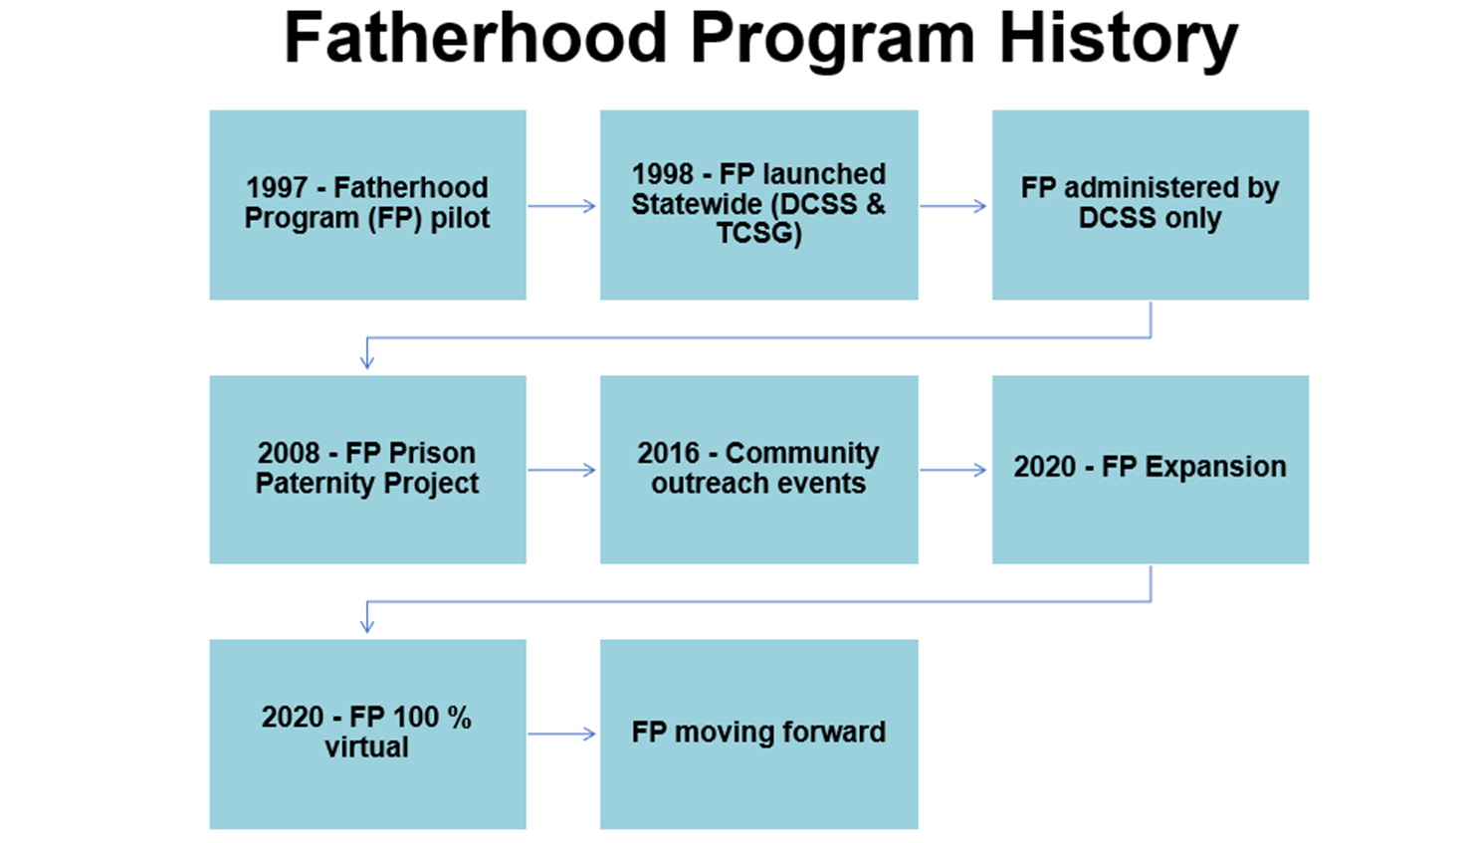

Slide 13

Program Overview
Employment-based program
Statewide program offered to both men and women
Connects participants with resources leading to career employment
Assists parents court-ordered to pay child support prior to contempt
Increases self-sufficiency, financial, emotional, and
parental involvement

Slide 14
Program Eligibility
NCP is unemployed or underemployed
NCP is receiving public benefits
NCP is homeless
Active IV-D case
Paternity is established
NCP resides within 50 miles of a FH service area

Slide 15
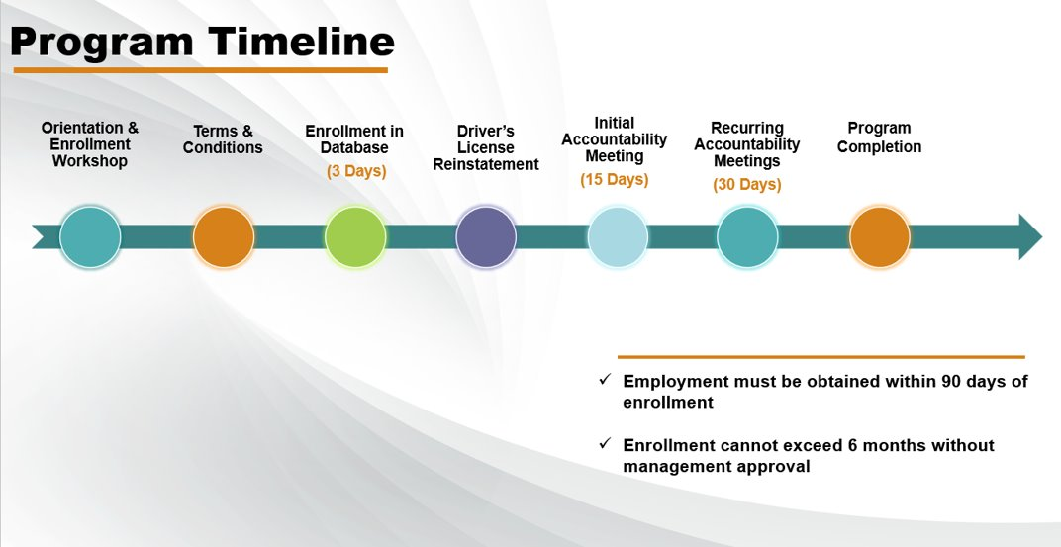

Slide 16






In Federal Fiscal Year 2024
In the Federal Fiscal Year 2024,
92%
of noncustodial parents owing child support in Georgia were fathers
68,338
cases were potentially eligible for an outreach program
5,485
parents were enrolled in the Fatherhood Program
1,924
parents successfully completed the program
11,036
children were served
1,524
participants were offered or referred to GED/short-term training resources
39
Fatherhood Outreach
Specialists administered
the program across Georgia

Slide 17
Partnerships
Contractual Partners
Technical College System of GA
22 technical colleges statewide
Omega Psi Phi Fraternity, Inc.
Host 6 informational seminars yearly to educate the community about the Fatherhood Program
Father’s Inc.
Emotional Wellness training for FH program participants and Cultural Sensitivity training for FH staff
GA Department of Corrections
Prison Paternity
Additional Partners
WorkSource GA
  Job Search
  Soft Skills training workshops
GA Department of Labor
  Federal Bonding
Goodwill
  Job Search
  Soft Skills
  Short-term training
Internal Partner
DHS Access and Visitation
Notes:
Official Partners : Contract is in place
Technical College System of GA : Training courses such as warehouse distribution, forklift safety, welding, manufacturing, hospitality, and CDL
Omega Psi Phi Fraternity, Inc. : Presentation includes an area community partner and employer
Father’s Inc.: 10-week course of learning designed to develop practical and comprehensive fatherhood skills that are transferable throughout all aspects of life, to include: interpersonal relationships, careers and employment, business, parenting, etc.
GA Department of Corrections: provides a movement report to assist with locating individuals with DCSS cases where paternity has not been determined
Unofficial partners:
WorkSource GA: – assistance with resume writing, dress for success, interview skills
GA Department of Labor: Federal Bonding
Goodwill: job search, soft skills, short tern training
Internal Partner
Access and Visitation:
Assistance with child access and mutual visitation agreements
Mediation
Supervised and Unsupervised visitation
Neutral exchange
Legitimation resources

Slide 18

Georgia Parental Accountability Court Program

Slide 19
Parental Accountability Court (PAC) Program History
DCSS leadership
1st PAC Program
Pilot
Criminal Justice Reform
The Idea
The idea was proposed by former Supreme Court of Georgia Chief Justice Leah Sears
The first PAC program was launched in the Coweta Judicial Circuit in October 2009 with Judge John Simpson
Initial pilot showed success, leading to expansion and funding of coordinators
In 2011, the Special Council on Criminal Justice Reform, under Gov. Nathan Deal, recommended expanding accountability courts to support criminal justice
DCSS leadership visited North Carolina and adapted the model for Georgia

Slide 20
Program
Evolution
Lessons
Learned
Expansion to 45 judicial circuits.
Integration of strategies when working with customers
PJAC, Motivational Interviewing, Trauma Informed Care
Strengthened collaborations with community partners
Standard Operating Procedures implemented to improve participant success.
Importance of judicial and community buy-in
Need for wraparound services beyond just employment
Challenges in participant engagement and retention.
Data tracking and performance measurement are critical
Notes:
Goal to expand to all 51 judicial circuits

Slide 21
Program Overview
Collaboration between Georgia DHS and Council of Superior Court Judges
Alternative to incarceration
Each program is tailored to the needs of the local community by partnering with government, non-profits, private, and community-based agencies to provide services to participants
Judicial oversight to address barriers
Increase parental accountability, self-sufficiency, and child support collections

Slide 22
PAC Team Members
PAC Coordinator
Local Office
Community Partner
Judicial Partner
Local Office Attorney
Guidance
Legal
Refer / Support
Provide resources
Participant
Adhere to the terms and conditions

Slide 23


Program Eligibility
Contempt has been filed, or case qualifies for Consent Contempt.
Consent Contempt – A Pre-Contempt Checklist has been completed, and case is eligible for contempt actions. Customer has provided voluntary consent to participate.
Customer is currently incarcerated for failure to pay child support, or a pending arrest order is in place.
Important Note: It is important that the case has been screened by a PAC Coordinator and barriers have been identified.

Slide 24
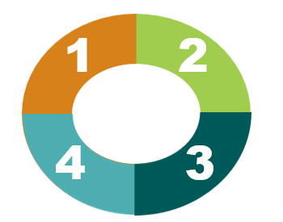
PAC Program Phases
Intake
Complete forms, interviews, and assessments (includes GCIC)
Sign terms & conditions
Referrals to service providers
Driver’s license reinstatement review
Phase I
Complete job searches or attend approved training courses
Comply with any treatment services or community outreach resources
Provide updates to the PAC Coordinator at the determined frequency
Attend PAC Court hearings
Phase II
Comply with any prescribed treatment plans
Provide updates to the PAC Coordinator at the determined frequency
Maintain employment
Attend PAC court hearings, when applicable
Graduation
Obtained gainful employment or secured an appropriate alternative for income
Completed their case plan as required by the judge
Paid as ordered for six consecutive months

Slide 25
Program Evaluation
Increases Payments
Referred
Enrolled
Removed
Graduation Success
Increase in payments
Employment & Education Matters
Increase in payments

Slide 26
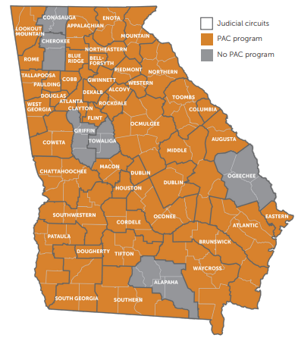



By the Numbers, as of Federal Fiscal Year 2024
Since Fiscal Year 2009, the PAC program
has helped:
7,878
noncustodial parents who were at risk of
incarceration avoid jail time and provide much
needed support to
18,544
of Georgia’s children. Program participants
paid an estimated
$34.6M
in support, which, in return, has saved the state
millions in incarceration costs.

Slide 27
Partnerships
Staffing Agencies
Labor Finders & Hire Dynamic
Internal Resources
Department of Labor
TOPPSTEP
Career Training Centers
Goodwill Career Center
Local Community Resources
Family Connection, Eckard Connect Americus
Faith Community Resources
St. Vincent DePaul Catholic Church
Health Clinics
Good Samaritan Health Clinic & Hand of Hope
Notes:
Internal Resources: Avenues located within the state department to assist NCPs with visitation, Federal Bonding letters, reinstatement of driver’s license, refer to when needed for SSA services and TANF/Medicaid when needed and many other benefits
Staffing Agencies: Used to find temporary or permanent employment for NCPs & Some may offer certificate programs
Local Community Resources: Assist with providing food, transportation, utility assistance, clothing and other local resources needed to address specific needs
Faith Community Resources: Used for counseling, mentorship, food banks, temporary shelter, utility assistance, emergency assistance and other outreach services as needed
Career Training Centers: Educate, job training, workshops for success, job fairs and provide many other services that’s needed to promote for employment

Slide 28

Contact Information
DCSS Website: childsupport.georgia.gov
Kristi M. Stone
Deputy Director of Operations
Division of Child Support Services
Georgia Department of Human Services
Email: kristi.stone@dhs.ga.gov

