Slide 1


Slide 2

Orange You Curious What’s Included in the NCSEA Legislative Proposals?

Slide 3

Introduction

Slide 4

Why New Legislation?
Mission is shifting from recovery toward family support
Performance is outrunning incentive measures
Enforcement measures should be strengthened for new economy
Intergovernmental processes need refinement
Supportive services deserve earmarked funding
Funding base needs expansion to support
needed changes

Slide 5
Background
Shift in Mission from Recovery to
Family Support

Slide 6

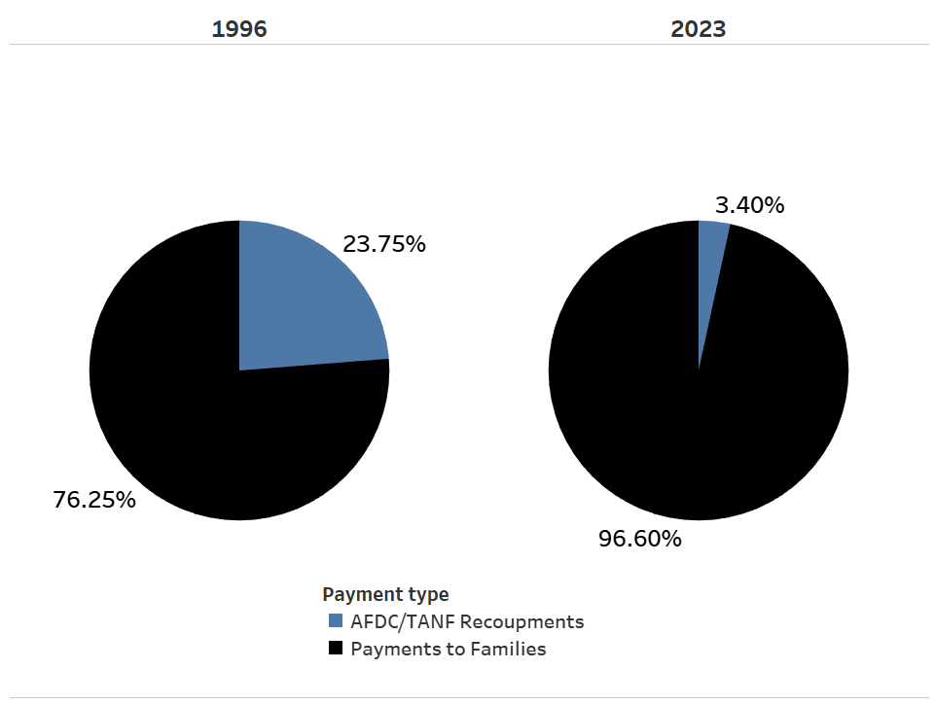
The Changing Role of Child Support:
Reduced Role in Welfare Recovery

Slide 7
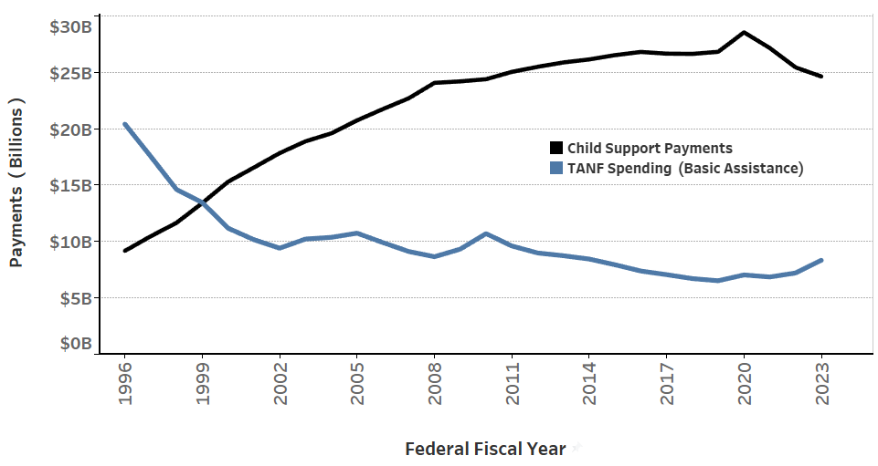
TANF Cash Benefits vs Child Support Payments to Families 1996-2023

Slide 8
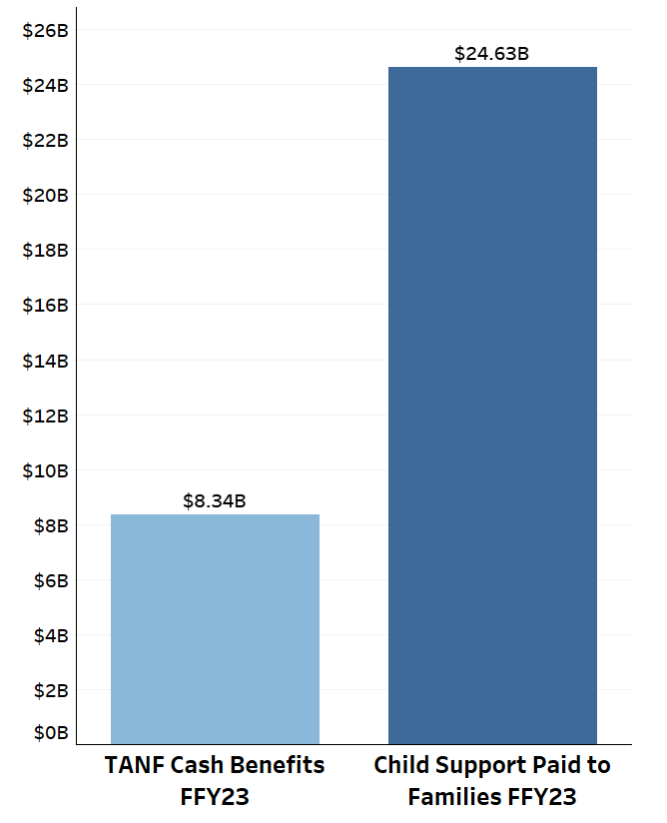
U.S. Child Support Payments Are Three Times
TANF Payments to Families FFY 2023

Slide 9
Child Support Now Major Component of the Safety Net for Single-Parent Families
Safety Net As It Now Stands:
SNAP
Medicaid/CHIP
Child Support
TANF

Slide 10
NCSEA Proposal Part I
End Retained Collections from Current TANF Recipients and End Recoupments from Former TANF Recipients

Slide 11
NCSEA Proposes Ending Recoupments and Retained Collections
Recoupments from former TANF cases
Would end recoupment of previously received TANF benefits by former TANF recipients:
  All child support received would be paid to former TANF recipients
  No more “state-owed arrears”
  No capture of previously received TANF benefits from IRS offsets

Slide 12
NCSEA Proposes Ending Recoupments and Retained Collections
(2) Retained Collections from Current TANF Cases
Would end retained collections from current TANF recipients
  Mandatory assignment of child support to government would be ended
  All current child support and arrears received while on TANF would be paid to family, including tax offsets
  States would not be required to pay federal government the federal share of collection

Slide 13
Recovery from former TANF cases compromises self-sufficiency
Largest share of recoupments comes from former TANF families
What is the justification for diverting much-needed support from families at very point they most need funds to sustain self-sufficiency?
Outdated policy undermines family independence and creates additional TANF costs
Note: DRA 2005 allows states to pass through all collections to former TANF families but only four states do so in entirety (California, Illinois, New Mexico, and Wyoming (and soon ND))

Slide 14
TANF recoupments impose heavy financial burdens on program
Substantial accounting costs for tracking receipts and assigning to correct buckets
May cost as much as 40 cents to collect each dollar of recoupments
Inflates development costs for new systems by estimated 5 – 7 percent

Slide 15
Recoupments from former TANF cases compromise mission
Mission has shifted overwhelmingly from cost recovery to family support and cost avoidance
Recovery from former TANF causes mission dissonance for staff
State-owed arrears collection makes customers angry and adversely affects parental view of program

Slide 16
Ending Retained Collections from Current TANF Recipients Directs More Money to Families with Children
Encourages child support payment:
  Colorado study showed increase of 10 percent in number of payments and 39 percent in amount of payments
By establishing reliable payment stream, encourages self-sufficiency
Puts more money in hands of families with children

Slide 17
Sticking Point: Adverse Financial Impact
Retained collections: small proportion of total collections, but large source of funding for program operations
Former TANF recoupments: 8.9 percent of program administrative costs (state share)
Current TANF retained collections: 6.7 percent of administrative costs (state share)
NCSEA proposal to end retained collections conditional on backfill funding: propose expanding incentive pool by 150 percent

Slide 18
Avoided Costs Pay Estimated Half of
Program Expenditures
Latest research shows program savings amount to 49 percent of administrative costs – without counting retained collections
Savings come from reductions in participation and reductions in benefits in multiple programs:
  Medicaid and CHIP
  SNAP
  SSI
  TANF (not including retained collections)
  Housing subsidies and other public programs

Slide 19
NCSEA Proposal Part 2
STRENGTHEN ENFORCEMENT

Slide 20
New Enforcement Measures
New Hire Reporting for Independent Contractors [amend 42 U.S.C. Section 653a new hire reporting]
  Individual or sole proprietor who receives $600 or more in income during the tax year for work completed in the course of the individual’s trade or business
  Who is not an employee of the purchaser, and
  Has completed and submitted a W-9 to the purchaser and is receiving income that is reportable by the purchaser on a 1099-NEC, 1099-K, or similar form

Slide 21
New Enforcement Measures
Lump sum employer match
  Create a national process for employer reporting of lump-sum payments to employees who are currently subject to income withholding. Authorize the OCSS to provide a single point of contact for employers to report lump-sum payments in lieu of reporting to each state in which the employer does business. OCSS would share the results of any match with the employer and with any state that has a child support case involving the employee receiving the lump sum.
Prohibit IRS from holding states liable for fraudulent offsets
Multistate bank levies
  Require full faith and credit for lien and levy notices and require OCSS to send lien and levy notices to banks at state request.

Slide 22
New Enforcement Measures
Mandatory reporting of insurance claims, including the claimant’s Social Security Number
Mandatory reporting and intercept of gambling proceeds in excess of an amount set by OCSS, including on-line and sports betting
Mandate laws requiring a Social Security Number or other unique identifier in order to register a motor vehicle, to support a suspension process

Slide 23
“Cutting Room Floor”
Income withholding honored by federal Bureau of Prisons
Probate match against centralized database of delinquent payors
Greater data matching and outreach with state correctional facilities
Required data match with cellular phone companies, cable companies, and utilities
Require State Department to create revocation process

Slide 24
“Cutting Room Floor”
Expanded release of FTI to parents, courts, and others
Authorize assistance from US Marshals Service
Require states to create electronic registry of professional licenses
Require states to create on-line lien registries

Slide 25
NCSEA Proposal Part 3
INTERGOVERNMENTAL IMPROVEMENTS

Slide 26
New Intergovernmental Enforcement Measures
Mandatory Income Withholding Compliance for Interstate Unemployment Insurance [amend 42 U.S.C. Section 666(b)]
  Require state unemployment agencies honor other state’s child support income withholding orders for unemployment insurance benefits to the same extent they honor intrastate orders for child support and spousal support.
Interstate employer option to report directly to National Directory of New Hires [amend 42 U.S.C. Section 653a(b)(8)]
Other ideas dropped from original proposal
  Improved frequency of interstate arrears balance reporting
  Mandate use of all Federal Interstate Communication Tools
  New Workgroup to Study New Federal Technology Solutions and Interstate Payment Processing

Slide 27
NCSEA Proposal Part 4
Performance Measures Updates

Slide 28
Update and Strengthen Federal Performance Measures
Original performance measures established by Child Support Performance and Incentives Act of 1998 (CSPIA)
Recommendations reflect experience gained since original implementation
Recommendations also reflect improved performance over intervening 25 years since performance measures took effect
Does not change collection base or weights of measures

Slide 29
Revamped PEP Measure Needed – Objectives
End intuitively illogical results (12 states over 100 percent in FY 2024)
Make results current -- eliminate prior year base year
Update ranges to reflect improved performance (currently 50-80 percent)
  In FY 2024, every state was above 80% and earned full incentive
Eliminate penalty or align with incentives

Slide 30
Proposed New PEP Measure
Retain state option for statewide or IV-D PEP version
Change prior year base year to current year
Counts paternities established during the year and born out of wedlock children during the year even if the case is closed before the end of the federal fiscal year
Raise minimum to 80 percent/maximum to 95 percent
Eliminate penalty

Slide 31
Proposed New IV-D PEP Measure
Children in IV-D cases open during or at the End of the
Federal Fiscal Year with Paternity Established or Acknowledged (Line 6)
______________________________________________________
Children in IV-D cases open during or at the End of the Current Federal Fiscal Year who were Born Out of Wedlock (Line 5 with change)

Slide 32
Proposed New Statewide PEP Measure
Children in the State with Paternity Established or
Acknowledged during the Fiscal Year
(Line 8)
______________________________________________________
Children in the State Born out of Wedlock
during the Fiscal Year
(Line 9)

Slide 33
Updated Order Rate, Current Support, C-E
Support order
  New minimum 75 percent (currently 50)
  New maximum 95 percent (currently 80)
Current support
  New minimum 50 percent (currently 40)
  New maximum 80 percent (unchanged)
Cost-effectiveness
  New minimum $3.00 (currently $2.00)
  New maximum $6.00 (currently $5.00)

Slide 34
Major Changes Proposed for Arrears
Based on amount of arrears collected not number of cases with collection
Retains existing incentive for right-sizing current support obligations and case management
Strengthens incentive by raising minimum and maximum levels

Slide 35
New Measure: Arrears Collection compared to This Year’s Uncollected Current Support
Compares the amount of current support that was not collected during the year with arrears collected during the year
Formula: total current support collected plus arrears collected divided by total current support due in a year
If arrears collected during the federal fiscal year are less than the current support that was not collected in the month due, the collection rate is less than 100 percent
If arrears collected during the federal fiscal year are more than the current support that was not collected in the month due, the collection rate is greater than 100 percent
Minimum 70 percent; maximum 100 percent

Slide 36
Proposed Arrears Measure
Total amount of Support Distributed as Current Support During
the Fiscal Year (Line 25) + Total amount of Support Distributed
as Arrears during the Fiscal Year (Line 27)
______________________________________________________
Total amount of Current Support Due for the Fiscal Year (Line 24)

Slide 37
Proposed Arrears Measure Example
Current support due $100 million (in current year)
Current support collected $70 million
Example 1: $20 million arrears collected plus $70 million current support = 90 percent (not keeping up)
Example 2: $40 million arrears collected plus $70 million current support = 110 percent (reducing arrears backlog)

Slide 38
Performance Measures Integral Part of Modernization Package
Intended as the program’s side of bargain with Congress
Program agrees to raise bar on performance in exchange for funding and program improvements from the federal government
Attempt to minimize changes to existing reporting system
Would represent win-win for the program

Slide 39
NCSEA Proposal Part 5
Funding

Slide 40
Expanded Federal Funding for NCP Services
Objective: assist noncustodial parents to increase their ability to earn income
Employment and related services eligible for IV-D funding (like current regulation)
Cap funding at three percent of administrative costs
Designate noncustodial parents as a priority group for WIOA services

Slide 41
IV-D Funding for Parenting Time Orders
Objective: develop parenting time agreements that foster a deeper relationship with the child in need of support
Parenting time agreements, with appropriate domestic violence safeguards
Capped at one percent of IV-D administrative costs

Slide 42
Other Funding Recommendations
Update visitation/custody grants serving noncustodial parents to reflect inflation (have not increased since 1996)
Replace mandate to charge fees in non-assistance cases with a state option

Slide 43
Conclusion

Slide 44
Proposed Legislation Would Modernize Program on Its 50th Anniversary
Would complete transition to family services/safety net mission and would eliminate conflict with recovery mission
But program would still play significant role with avoided costs, helping to pay for itself
Would strengthen enforcement and intergovernmental tools
Would add funding to offset losses from recovered TANF funds and to support added services to non-custodial parents

Slide 45
Congress May Consider Proposed Legislation As Soon As This Year
Initial reaction from committee staff has been encouraging from both parties – exemplifying bipartisan support of the program
Congress may take up after budget bill passes
While outcome is unpredictable, Congressional interest is a positive sign that some worthwhile legislation may pass in foreseeable future
  Strong support for program during Congressional consideration of Tribal Child Support Enforcement Act

