Slide 1
Partnering to Promote Economic Mobility
Through Benefits Cliff Mitigation
+ Aligned E&T Programming
August 2025

Slide 2




ABOUT US
Member Driven
Representing leaders from state,
county, and city human services agencies across the country.
Bipartisan
With a focus on building common ground and generating practical solutions that work for people and communities.
Notes:
So who are we? We are a member-driven national network of leaders from states, territories, counties, and cities across the country.
We are bipartisan—and deeply committed to building common ground and generating practical solutions that work for families and communities.
[Additional background to share as relevant for your specific audience]
Our member agencies span urban, suburban, and rural communities, and we’re striving to be more inclusive of Tribal communities as well.
Our origins grew out of the Great Depression as states and local jurisdictions were first tasked to set up an infrastructure of social service supports.

Slide 3
Agenda
Introduction
Q&A
APHSA’s Benefit Cliff Resource Hub
Transforming Services: Ohio’s Approach to Work First
Louisiana Department of Children and Family Services
Upcoming Opportunity – Data & Impact State Action & Innovation Lab
Notes:
New England Report https://www.jtgfoundation.org/2024/04/report-new-england-states-tackle-benefit-cliffs/

Slide 4




Today’s Panelists
Rebekah Sides
Senior Project Associate for Employment and Training
American Public Human Services Association (APHSA)
Mindy Kowalski
Assistant Director
Ohio Department of Jobs & Family Services (JFS)
Ricardo Williams
SNAP Employment & Training Manager
Louisiana Department of Children & Family Services (DCFS)
Khristian Monterroso
Senior Associate for Data & Technology Innovation
American Public Human Services Association (APHSA)
Notes:
New England Report https://www.jtgfoundation.org/2024/04/report-new-england-states-tackle-benefit-cliffs/

Slide 5
A benefit cliff, sometimes referred to as “the cliff effect,” occurs when a small increase in earnings results in a sharp reduction or total loss in public assistance.
- American Public Human Services Association

Slide 6
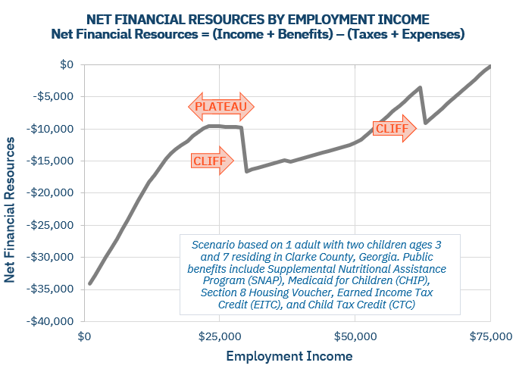
What is a “benefit cliff”?
Example Scenario of Benefit Cliffs Simulated by the Federal Reserve Bank of Atlanta
Source: “What is a benefit cliff?” Federal Reserve Bank of Atlanta.
Notes:
This illustration assumes that the parent receives SNAP, TANF, Childcare subsidies, Section 8 Housing Choice Voucher, Medicaid and Marketplace Subsidies, WIC, School Meals, and Federal tax credits

Slide 7



Martha O’Bryan Center’s Research
At least ONE IN Three
Individuals getting public benefits are estimated to have made decisions about their employment due to concerns about loss of public benefits, according to research conducted by the Martha O’Bryan Center.
Source: TAEM Surveys, Martha O’Bryan Center.

Slide 8
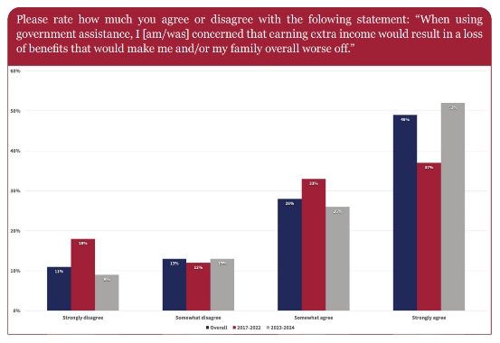
Sutherland Institute’s Research
52% of benefits recipients surveyed hold concerns about increases in earned income.
Source: Sutherland Institute and Lighthouse Research Survey (2024).
Notes:
This illustration assumes that the parent receives SNAP, TANF, Childcare subsidies, Section 8 Housing Choice Voucher, Medicaid and Marketplace Subsidies, WIC, School Meals, and Federal tax credits

Slide 9
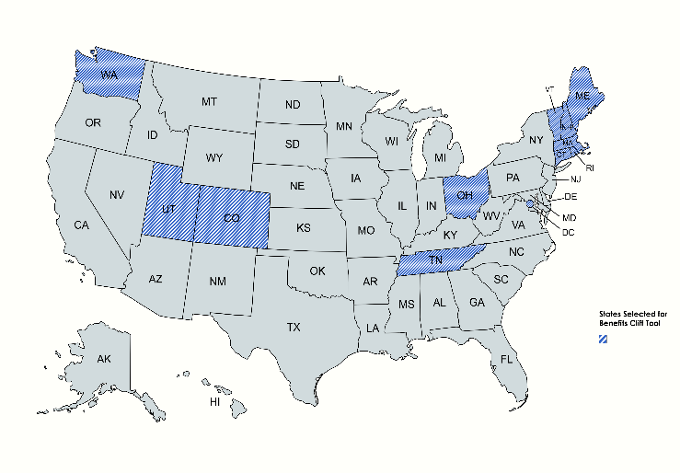
APHSA’s Benefit Cliff Resource Hub & Dashboard
States included:
Washington, Utah, Colorado, Tennessee, Ohio, New Hampshire, Maine, Connecticut, Vermont, Rhode Island, Massachusetts, and the District of Columbia
In Scope: any state-level policy related to a federal benefits program that can help alleviate a cliff effect in that state (e.g., LIHEAP, CHIP, Medicaid, HUD, SNAP, TANF, child care, etc.)
Source: APHSA Benefit Cliff Resource Hub

Slide 10
Resource Hub & Dashboard: Project Scope
In scope
Federal benefits programs including SNAP, TANF, Medicaid, CHIP, HUD, LIHEAP, and child care.
State-level policy options that can help alleviate benefit cliffs.
Out of scope
Strategies that primarily rely on non-federal funding to address cliff effects or that are otherwise not easily replicable at scale across the nation.
County-level benefit cliff policy options.
Source: APHSA Benefit Cliff Resource Hub

Slide 11
Resource Hub & Dashboard: Project Overview
Background and Purpose
APHSA’s Benefit Cliff Resource Hub gathers information about what benefit cliff mitigation policies states have implemented. This tool was influenced by the work New England has done to strategize across programs to address benefit cliffs collectively.
This policy tool visualizes specific policies that can mitigate the cliff effect in each state, filtered by programs and types of cliff policy options.
This tool is like other projects that take inventory of state policy options within federal programs but will focus on benefit cliff mitigation strategies implemented across multiple human services programs in a state. State-funded programs are out-of-scope.
Source: APHSA Benefit Cliff Resource Hub
Notes:
New England Report https://www.jtgfoundation.org/2024/04/report-new-england-states-tackle-benefit-cliffs/

Slide 12
Resource Hub & Dashboard: Project Phases
Interview SMEs:
Build on what’s already been done.
Develop Dashboard Concept:
Apply interview themes to dashboard concept design.
Research Selected States:
Using existing tools, conduct extensive internet research about states’ policies.
Interview Selected States:
Meet for one or two 60-minute interviews of selected states.
Collect Quantitative Data from States:
Send selected states a follow-up spreadsheet to fill in any data gaps.
Design State Profile Briefs:
Compile narrative data into short PDFs detailing state initiatives, assembled workgroups, etc.
Select States:
Select states for pilot design based on advisory board feedback and previous research.
Source: APHSA Benefit Cliff Resource Hub
Notes:
12 interviews completed since our last meeting, have met with all of the pilot states at least once

Slide 13
Leveraging Opportunities for Change
Insights Into How States Advance Policy Reforms
Center Family Perspectives: Engage directly with families who receive benefits to better understand how policies are experienced, including the difference between perceived and actual benefit cliffs.
Elevate Employer Insights: Collaborate with employers to highlight how policy dynamics impact workforce stability and business operations.
Communicate with Purpose: Framing and messaging are important. Use language that reflects shared goals—supporting families, strengthening the workforce, and improving services delivery.
Build Collaborative Partnerships: Foster cross-sector collaboration with community members, agencies, legislators, and other stakeholders to co-create informed and sustainable solutions.
Source: APHSA Benefit Cliff Resource Hub

Slide 14
Resource Hub & Dashboard: State Profile Briefs
Qualitative Components
case studies/examples
funding mechanisms
benefit cliff calculators
MOUs required for change?
policy change rationale
how one policy impacted other policies
culture change
“Can you include a little blurb? Here’s what this policy is; how does this policy affect the way benefits phase out? How do benefits phase out? Which all else equal means X? Pulling the pieces … how does this relate to other policies?”
third-party provider strategies
employer strategies
Source: APHSA Benefit Cliff Resource Hub

Slide 15
Benefit Cliff Resource Hub Demonstration

Slide 16
A Note About Income Sources
Child support adds another layer of complexity
Pass-Through and Disregard Policies
“Fill the Gap” Policies
Excess Payment Policies
Source: APHSA Benefit Cliff Resource Hub
Notes:
https://aphsa.org/benefits-cliffs-nav-test/#bcdashboard – unpublished page: password shared with AV Team only

Slide 17
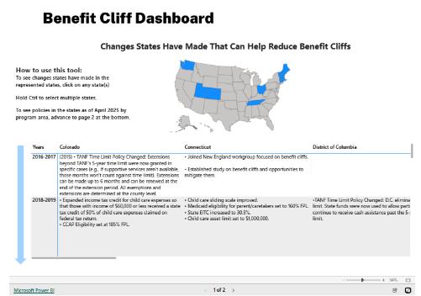
Benefit Cliff Resource Hub
Source: APHSA Benefit Cliff Resource Hub
Notes:
https://aphsa.org/benefits-cliffs-nav-test/#bcdashboard – unpublished page: password shared with AV Team only

Slide 18
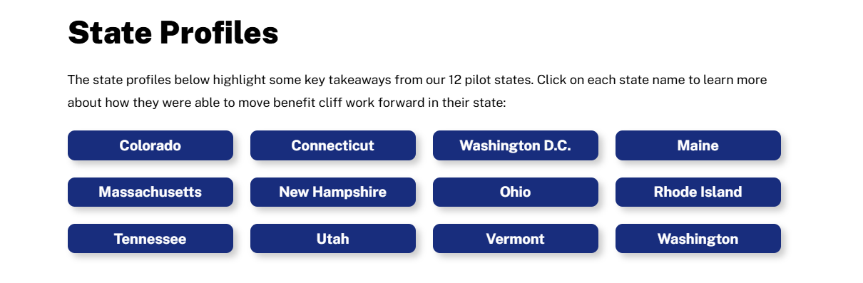
Benefit Cliff Resource Hub
Source: APHSA Benefit Cliff Resource Hub
Notes:
https://aphsa.org/benefits-cliffs-nav-test/#bcdashboard – unpublished page: password shared with AV Team only

Slide 19
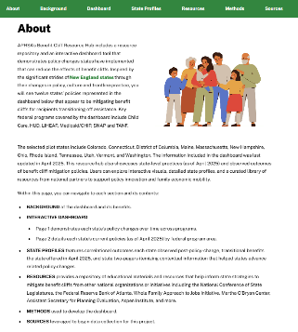
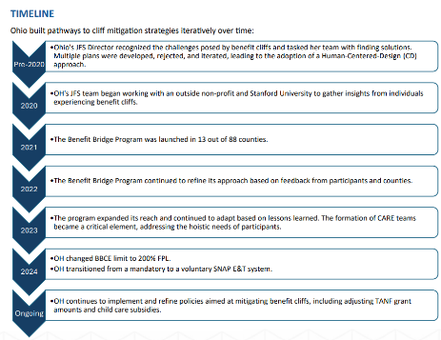
Benefit Cliff Resource Hub
Source: APHSA Benefit Cliff Resource Hub
Notes:
https://aphsa.org/benefits-cliffs-nav-test/#bcdashboard – unpublished page: password shared with AV Team only

Slide 20
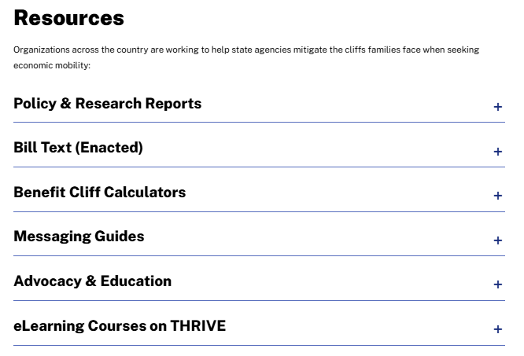
Benefit Cliff Resource Hub
Source: APHSA Benefit Cliff Resource Hub
Notes:
https://aphsa.org/benefits-cliffs-nav-test/#bcdashboard – unpublished page: password shared with AV Team only

Slide 21

Our Shared Vision: Stability and Mobility
Human services at its best helps families in times of need to stabilize and build toward economic mobility (APHSA, 2020).
Research shows that in many cases, having both parents involved in a child’s life and supporting their wellbeing correlates positively with improved outcomes for that child (e.g., Flouri, 2006; Nepomnyaschy L, Magnuson K., & Berger LM, 2013).
When we support parents’ economic mobility, they are better equipped to care for the needs of their children.
Notes:
New England Report https://www.jtgfoundation.org/2024/04/report-new-england-states-tackle-benefit-cliffs/

Slide 22
References
What Are Benefits Cliffs? Federal Reserve Bank of Atlanta. https://www.atlantafed.org/economic-mobility-and-resilience/advancing-careers-for-low-income-families/what-are-benefits-cliffs
For TAEM Surveys see Investing in community expertise, Tennessee takes on the benefits cliff. Fed Communities. https://fedcommunities.org/stories/tennessee-benefits-cliff-investing-community-expertise/
Strengthening the American Dream. Sutherland Institute. https://sutherlandinstitute.org/wp-content/uploads/2024/11/Strengthening_the_American_Dream.pdf
Benefit Cliff Resource Hub. American Public Human Services Association. https://aphsa.org/benefit-cliff-dashboard/
Cornerstone for Resilient Communities and a Revitalized Economy: The Role of Human Services in Building Well-Being from the Ground Up. American Public Human Services Association. https://aphsa.org/wp-content/uploads/2024/07/21604f7d-b78c-4fa1-80e3-369fd6473c9d.pdf
Flouri E. (2006). Parental interest in children’s education, children’s self-esteem and locus of control, and later educational attainment: Twenty-six year follow-up of the 1970 British Birth Control. British Journal of Educational Psychology, 76(1), 41-55. ‪https://scholar.google.com/citations?user=eKAmFrwAAAAJ&hl=en
Nepomnyaschy L, Magnuson K., & Berger LM. (2013). Child support and young children’s development. The Social service review, 86(1), 3-35. https://doi.org/10.1086/665668
Notes:
New England Report https://www.jtgfoundation.org/2024/04/report-new-england-states-tackle-benefit-cliffs/

Slide 23


Transforming Services:
Ohio’s Approach to
Work First
august 2025
Mindy Kowalski
Assistant Director, Human Services

Slide 24
Agenda
1
Work First Ohio–Aligned Services Across Programs
2
Ohio’s Programs
SNAP Employment & Training (E&T)
Benefit Bridge
Comprehensive Case Management and Employment Program (CCMEP)
Prevention, Retention and Contingency (PRC)
Notes:
The former administration released new regulatory authority expanding the ability to spend IV-D funding on non duplicative employment services. It was very late in the admin and the new administration has not issued anything to let states know how to (or whether we still can) elect the option to do this in our state plans.

Slide 25
Work First Ohio– Aligned Services Across Programs
Sustained Client Self-Sufficiency & Employer Needs Met
WIOA
PRC
Job Skills
Income Supports
Life Skills
Well Being- Score
Apprenticeships
Career Coaching
Subsidized Employment
Educational Programs
Job Readiness
Job Retention
Vocational Education
On-the-Job Training
Job Search Training
Supervised Job Search
Work Experience
Workfare
Federal Poverty Level
CCMEP
Child Care Payment
Supportive Services
Emergent Needs
Incentives
Health Insurance
EBT Card
Cash Assistance
Financial Literacy
Peer Mentoring
Counseling
Mental Health Treatment
Addiction Treatment
Parenting Classes
Benefit Bridge
SNAP E&T
OWF
Program Eligibility & Well-Being Assessment
Notes:
Families in the child support program exist across the full well-being continuum. Many are self sufficient and regularly pay and receive support. (we are exploring opportunities to integrate service delivery for those families who may be eligible for upskilling and supports.
For an obligee in the child support program, child support can also be an important non subsidized income support as well.

Slide 26


Health & Human Services
SNAP E&T

Slide 27



Transactional to Transformational SNAP E&T:
stop chasing people and start helping them
OLD STATE
Compliance-driven
CURRENT STATE
Outcomes-driven
Your days are spent attempting to schedule assessments with all ABAWDs and sanctioning them if they do not participate in the program.
Administratively Burdensome
Your days are spent helping unemployed ABAWDs and those in the county-determined population who voluntarily participate in the program access education, training, and job supports so that they can achieve self-sufficiency.
Less Administrative Tasks
Un-engaged Participants
Highly-engaged Participants
Poor Participant Outcomes
Positive and Sustainable Participant Outcomes
Notes:
SNAP/Child Support data:
9.55% of SNAP Recipients (86,063 of 901,194) are also known or potential child support obligors.
16.55% of Known or Potential Child Support Obligors (86.063 of 519,866) are also SNAP Recipients.

Slide 28







SNAP E&T Features
Economic Mobility
Every participant sets goals to overcome barriers to their economic mobility
Financial Literacy Training
Every participant receives financial literacy training
Employability and Self-Sufficiency
Every participant makes satisfactory progress towards sustainable employment and self-sufficiency
Priority of Service
Every unemployed ABAWD receives priority of service when they choose to participate
Continuum of Services
Every participant has access to a continuum of services to overcome barriers to participation
SNAP E&T Program
Serves Employer Needs
Every participant gains the job skills and etiquette that employers need
Serves Local Economic Needs
Counties can design the program and conduct outreach to populations outside of the state’s target population based on local economic needs

Slide 29

Health & Human Services
Benefit Bridge
29

Slide 30



Understanding the Benefit Cliff
SMITH FAMILY
Wife, Jennifer, is in school full-time
Matt, husband, is employed part-time
Two kids, Hallie and Jack
Matt is working part-time. He is receiving SNAP and Child Care.
Matt struggles to afford housing, transportation, and food. He wants to move up to full-time, but discovers this would put him over-income and cause his family to lose SNAP.
Notes:
Understanding the Benefit Cliff: As clients reach a benefit cliff, they frequently lack the knowledge to make educated decisions to prepare for the change; and often do not have a support system to lean on when one of life’s many unexpected events arise. This creates a cycle of dependency that with strategic support and education could change.
Cycle of dependency: Decrease in public assistance→ Net loss in income for households→ Discouragement / recycle back on assistance

Slide 31










Benefit Bridge Overview
Purpose: The Benefit Bridge helps families experiencing reduced benefits due to increased wages continue their path to self-sufficiency by providing life skills, career skills, mentoring, and financial literacy supports, ensuring participants can maintain employment, gain skills to advance to higher-paying jobs, and become self-sufficient.
Core Components
EMPath Training (for workers)
Care Team
Financial Literacy (for participants)
Trauma Training (for workers)
More Guidelines on target populations
Flexible Funding
Specific Incentives
Bridge Score
Calculator

Slide 32
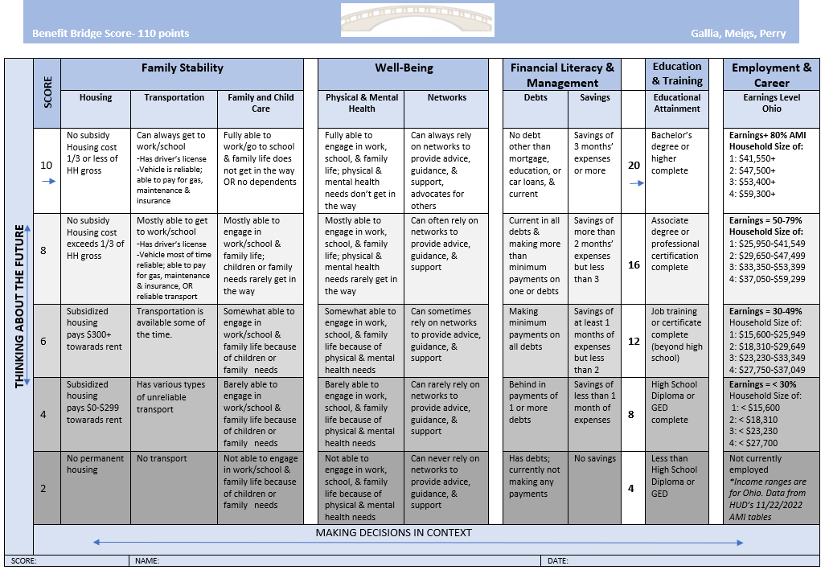
Bridge Score
The Empath Bridge Score helps guide goal-setting and monitor progress in the program.
  The Bridge Score is determined by the participant with guiding questions and conversation by the peer mentor. The Bridge Score also drives the goal setting.
Notes:
For "obligees" or the child support case participants who are supposed to receive payments, positive coparenting can increase the family and child care score in family stability and can increase obligor's willingness to contributing monetary support. Regular receipt of child support can also improve scoring in financial literacy management for obligee.
For an obligor, higher scoring in pillars should also drive increased payment. Notably, financial literacy and management support has been correlated to increased support payment as well.
Common reasons for nonpayment :
Financial Hardship – Some parents struggle with unemployment, underemployment, mental health, drug addiction, disability, or other financial difficulties that make it hard to keep up with payments.
Disputes Over Custody or Support Terms – If a parent feels the support amount is unfair or disputes the custody arrangement, they may resist paying.
Intentional Avoidance – Some parents purposely avoid payments, possibly because of resentment toward the other parent or lack of connection with their child. In these situations, parents will sometimes work for cash or other jobs that income withholding garnishment is not possible.
Lack of Awareness or Understanding – Some parents may not fully understand their obligations or the consequences of not paying.
Lack of trust in Government- Some parents avoid paying child support due to distrust in government involvement, fearing loss of control over financial decisions, privacy concerns, or inefficiency in the system.

Slide 33

Health & Human Services
CCMEP
33

Slide 34



CCMEP Program Overview
CCMEP engages low-income young adults in meaningful employment and training activities to build lifelong, sustainable careers.
Help low-income young adults:
Build career paths
Find employment
Break the cycle of poverty
Combines case management with employment and training services
Meets individuals where they are by tailoring services to align with their unique interests, abilities, and goals
Low-income youth ages 14-24 who are appropriate to enroll in an employment and training or education program
Parents ages 14-24 seeking cash assistance through the Ohio Works First program
Program Goals
Key
Features
Eligibility Criteria
Notes:
This program meets individuals where they are, tailoring services to align with their unique interests, abilities, and goals. It also recognizes and addresses barriers that may stand in the way of progress, such as unstable housing, lack of child care, or other life challenges. Before focusing on employment or educational milestones, CCMEP ensures individuals have a strong foundation from which to build.
The program is not one-size-fits-all. The CCMEP team partners closely with each participant, walking alongside them to create a personalized plan that reflects their needs and aspirations. With ongoing support and access to critical resources, individuals are empowered to work toward long-term self-sufficiency and success.

Slide 35
CCMEP Services
Caseworkers partner closely with each participant, walking alongside them to create a personalized plan that reflects their needs and aspirations.
Job Skills | Income Supports | Life Skills
Apprenticeships Career Coaching Subsidized Employment Educational Programs Job Readiness Job Retention Vocational Education On-the-Job Training Job Search Training Supervised Job Search Work Experience | Child Care Payment Supportive Services (e.g. transportation assistance, child care, housing referrals) | Financial Literacy Peer Mentoring Counseling

Slide 36

Health & Human Services
PRC
36

Slide 37

PRC Overview
PRC services provide short-term, emergency assistance—such as help with rent, utilities, or employment-related needs—to eligible individuals and families facing immediate financial challenges.
Reduce need for ongoing assistance
Increase employment retention
Improve family stability
Rapidly respond to emergencies
Enhance self-sufficiency
County-tailored program
Focus on prevention, employment retention, and crisis response
Employed or unemployed parents of minor children who have a gross income of 200% FPL or less
Includes pregnant women or teens
Program Goals
Key
Features
Eligibility Criteria

Slide 38
PRC Services
Caseworkers partner closely with each applicant, helping them identify urgent needs and connecting them to tailored assistance that supports their family’s stability and self-sufficiency.
Job Skills | Income Supports | Life Skills
Apprenticeships Career Coaching Subsidized Employment Educational Programs Job Readiness Job Retention Vocational Education On-the-Job Training Job Search Training Supervised Job Search Work Experience | Cash Assistance Emergent Needs Supportive Services | Counseling

Slide 39



THANK YOU!

Slide 40
Promoting Economic Stability & Mobility
Presented by: Ricardo Williams,
SNAP Employment and Training Manager, Louisiana Department of Children and Family Services

Slide 41

Louisiana’s 'Set for Success' Model
SNAP E&T – Voluntary training for SNAP recipients with multiple components
STEP – TANF employment program focused on barrier removal
CSE E&T – Formerly supported non-custodial parents in meeting obligations; Partnered with courts to engage participants and implemented income withholding measures.

Slide 42
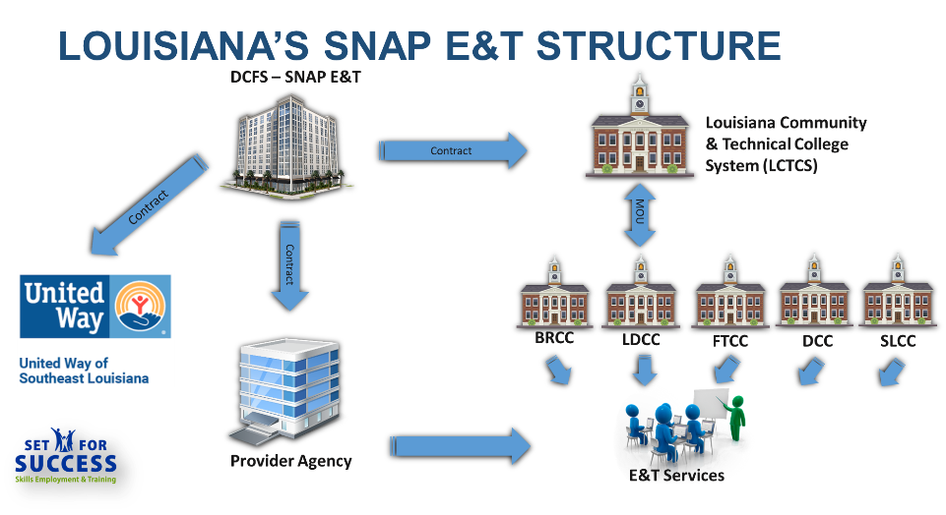

Slide 43

E&T Supports in Louisiana
Reimbursements: transportation, childcare, internet, uniforms, certifications
Individualized employment plans
Real-time participant tracking through SNAP Works
Quarterly provider meetings and cross-training

Slide 44

Why Employment & Training Services Matter
Connects public benefit recipients to long-term economic stability
Provides skills training, work experience, and wraparound supports
Empowers families to transition from survival to sustainable income

Slide 45

Why Employment & Training Services Matter
Non-Custodial Parents: Builds job skills, connects to stable employment, reduces barriers, and supports meeting child support obligations.
Custodial Parents: Increases earning potential, provides supportive services, and promotes family stability and self-sufficiency.

Slide 46
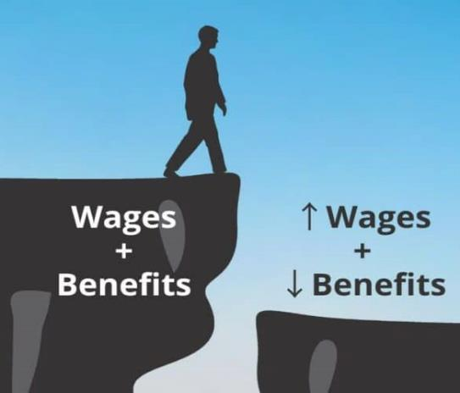
Understanding the Benefits Cliff
Definition: Sudden loss/reduction of benefits when income increases slightly
Impact: Discourages advancement and disrupts financial stability
Solution: Policies and tools to smooth the transition to higher wages

Slide 47

Louisiana’s Approach to Mitigating Benefit Cliffs
Partnership with United Way Southeast Louisiana
Use of benefit cliff calculators in case management
Financial coaching to support transition
Policy advocacy to reduce benefit loss
Cross-program integration: SNAP E&T, STEP (TANF Work program), with Workforce Boards

Slide 48
Transfers DCFS Workforce Development Workforce programs from DCFS to Louisiana Workforce Commission ('Louisiana Works')
Implementation: Programs transfer by Oct 2025;
SNAP & disability determination services move to Louisiana Dept. of Health
Impact: Fully integrated benefits access and workforce development
Integration with Workforce Development Boards for regional labor market match
Pilot co-location sites for one-stop access
'One Door' Reform Overview

Slide 49
Impact on Families
Families gain skills, stable employment, and financial independence
Improved child well-being through economic stability
Stronger communities through reduced benefit reliance

Slide 50
Call to Action
Expand cross-sector partnerships
Leverage benefit cliff data for informed policy change
Highlight success stories to maintain momentum

Slide 51
Ricardo.Williams.DCFS@la.gov

Slide 52
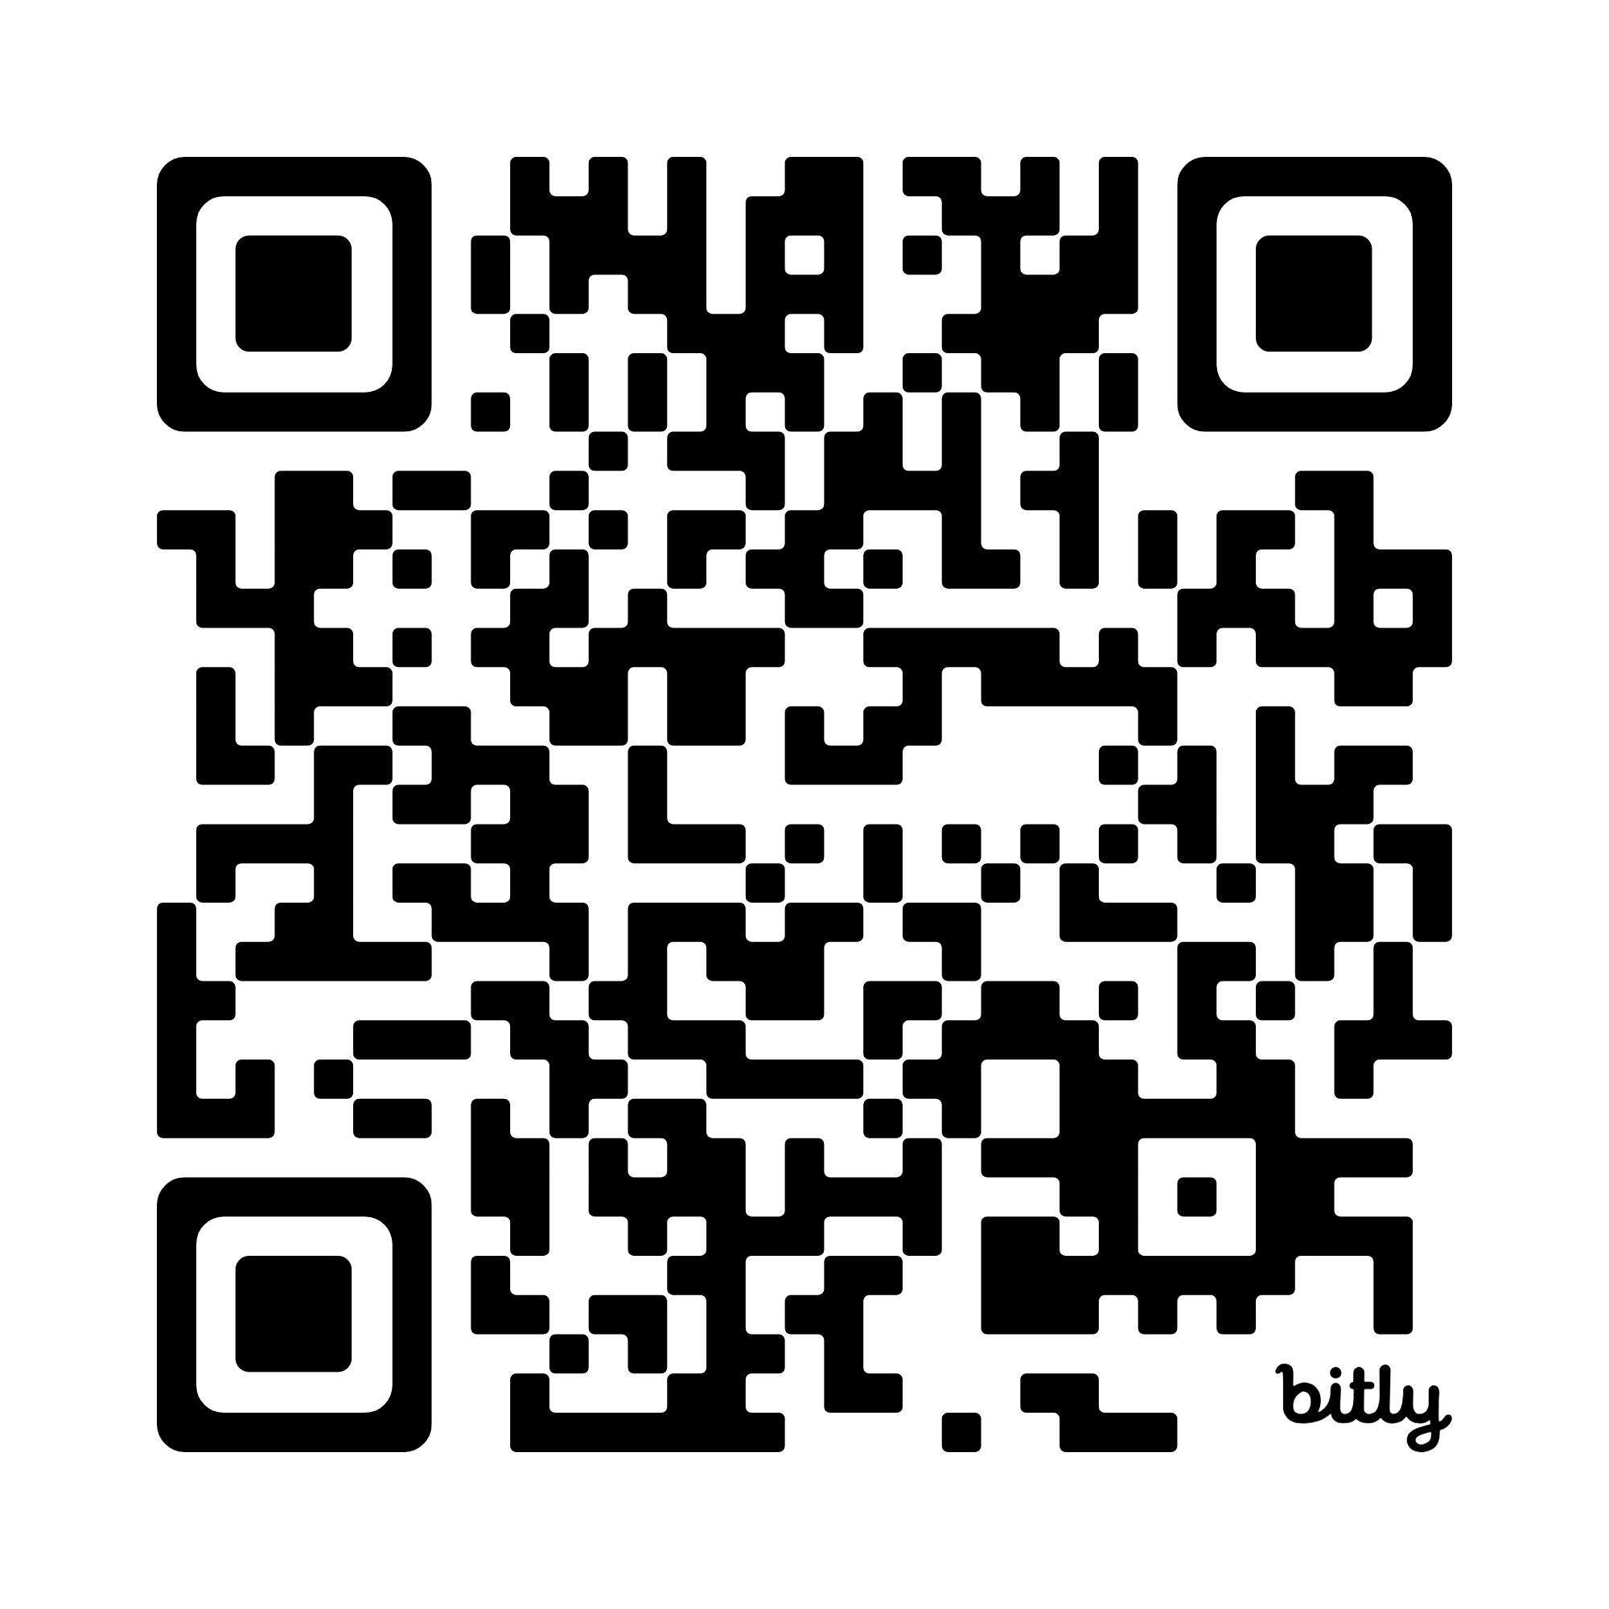
Join Us: State Action & Innovation Lab RFP
Aligned Customer-Centered Ecosystem of Services & Supports (ACCESS)
The Data & Impact State Action & Innovation Lab ("Data SAIL") will provide hands on technical assistance and innovation funds to three states to address cross-sector misalignments in data and technology across health, human services, and workforce programs.
Cross-sector state agency teams will receive an estimated $200k innovation grant plus training and technical assistance from APHSA, NASWA, the Coleridge Initiative, and U.S. Digital Response.
RFP Information Session – 8/21 4:00 pm ET
RFP Proposal Deadline – 9/19
To learn more about ACCESS / Data SAIL RFP
Visit: www.roadmaptoaccess.com/data-sail
Email: kmonterroso@aphsa.org

Slide 53
Join Us: Exploring Child Support – TANF
Community of Practice
Co-hosted by the American Public Human Services Association (APHSA), National Council of Child Support Directors (NCCSD), and National Child Support Engagement Association (NCSEA)
The community provides a forum for public administrators to explore opportunities for collaboration and alignment between TANF and child support programs in the interest of shared values and outcomes for families.
Community of Practice membership is limited to state and local public sector TANF administrators and Child Support directors, or their public agency designees.
Please sign up here: SmartSheet Registration List
Or email Khristian Monterroso – kmonterroso@aphsa.org

Slide 54

Q & A

