Slide 1
Opportunities and Lessons Learned from the SAVES Grant-Funded Initiative in Child Support
Safe Access for Victims’ Economic Security
(SAVES) Demonstration:
Wisconsin’s Network For Safety (WINS) In Child Support
Notes:
Welcome, everyone. Can you see my slide? I want to tell you about Wisconsin’s experiences implementing the SAVES demonstration and what it tells us about the role of grant-funded projects within our child support program.

Slide 2
SAVES Demonstration
Section 1115 grant
  Other grantees are Colorado, Georgia, Michigan, Minnesota, Missouri, New York, Ohio, Oklahoma, Texas, Virginia, Washington, and the Lac Courte Oreilles tribe.
Learning agenda
Design and test practices for safer access to child support for domestic abuse victims.
Identify opportunities/barriers to address child support during protective order hearings and to address parenting time during child support hearings.
Notes:
Wisconsin is one of thirteen SAVES grantees.
SAVES is a demonstration to pilot ways of connecting participants to child support services more safely and helping them understand how court actions will affect both their children’s living arrangements and support orders.
We have been road-testing new practices in 3 counties [Brown, Kenosha, St Croix]

Slide 3
Why Wisconsin Pursued this Grant
Built on prior/concurrent WI initiatives
  A statewide task force identified risks and opportunities for domestic violence (DV) victims who are navigating the child support process – focused on getting better outcomes for parents, children, and the state.
  Other special projects were focused on NCP employment and fairness in the child support process; these insights have informed Wisconsin’s SAVES grant strategies.
Influential data
Prevalence of DV and its financial costs in WI.
Research on the role of the child support program in DV situations.
Notes:
The impetus for this project was twofold.
First, the Department of Children and Families [and BCS ?] identified an opportunity to more closely examine how DV victims navigate the child support program, and how the program can get better results when working with victims and when interacting with other programs that touch their families. Meanwhile, other grant and waiver projects focused on services to NCPs, and more clarity and fairness in the process [or procedural justice]
Second, we found state and national studies suggesting that:
Between one quarter and one third of child support program participants may be current or former victims of DA.
Unresolved safety issues make it harder for the child support program to meet its performance goals for getting financial support to children, and hurt our larger economy in health care costs and lost productivity.
Financial stability may be the largest factor in whether victims and their children can escape and keep away from a dangerous situation.
The most precarious time for a victim is typically soon after they leave their partner – which is when our program usually meets them for the first time.
We also saw data suggesting that child support actions can inadvertently trigger renewed violence or other abuse, and
A national survey found that 9 of 10 victims say that they would pursue child support if they could do so safely.

Slide 4
5-Year Grant Timeline
2022-2023
Partnering with DV service providers, local economic support/benefit programs, and local judicial officials. Designing and piloting new practices.
2024-2025
Refining and expanding safety practices. Collecting data on DV screening, good cause and cooperation, and participant outcomes. Incorporating insights from the project into program policy guidance. Beginning to share lessons and how-to materials with other counties.
2026-2027
Expanding, further refining, and replicating safety practices statewide.
Notes:
This month we complete the 3rd year of our planned 5-year project [planned to continue through August 2027]
SAVES is a demonstration to pilot ways of connecting participants to child support services more safely, and for the child support program to address child placement when it’s appropriate to do so when working with victims.

Slide 5
Core Implementation Activities
Screening for and documenting the occurrence of DV among participants.
Planning and taking child support steps combined with safety measures.
Strategizing and troubleshooting for real case scenarios.
Training CSA staff and partners.
Reviewing policies and procedures. Identifying ways to scale up/replicate safety practices among other CSAs.
Notes:
Some of the project team’s main activities have included:
Screening for and documenting the occurrence of domestic abuse among referred participants and applicants,
Planning child support steps and safety measures with participants who are victims,
Strategizing as a team about case management situations that are identified by the WINS counties, or by counties they talk with, or by policy help desk questions and other BCS interactions with child support partners,
The demonstration counties have done a lot of staff training, and they engage their partners [especially DV service providers, benefit programs, and court partners] to help them better understand how the child support program works and how to help victims find their way through the process, AND
Looking at existing or new rules and procedures that could be adopted and sustained throughout the statewide child support program.
[[[[[[[Act on the desire of victims to have a child support order if they can do so safely
court staff, judges, and commissioners

Slide 6
Mid-Implementation Pivots
Initial focus was on facilitating Good Cause claims, but transitioned into focusing on “yellow light” (proceed with caution) approaches to help victims navigate child support cooperation.
Increasing focus on offering safety options/measures to all participants (not always having to determine which safety concerns are authentic).
Compensating for reduced capacity of local DV service providers – led to increased focus on safety planning between participants and child support staff.
Growing recognition of and response to participants who are navigating Family Court “pro se” (without counsel).

Slide 7
Yellow Light (Proceed with Caution)
Framework for Addressing DV Safety Concerns
Recognize signs of DV and DV-related aftereffects.
Create openings for disclosure.
Ongoing: Let the participant choose from options to pursue child support more safely. Take precautions and explain their limits.
Give referrals to DV services.
Use program materials and policies to increase safety, clarity.
Notes:
In broad strokes, the components of the project’s approach to working with domestic abuse victims include…
Training ourselves to Recognize situations in which a participant might be coerced or beaten, or trying to get back on their feet afterward. Sometimes this might be the reason a participant is slow to respond, or seeming unsure of what to do.
Creating openings for victims to tell us what happened or IS happening to them.
Working with participants so that they can choose among options, up to and including case closure if needed, and then taking safety steps, while explaining the pros and cons along with any limitations of the safety measures that the child support program offers.
Giving referrals to services including emergency shelter, legal help, crime victim services, and other supports.
Using stronger, clearer communication with participants and program partners.

Slide 8
Replication Big Steps:
How CSAs Can Hit the Ground Running
Require CSA staff to offer participants all safety options that are permitted by federal and state policy.
Clarify which safety options require participants to provide external documentation. Offer participants instructions or help getting documentation.
Seek cooperative agreements with local judicial officials/staff to use safety protocols, such as protecting address/whereabouts information for participants who have safety concerns.
Ask local domestic violence service providers what they wish their clients knew about navigating family court and child support processes. Find ways to get this information to all child support program participants.
Notes:
For guidance, see ACF-OCSS-PIQ-25-01, Policies to Promote Safety and Economic Stability for victims of Domestic Violence in the Child Support Program
This may require all CSA staff to get trained on how to explain and deliver safety options/modifications.

Slide 9
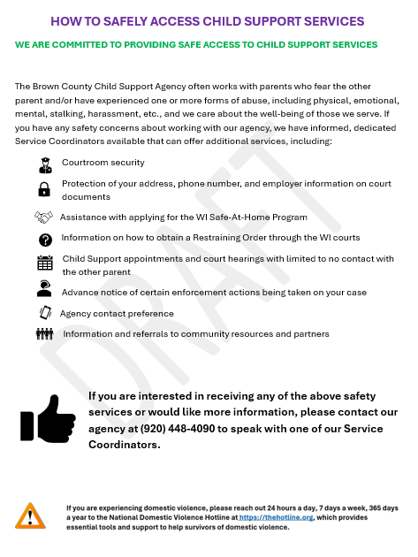
Tool to Replicate:
Safety Services
Flyer
Notes:
At first it might sound daunting to require CSA staff to offer participants a suite of safety options. Yet many of the options can be explained simply – as in this flyer that lists options like:
Courtroom security,
The Family Violence Indicator and address confidentiality,
Child support appointments with minimal contact with the other parent, and
Advance notice before enforcement actions are taken which might anger the other parent

Slide 10
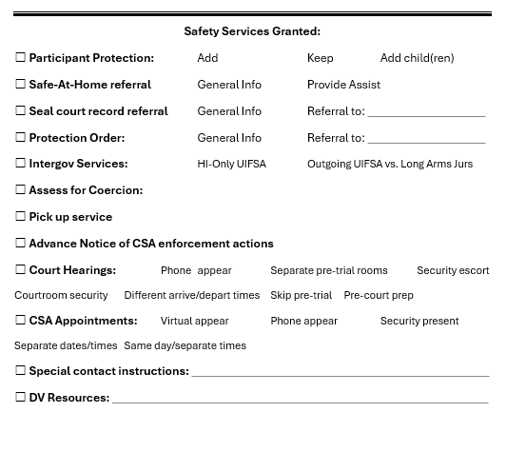
Tool to Replicate:
Safety Services
Menu for CSA Staff
Notes:
These options can also be organized in one place – which can act as a safety plan for delivering child support services.

Slide 11
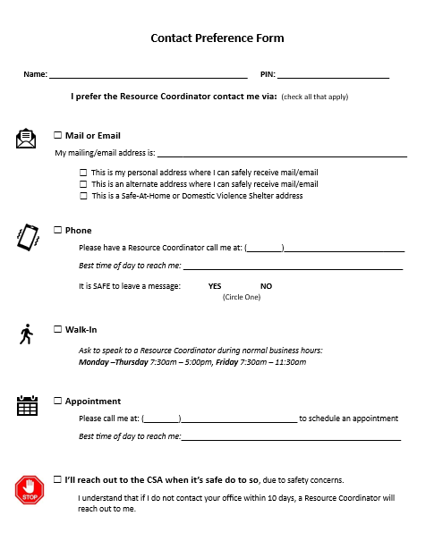
Tool to Replicate:
Asking for
Contact Preferences
Notes:
One of the first steps a CSA can take is to ask participants how and when they prefer to be contacted, as in this form. In piloting its use, we have found that even participants who have no safety concerns will return this form because they appreciate the opportunity to influence their customer service experience. Also note that at the bottom of this form, a participant can indicate that they have safety concerns. This option includes a deadline so that the CSA can continue to pursue establishment and enforcement in a timely way.

Slide 12
Replication Baby Steps:
Encouraging CSAs to Start Where They Are
Ask all participants how and when they prefer to be contacted.
Give all participants a list of the CSA’s safety services and ask which they would like used on their case. Allow participants to change their mind as their safety situation evolves.
Give CSA staff and participants step-by-step instructions for seeking a protection order or enrolling in an address confidentiality program that their state may offer.
Give all participants information about local domestic violence, crime victim, and legal services. Offer to facilitate the connection.
Post safety flyers throughout CSA offices and public buildings, including in restrooms. Have brochures, business cards, or tear off phone numbers available for participants to take conveniently and inconspicuously.
Notes:
Also: Provide a Quick Escape button on child support website(s). Give participants information about digital safety.

Slide 13
Contact Information
Wisconsin SAVES Demonstration
Phyllis Fuller
Wisconsin Bureau of Child Support
phyllis.fuller@wisconsin.gov
Caroline Schultz
Wisconsin SAVES Project Manager caroline.schultz@wisconsin.gov

Slide 14
Enhanced Safety Measures
Enter Privacy Protection (Wisconsin’s Family Violence Indicator) and add notes in the data system that there are DV safety concerns.
Help access and integrate DV services.
Help with enrollment in the state’s address confidentiality program. Be prepared to pause/close establishment or enforcement if it is unsafe to proceed.
Schedule appointments/genetic testing on different days. Minimize contact between parties wherever possible.
Notes:
I’ve listed examples here of some safety measures that the child support program can offer. These include
Entering the FVI and adding notes to flag when a participant has domestic abuse safety concerns or there are other reasons that the CSA believes there may be abuse, such as a protective order found in CCAP. [pause]
Helping to connect domestic violence services by local partners during the child support establishment process and in ongoing case management. [pause]
Helping the applicant or participant to enroll in Wisconsin’s Safe at Home address confidentiality program operated by Wis- DOJ. [pause]
Being prepared to halt establishment or enforcement activities when conditions are unsafe for the victim or their children. [pause]
Scheduling the parents’ Child Support activities [appointments/genetic testing] to happen during different days or times, working to minimize contact between the parties, [Next Slide]
[note CSL 25-05 if questions]

Slide 15
Enhanced Safety Measures, continued
Work with courts to facilitate the victim attending court hearings by phone or video.
Request additional security for courtroom. Provide separate waiting/seating areas for victim and abuser. Stagger leaving times from court and provide escort if available.
Encourage victims to have an advocate, friend, or other support present for public hearings. Explore having a service representative accompany a victim to private hearings (may vary by court).
Notes:
And similarly, Working with court officials and staff to arrange remote court appearances if allowed, and arranging additional security for in-person appearances. Also, encouraging victims to have an advocate, friend, or service representative present, and encouraging the court to allow this when appropriate.

Slide 16
Early Lessons from the Wisconsin SAVES Demo
Focus on how-to: Many child support staff are unsure how to react to DV situations or worry about making the situations worse.
Don’t need to determine whether the safety concerns are “real”: Simply offer the safety options that the program is allowed to make by statute. Doing so may yield more participation/cooperation.
Key role of OCSS to help judicial officers learn more about how DV influences the child support process – and how it influences the parallel, often separate family court actions that are focused on custody and parenting time.

Slide 17
SAVES Demonstration Guideposts
Find ways to get better outcomes for parents, kids, and the program.
Connect crime victims with life-saving services and resources.
Bring focus to the outcome we ultimately are talking about here: getting support to kids.
Create the conditions in which parents will cooperate with the child support program. Be smarter about why participants may take or don’t take certain actions – by seeing child support through their lens.
Don’t contribute to lethal attacks.
Neither the participant nor the child support program needs to default to case closure.

Slide 18
Replication Might Not Yield the Same Results:
Why?
Many demonstrations include sufficient time for design and redesign, trial and error. Replications do not always have this luxury.
Conditions may be quite different – such as a new setting, players, population, or economy.
The replication may not be as well-resourced as the original demo.
However: Do not assume that an ambitious demonstration is impossible to scale-up or replicate.
Notes:
[more details about this bullet: The replication may not be as well resourced as the original demo:]
Core operational staffing
May not have all components of the original model. Might be missing a key ingredient of the secret sauce
Not the same extent of TA/feedback built into replication
Agencies that are attracted to demos might have key leadership or other assets that are hard to identify and imitate

Slide 19
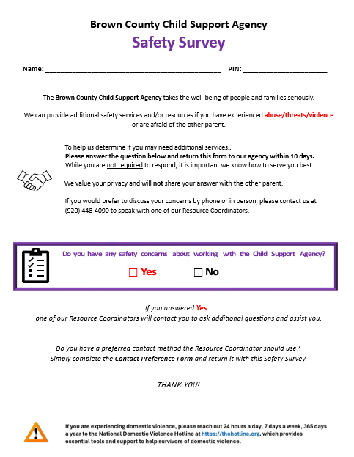
Tool to Replicate:
Initial
One-Question Screening Survey

Slide 20
Outcomes:
Safety
Surveys
Pilot
Initial One-Question Screening Survey (N=466)
  12 percent were returned
  Among surveys returned, 25 percent indicated some type of safety concern
Follow-Up Safety Survey (N=22)
  95 percent of those who completed a follow-up survey had DV concerns and were offered DV safety services
  CSA staff encouraged 5 respondents to file a good cause claim (3 of the 5 filed a claim, and each was approved)
    Results as of 6/6/2025

Slide 21
Wisconsin SAVES Project Features
Three counties: Brown, Kenosha, St. Croix
  Also learn with Lac Courte Oreilles child support program
Increase DV training for caseworkers
Tap a victim-led advisory group to learn what they’ve learned about child support
Map the child support process to identify pain points
Revamp child support documents and create new tools
Work with benefit programs, courts, and DV providers for both of the following compatible outcomes:
  Safety AND financial support
Notes:
[Expert informed DV training for staff
[Building relationships with local DV shelters, meet & greets, collaboration
[Sub-group developed Screening Tool & Scripts for Staff
[Created and/or supplemented existing positions with WINS through Grant
[Revamped Good Cause process & work together as a team to triage cases
[Staff working cases through DV lens

Slide 22
Assessment of Family Violence Indicator (FVI) Incidence
Conducted by one of the three SAVES pilot counties.
4,466 instances of the FVI among 14,000 IV-D cases.
The CSA has been reaching out to participants to confirm, remove or update the FVI.
  Learning participants’ circumstances and preferences – one size does not fit all.
Notes:
(Brown County conducted this in spring 2025)

