Slide 1


Slide 2

Data-Driven Progress:
Child Support Partnerships Through the Lens of Analytics
Joey Arthur, OCSS DFS Data Analytics Branch Chief
Cynthia Longest, OCSS Senior Technical Advisor

Slide 3

This session highlights the evolution of OCSS’ data analytics: from basic reporting to dynamic analytics designed for the Directors, including real-world applications.

Slide 4

Agenda
Background Information
Example Use Case slides
Newer Findings of Interest
  Improving Collections:
    Cumulative Arrears to Debtor File comparisons
    Debtor File choices and OCSS enforcement tools
    “Other Collections” comparisons
  Administrative:
    FFP for allowable Non-IV-D Expenses
    State Funds Only Investment & Cost Effectiveness

Slide 5
Background Information
Then and Now with OCSS Data
OCSS Data Analytics for Directors Project
Available Analytics Reports
What is a “Use Case”?
Notes:
Background:
Then and Now with OCSS Data
OCSS Data Analytics for Directors project
Available Reports
What is a “Use Case”?
Then and Now addresses from the description: how data analytics has evolved from basic reporting to a cornerstone of strategic decision-making
OCSS project addresses from the description: helping programs identify trends, improve performance, and respond to changing needs.
Use Case discussion and Newer Findings addresses from the description: insights that nourish stronger programs and smarter policies and real-world state comparisons, innovative tools, and collaborative success stories that demonstrate how the state and federal partnership can improve outcomes

Slide 6
Then and Now with OCSS Data
  Basic Report tables to Interactive Visual Reports
    Report Tables in PDF or web browser
    Added Excel spreadsheets
    Added Interactive Tableau reports, visual and dynamic
    Use Cases – Demonstrate how to use reports
  Example of Interactive Features
Notes:
OCSS still publishes the basic tables in PDF and excel versions but has since added the Tableau reports for Directors.
Example caseload slides from Arrears Deep Dive report: 35 and 36 (bar and trendline)

Slide 7
OCSS Data Analytics for Directors Project
  Project vision:
    Use more visual analysis
    Facilitate comparisons with similar states and national data
    Highlight outliers in a factual way
    Provide useful analytics to all states
    Use a tool that is free for states, easy to use, and intuitive
  Reports should:
    Give actionable information
    Provide a deeper dive
    Be developed with assistance from states and OCSS experts
  Reports are only intended for:
    IV-D Directors and designees
    OCSS regional staff so they may assist Directors
Notes:
The project idea was brought to Directors in closed door session of NCCSD conference in 2018. Project started in mid 2019 when Cynthia joined OCSS.
Provide useful analytics to all states regardless of their analytical resources and capabilities
Reports would not be available to the public, and state/federal audience is intentionally limited

Slide 8
Analytics Reports
Available Reports
  Current Support Deep Dive
  Arrears Deep Dive
  IV-D IWO
  Overall Collections (includes Collections Base and Incentives)
  Cost Effectiveness Deep Dive (includes System and State Only Expenditures)
  Undistributed Collections (Overall, by Category,
  and by Age)
Support Order Deep Dive (in development)
Notes:
8 reports available already and 1 in development

Slide 9
What is a “Use Case”?
  Real-world application of the analytics reports to inform program and policy decisions
  Goals:
    Illustrate for Directors how they can use the Tableau reports
    Present visual data to inform legislators, governor’s office or umbrella agency leadership
    Using data to tell a state’s story
    Use experience to point out possible areas to examine
  44 Use Cases completed (each has 20 to 63 slides)
Notes:
Use cases are the real-world applications of the Tableau reports in asking questions, and in building data-based evidence for change. It was the next logical step after the Tableau reports—to really demonstrate to Directors how they can utilize the reports.

Slide 10
Example Use Case Slides
Arrears Deep Dive
UDC by Age & UDC by Category
IWO
Current Support Deep Dive
Cost Effectiveness
Notes:
These are slides pulled from prior Use Cases, so their formatting looks a little different.

Slide 11
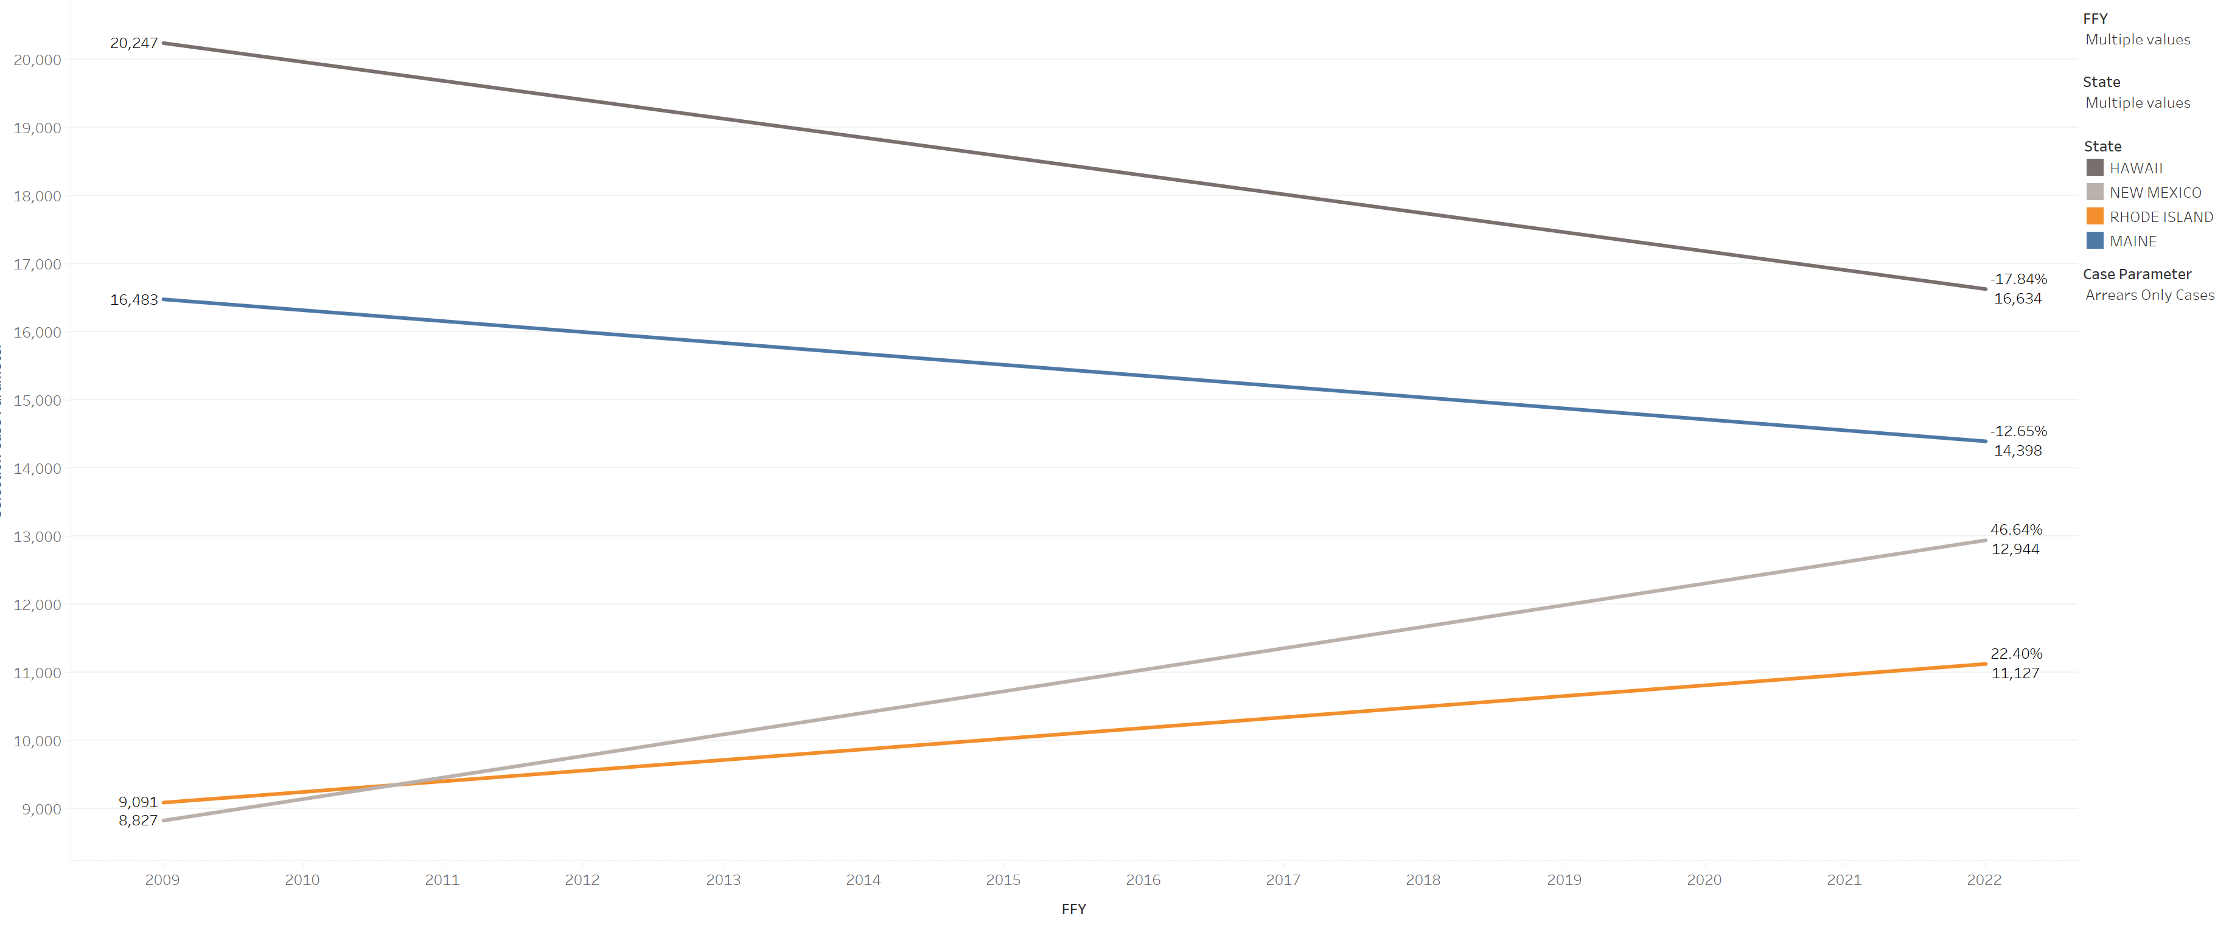
Arrears Only Caseload Trends FFY2009 - FFY2022
NM’s Arrears Only caseload has gone up the most since FFY2009:
NM: +46.64% (up 4117 cases)
RI: +22.40% HI: -17.84%
Nat’l: +4.80% ME: -12.65%
Notes:
Arrears Deep Dive report. NM asked for a Use Case focusing on Arrears in early 2024. Data available at this point was through 2022. Arrears only caseload growth was an interesting finding, prompting work in this area.
OCSE-157 Line 2e. Trends of NM and comparison states. Tooltip shows caseload numbers at various points, as well as the percentage change between each year selected. To see % change between 2009 and 2022, choose just those two years from the FFY dropdown.

Slide 12
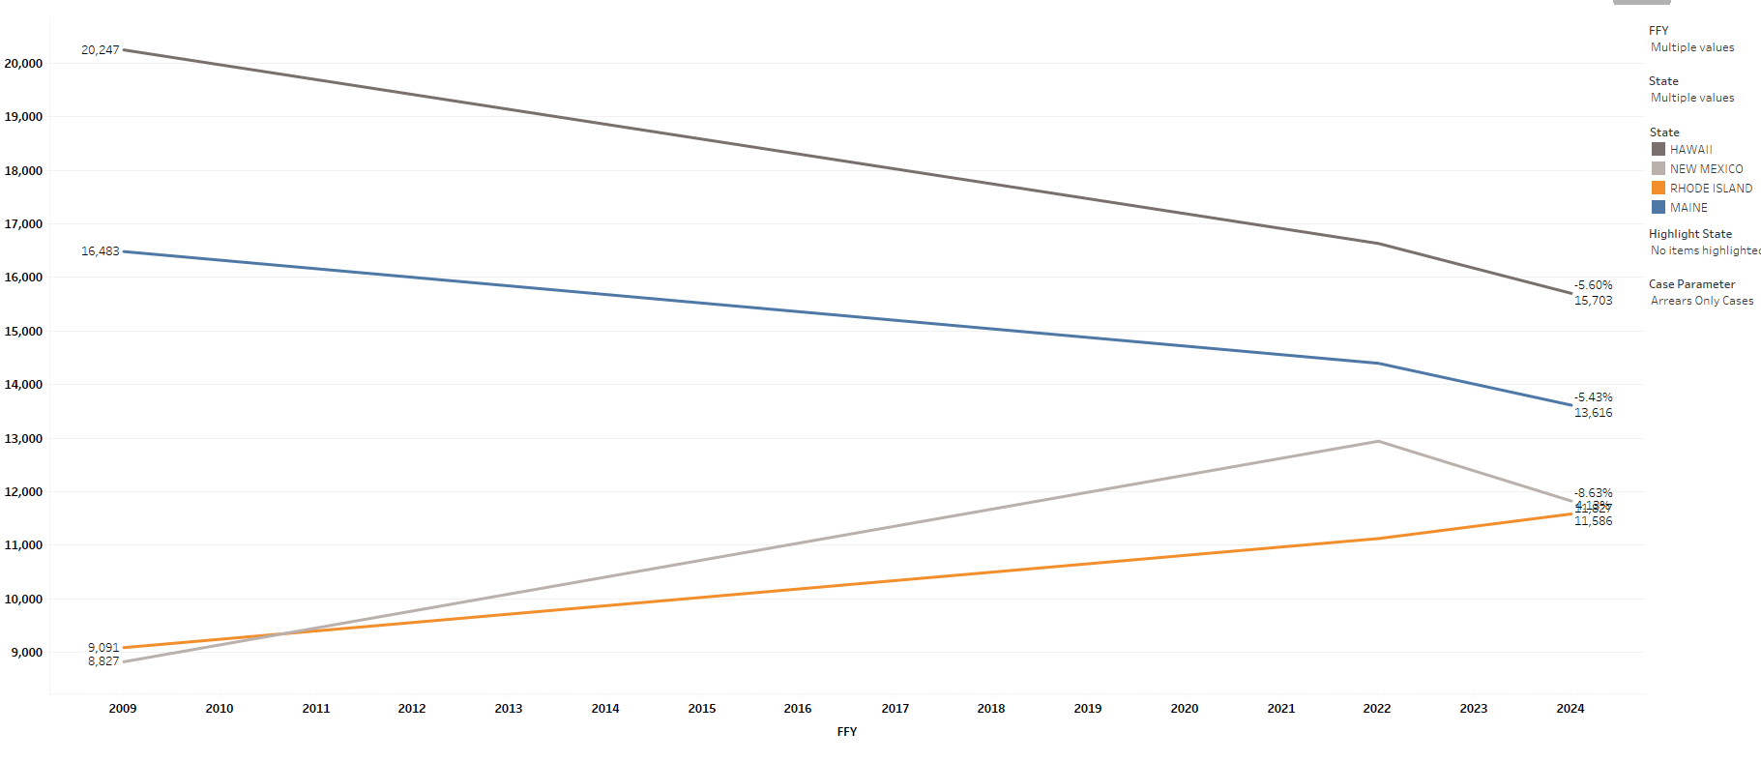
Arrears Only Caseload Trends FFY2009 - FFY2022 - FFY2024
NM’s Arrears Only caseload has gone down 8.6% since FFY2022.
Notes:
NM again. Quick update showing progress on reducing Arrears Only cases.
States can use the reports to show progress after they have seen issues from Use Cases and initiated special projects.

Slide 13
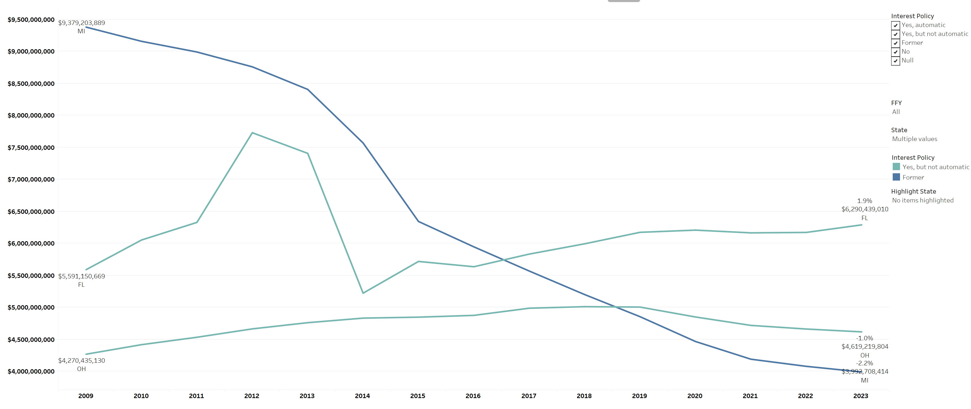
Interest Policy applied to Cumulative Arrears Due
Interest policies are indicated by color.
MI’s interest policy changed to cease interest January 1, 2010.
MI: -57.4% ($9.4B -> $4B)
Nat’l: +7%
OH: +8.2%
FL: +12.5%
Notes:
Another Arrears Deep Dive example. Michigan Use Case from December 2024.
If you are a state that has automatic interest and under criticism for a large amount of cumulative arrears due, you can use the ADD report to show how other states that changed their interest policy fared with cumulative arrears.
OCSE-157 Line 26. On Tableau report, hover to see Tooltip on various slides; it shows the specific interest answers from the IRG. Note: If the IRG indicated that the IV-D agency did not calculate interest on IV-D cases, those states were characterized as “Not automatic” even if their statute has an interest amount authorized.

Slide 14
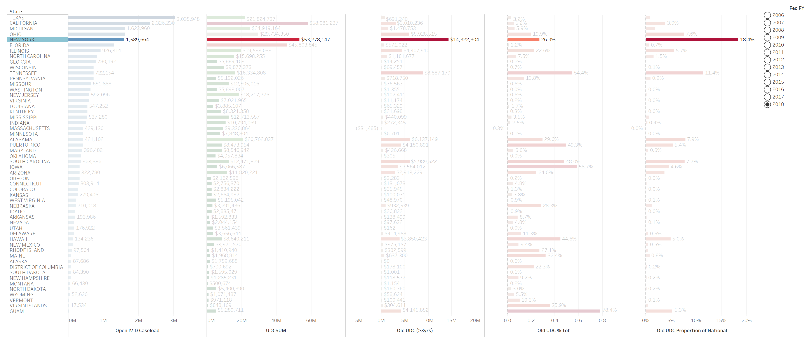
NY has the highest proportion of the National “Old” UDC – 18.4%
Notes:
UDC by Age report. NY volunteered to be the “guinea pig” Use Case to introduce the report to the Directors in a webinar, December 2020. NY was able to use this Use Case in their materials to support the need for the change in their escheatment law. Per the NY Director’s email June 2021: “both houses passed our unclaimed funds proposal to streamline the escheatment process for unclaimed/undistributable child support.”

Slide 15
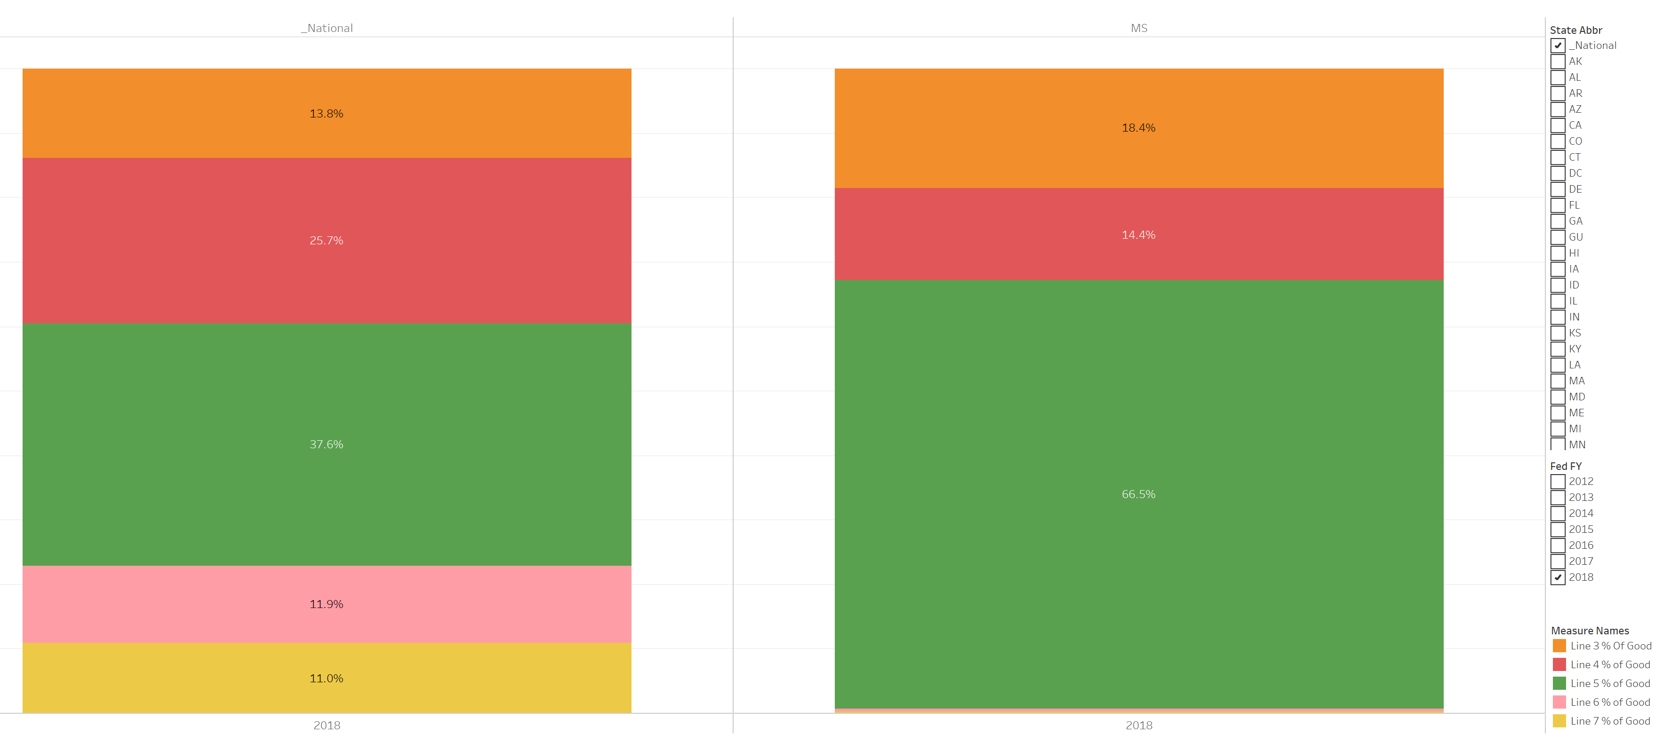
Interestingly, most of MS’ “good” UDC falls into Line 5’s “future support” category, which is almost double the national average:
66.5%, or $6.7M out of $10M “good” UDC is being held for “future support”
Notes:
UDC by Category report. 2018 data Mississippi Use Case showing “good” UDC percentages and Future Support anomaly compared to National %.

Slide 16
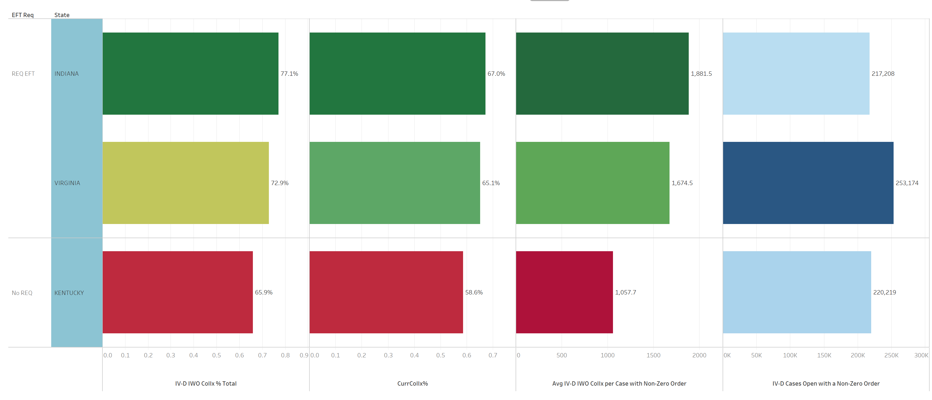
Comparing with States with EFT IWO payment processing requirements
Nat’l Avg: 72%
Nat’l Avg:
66.1%
Nat’l Avg: $1908
Notes:
IWO report. KY volunteered to be the Use Case “guinea pig” for the IWO report. Slide from webinar to introduce the IWO report in 2020. Tableau report adds data points such as which states require employers to remit by EFT and allows comparisons on the IWO % of collections, current support performance measure, and average IWO collection per case. For the latter, lower numbers here can possibly indicate systems not adding arrears amounts to IWOs for unadjudicated arrears.

Slide 17
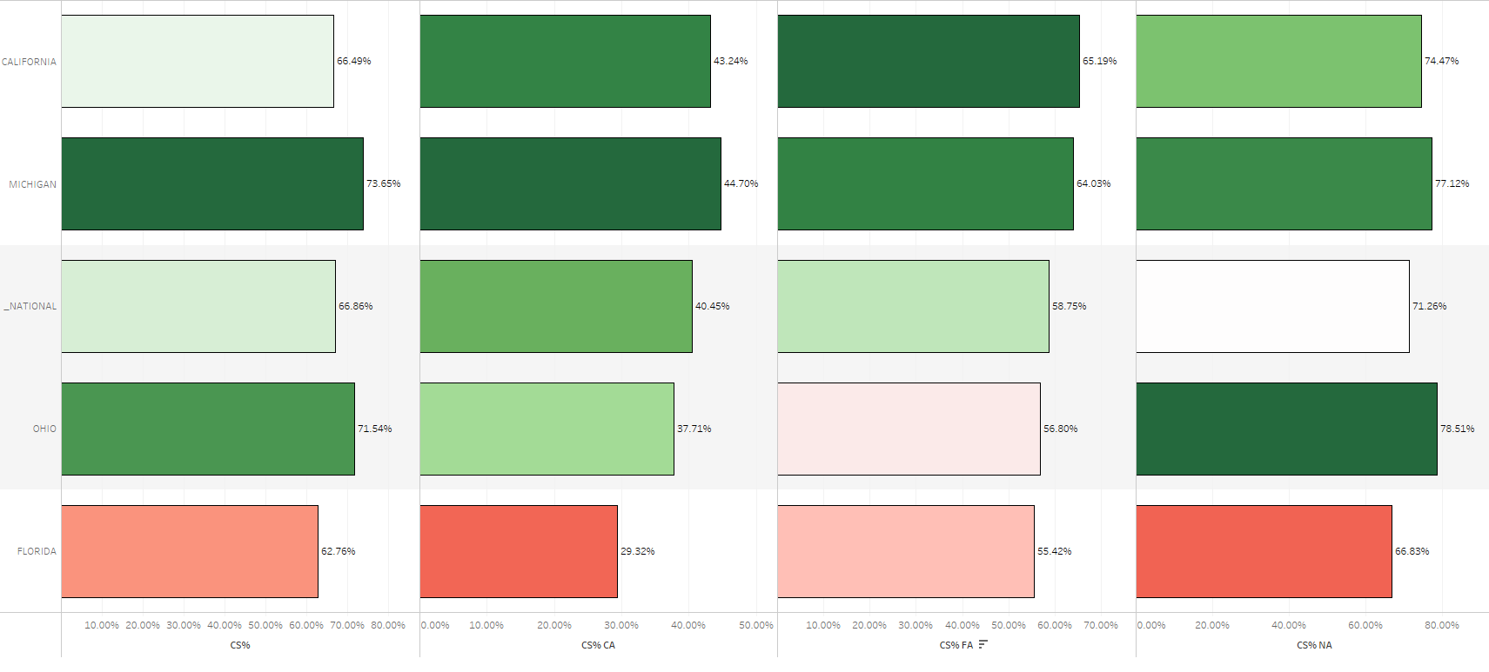
Current Support % by Case Type Comparisons:
Overall, Current Assistance, Former Assistance, Never Assistance
81,882 425,583 203,432
California is highest in FA non-zero order CS%, 2nd highest in CA and 3rd highest in NA.
Sorted by FA CS%, since that is California’s largest non-zero order caseload.
Notes:
Current Support Deep Dive report. CS Performance Measures for each case type. California requested a Use Case in 2022 to show to county leadership – since CA also uses Tableau, used to get their ideas flowing as well as analysis.

Slide 18
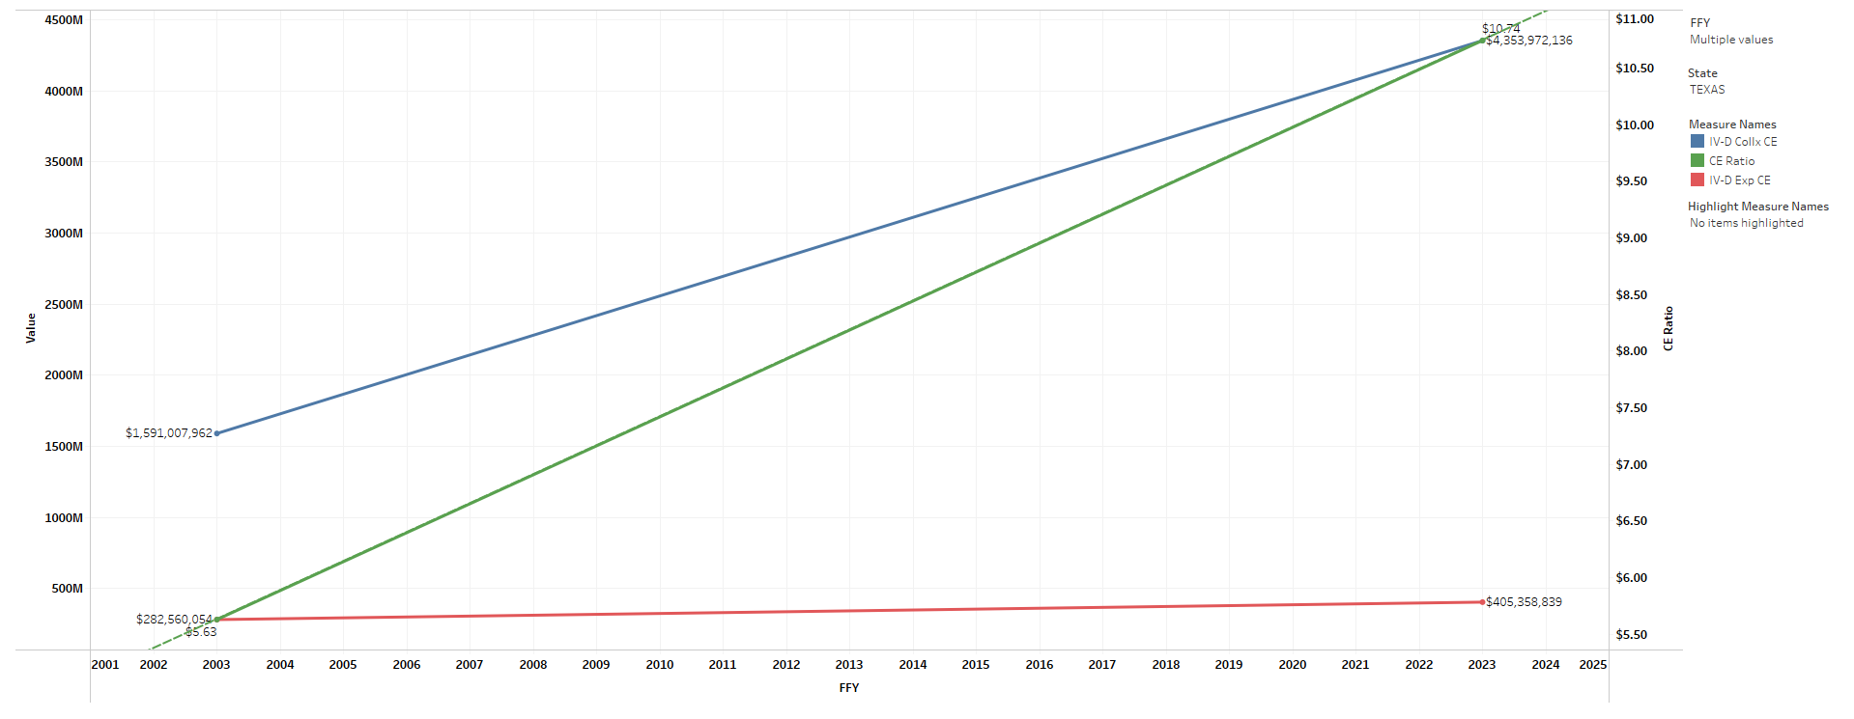
Trends of the CE Ratio and Components FFY2003 - FFY2023
Collections clearly have driven the TX CE Ratio increase:
Collx (blue line) up 174% (from $1.59B to $4.34B)
Exp (red line) only up 43% (from $282M to $405M)
CE Ratio (green line) up 91% (from $5.63 to $10.74)
Notes:
Cost Effectiveness report. Use Case to demonstrate the report at the introduction webinar at the end of 2024. Texas & Arizona agreed to be guinea pigs. This slide shows TX.
This slide helps analyze whether collections or expenditures have had the biggest impact on the CE Ratio. Tooltip shows data at various points, as well as the percentage change between each year selected. To see % change between 2003 and 2023, choose just those two years from the FFY dropdown.

Slide 19
Newer Findings of Interest –
Improving Collections
Cumulative Arrears Due vs. Debtor File Amounts
Debtor File choices and OCSS enforcement tools
Growth in “Other Sources” Collections

Slide 20
What is the “Debtor File”?
DEBTOR FILE: “The records maintained by OCSS that pertain to NCPs who owe past-due support, as certified by a state IV-D child support enforcement program.”
Arrears submitted by the states for TANF and Non-TANF amounts
Originally only used for Federal Tax Refund Offset (FTRO), with arrears thresholds of $150 and $500 for TANF and Non-TANF, respectively
Over time, Debtor File use expanded to cover other federal remedies:
  Passport Denial (mandatory but allows for exclusions) in 1997
  Administrative Offset (optional) in 1998
  MSFIDM (mandatory either individually with each state or
  with OCSS) in 1999
  Insurance Match (optional) in 2007
  Employer Lump Sum Match (optional) most recently
Notes:
Definition of Debtor File from the DFS Federal Collection and Passport Denial Technical Guide v14 March 2025.
Specifically, Passport Denial is a IV-D state plan requirement but it is not mandatory that all debts must be submitted as states can exclude on a case-by-case basis.
For MSFIDM, it is mandatory that an FI must match either with all states where they do business or through the MSFIDM program. If through MSFIDM, this is where info is matched with Debtor File.

Slide 21
Importance of Lower Debtor File Threshold
States have the option to submit with a lower threshold than the $150/$500 for federal tax refund offset*.
  At least $25 and at least 30 days past due
  At the time of the match, FTRO will not be intercepted unless the higher thresholds are met
  Cases are certified for Passport Denial if the $2500 threshold isn’t met
Some states have not taken advantage of the $25 threshold
They may be missing potential collections from OCSS matches:
  Employer Lump Sums through the CS Portal
  MSFIDM
  Insurance Match
  Administrative Offset
Notes:
This slide explores the first bullet in the next slide. These three remedies use the Debtor File to match. Impacts are probably to Non-TANF arrears that are above $25 but below $500. States could do an ROI analysis to see how many cases might be missing from potential matches. Some states may have (old?) rules that say they cannot put cases on the Debtor file unless the $150/$500 threshold is met.
For Admin Offset, there are currently approx. 46 states using admin offset in some capacity but as mentioned above, they may set their thresholds at 150/500 before submitting to the Debtor File.

Slide 22
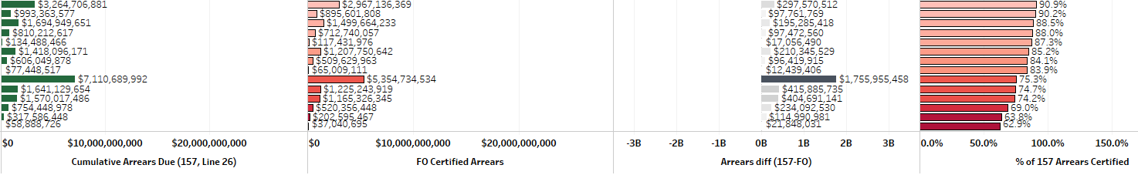
Cumulative Arrears vs. Debtor File
Text
Text
Text
Cumulative Arrears Due (157 report)
Debtor File Arrears
(approx. 9/30)
Amount Difference
% of 157 Arrears on Debtor File
States that have a low % in the fourth column have more arrears on their 157 than on their Debtor File. Are they missing opportunities for collection?
Potential Reasons for Difference:
Is the State only including arrears over the $150/$500 thresholds instead of the lower $25 allowed on their Debtor File?
Does the State have numerous unverified SSNs?
Are there issues with legacy or new system code?
Notes:
Snapshot of a portion of Arrears Deep Dive report slide 34. Generally, you would expect these two amounts to be close. But sometimes there are pretty big differences.
For example, the three States at the bottom of the list only have 62.9%, 63.8%, and 69% of their Cumulative Arrears on their Debtor File, $21.8M, 115M and $234M less, respectively.
This could be a policy decision or a system issue?
Note: The Debtor file amounts are as of as close to 9/30 as possible, given the different timeframes for state file submission.
There are a few states at the higher end of the scale (not shown) that have significantly higher amounts of Debtor File arrears vs. Cumulative Arrears. This could be because they are including Tribal arrears in their Debtor File, are submitting responding cases for non FTRO remedies on their Debtor Files, or they could be having state system issues with their Debtor File code.

Slide 23
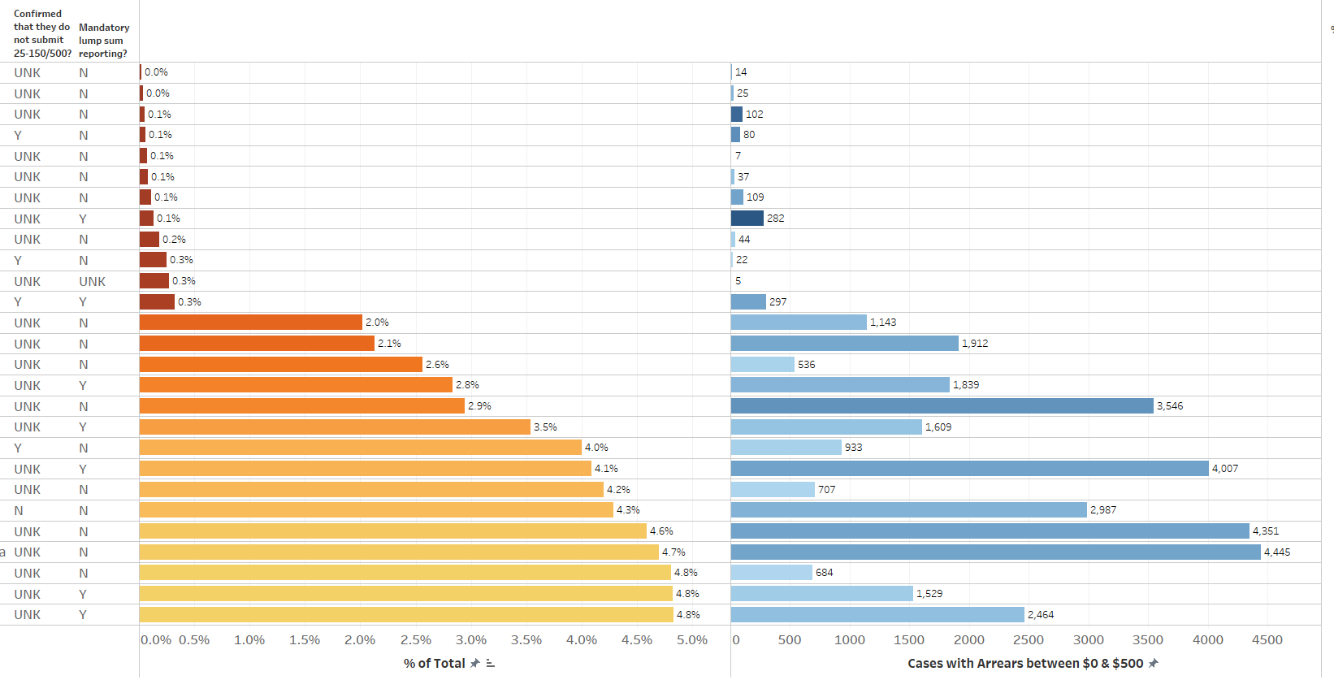
Analysis of States Not Using Lower Debtor File Threshold
States where the number of NonTANF cases with arrears between $0 & $500 is lower than 5% of total NonTANF cases submitted.
(Particularly important for states with Mandatory Lump Sum reporting?)
222,341
Notes:
“Confirmed” column: Some states are known not to be including the arrears between $25 & $150/$500 on their Debtor Files
“Mandatory” column: States with legislation mandating employers to report lump sums.
“% of Total” column: Of the NonTANF cases reported on the Debtor File, what % have arrears between $0 and $500? Slide only shows those states with % below 5%, but there are more with low percentages above 5%.
“Cases” column: Raw number of cases with arrears between $0 and $500.
Examples: Circles in first column indicate states we have confirmed are not submitting with the lower threshold. Circles in second column indicate states with mandatory employer lump sum reporting. One state is confirmed not to be submitting the lower debts.
Arrow: One state with lump sum reporting has only 282 cases out of 222,341 with the lower arrears.
Having a number in the fourth column means there are modifications happening that put the case in this category, but it doesn’t appear that the system coding includes the lower arrears originally.
States with modernization projects might want to consider this requirement for their new system.
Data as of 9-30-2024.
OCSS internal report FO062 used, but states could do their own calculations to determine whether their % was low.
Also they could ask their OCSS Tech Support rep for assistance. This is an internal (OCSS) report that stratifies arrears by the amount owed. Not yet in the Arrears report, but we plan to create an arrears report part 2—to include this information.

Slide 24
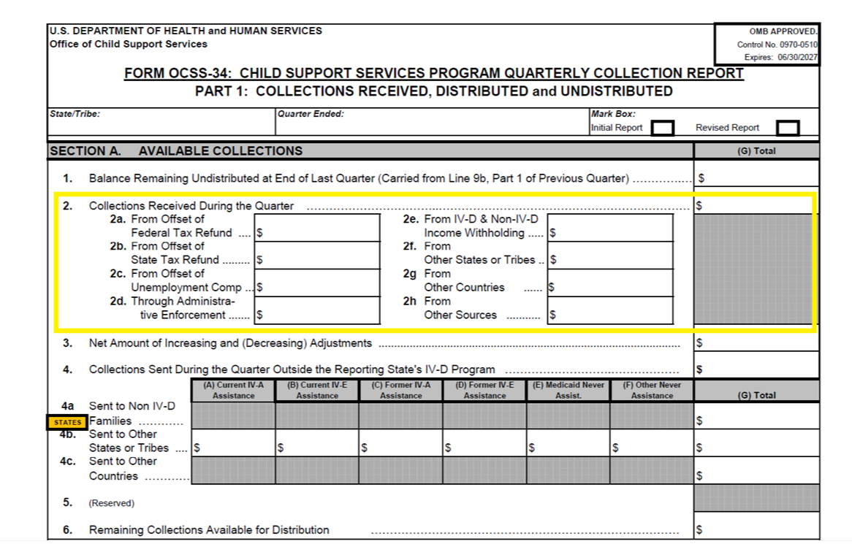
Growth in “Other Sources” Collections
Line 2h is all amounts not included on lines 2a through 2g. It includes payments by FIDM, insurance match, and administrative offset, as well as by check or EFT. It also includes special collections such as the Permanent Fund Dividend in Alaska.
Notes:
Final Newer Findings Collections slides. Other Sources collections increases in some states could be related both to Debtor File choices and to NCP payment choices.
OCSE-34 Instructions:
Line 2h. From Other Sources. All other amounts -not reported above – received on behalf of IV-D cases through the State’s or Tribe’s own collections procedures. This includes, but is not limited to: (a) payments received directly from non-custodial parents; (b) collections received through the IRS' full collection process; (c) collections received as a result of the administrative offset process; and (d) collections received through the Financial Institution Data Match. For “administrative offset” collections, report the full amount of the collection, prior to the reduction for the FMS service fee. The FMS service fee may be claimed as an expense on Form OCSS-396. [This is a direct entry 

Slide 25
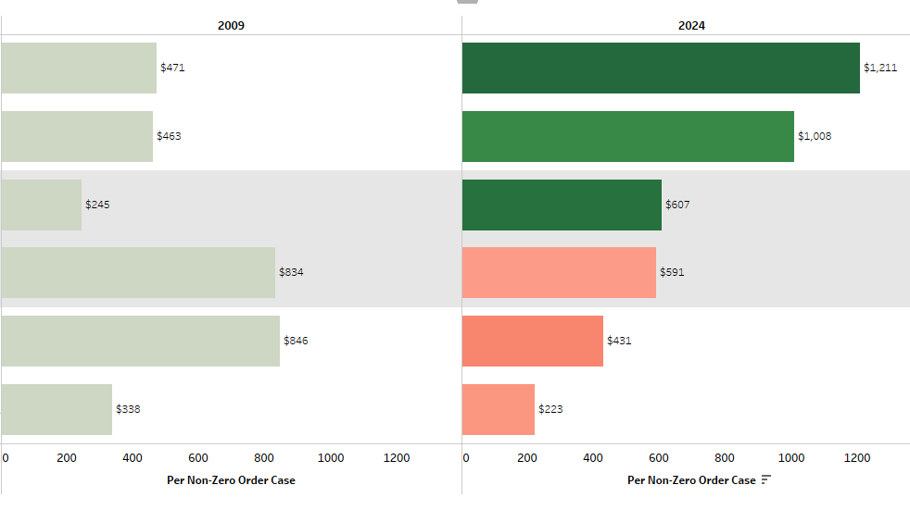
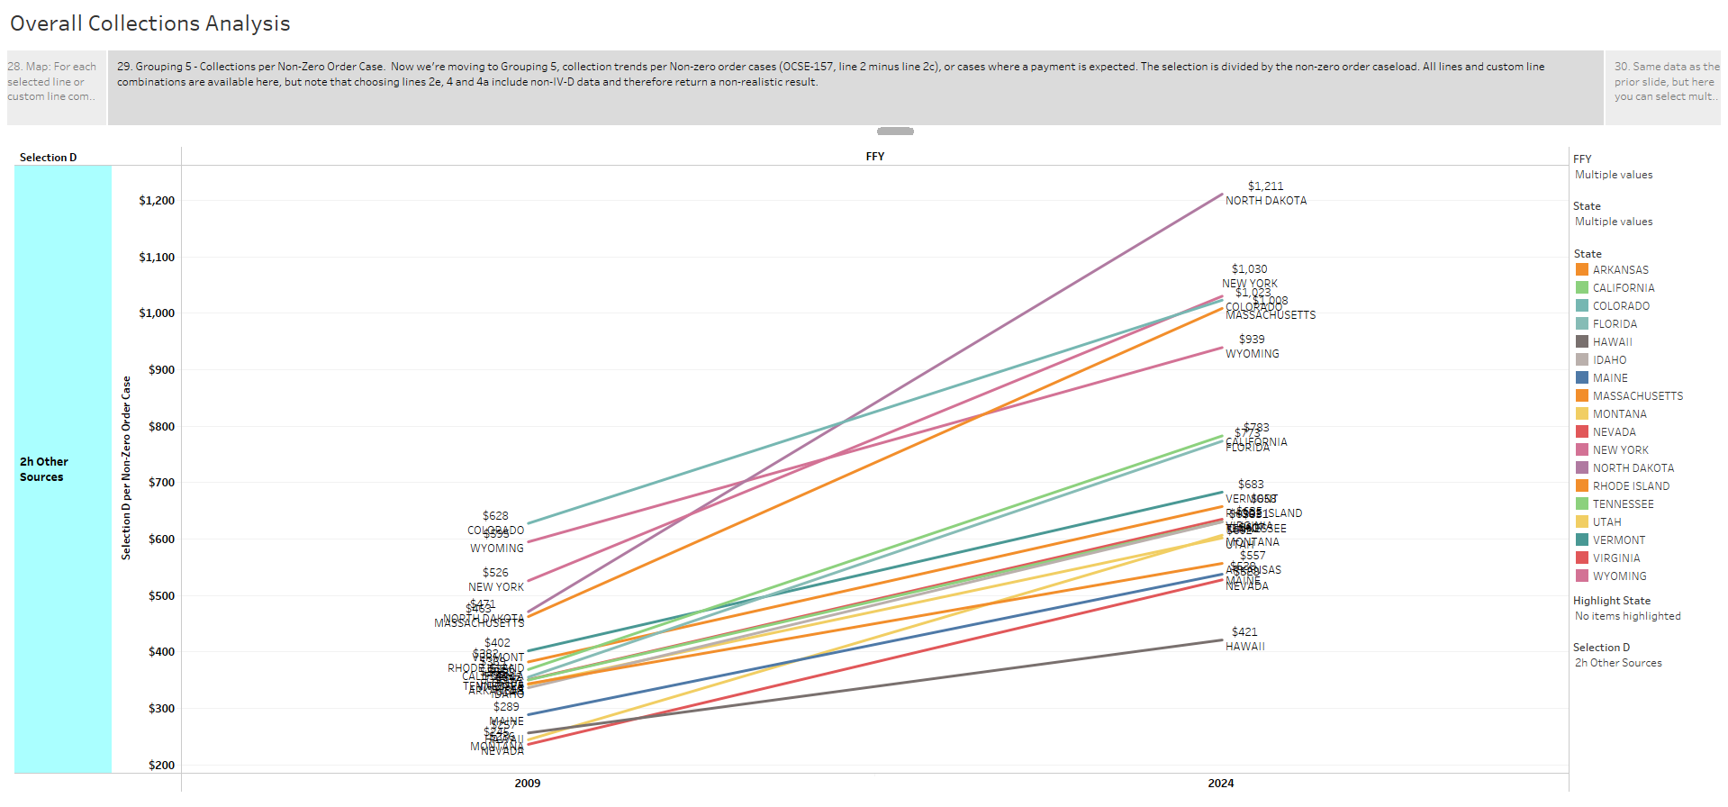
“Other Sources” Collx per Non-zero order case
Looking at “Collections per case” where a payment is expected levels the playing field, and accounts for caseload changes over time.
Color indicates higher and lower % increases.
Nat’l change 2009 to 2024: +43%
+157%
+118%
+148%
-29%
-49%
-34%
Notes:
This relates back to both the Debtor File being used for MSFIDM and Insurance Match (whose collections show up in Line 2h) and states’ growth in options for non-IWO eligible NCPs to make payments – PayNearMe, MoneyGram, etc.
Top three and lowest three by %. Like most of the Tableau reports, analysis gives ability to look to other states for best practices. Perhaps they changed their Debtor file, or have expanded their options for NCPs to pay more easily.

Slide 26
Trends of “Other Sources” Collx per Non-zero order case,
States with changes higher than Inflation
Another way of looking at the same data but includes inflation factor for analysis.
Between 2009 and 2024, cumulative price increase was 46.14%, per Bureau of Labor Statistics.
18 states are above the 46% inflation change.
Nat’l change: +43% ($445 -> $634)
One state has gone up 157% ($471 -> $1211).
X
XX
XX
X
X
$1211
+157%
$471
Notes:
Another way to look at it. This slide brings in the inflation concept. Would need to stay at 46% just to keep up with inflation. It shows 18 states with % increases over the inflation change of 46%.
“The average inflation rate between 2009 and 2024 was 2.56%, resulting in a cumulative price increase of 46.14%, according to the Bureau of Labor Statistics.”

Slide 27
Newer Findings of Interest –
Administrative
FFP for Allowable Non-IV-D Expenses
State Funds Only Investment and Cost Effectiveness

Slide 28
FFP for Allowable Non-IV-D Expenses
Specific Non-IV-D expenditures are eligible for FFP
Largest category is processing Non-IV-D IWO payments
Some states have large Non-IV-D IWO payment amounts but are claiming no FFP
Possible area for revenue in difficult budget seasons?
Formula calculation once with yearly benefit
OCSS-396 Instructions for eligible expenditures:
…The receipt in the State Disbursement Unit of a non-IV-D collection made through income withholding under a child support order, initially issued in the State on or after January 1,1994 (as included on Line 2e of Form OCSS-34) and the disbursement of these collections by the State Disbursement Unit; …
Notes:
FFP for Non-IV-D IWO expenditures
Full 396 Instructions for Line 1c.
Line 1c. Non-IV-D Administrative Expenditures. Expenditures for administrative costs associated with limited activity, required by law, in certain non-IV-D cases. Note: A non-IV-D case is any child support case where there has been no assignment of support rights to the State or where the State has not received an application for Title IV-D services.
Note: Collections received from non-IV-D cases other than through wage withholding are outside the purview of the Federal Child Support Services Program and any expenditures incurred in processing these cases or disbursing these collections are not eligible for Federal funding. These expenditures are not reported on any line of this report.
(See OCSS Policy Interpretation Question PIQ-10-01, published October 21, 2010, for further details on what may or may not qualify for FFP.)
Include only those amounts that can be identified as incurred directly as a result of one of the following required activities:
The submission to, and maintenance in, the State Case Registry of data with respect to each child support order established or modified in the State on or after October 1, 1998, in a non-IVD case;
The receipt in the State Disbursement Unit of a non-IV-D collection made through income withholding under a child support order, initially issued in the State on or after January 1,1994 (as included on Line 2e of Form OCSS-34) and the disbursement of these collections by the State Disbursement Unit; and
The reporting required by OCSS of financial and statistical information related to a non-IVD case on this and other Federal financial or statistical reports.
Do not include:
Expenditures for any other non-IV-D case activity, such as enforcement or maintenance of case records.
Expenditures associated with any establishment, processing, collection or other activity not listed above for any other non-IV-D child support case.

Slide 29
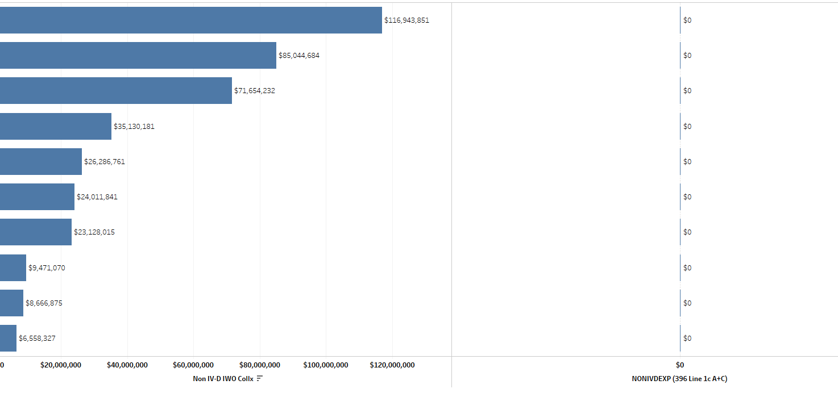
States with Over $5M in Non-IV-D IWO Collections but
$0 Line 1c FFP Claimed
Notes:
2023.

Slide 30
State Funds Only Investment and Cost Effectiveness
Directors requested data to show the impact of state investment in the program
Cost Effectiveness report has specific slides
For every state $1 invested, collections are $…
Formula subtracts FFP, federal incentives, and Non-IV-D expenditures to show just State dollars spent

Slide 31
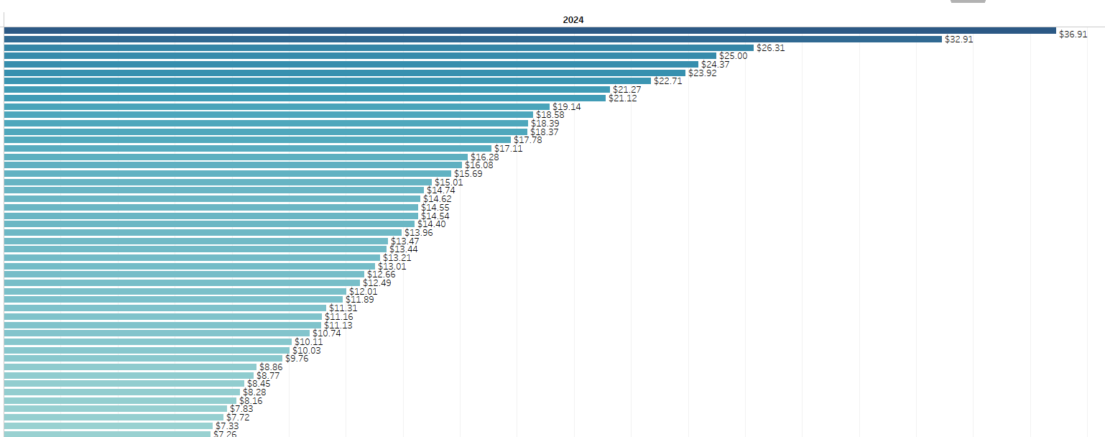
State Investment and Cost Effectiveness
Notes:
Not the entire range of states but gives an idea. Going to the legislature to say “For every state dollar you invest in the IV-D program, it collects $xx for families.”

Slide 32
Contact Information
Joey Arthur, Data Analytics Branch Chief
OCSS Division of Federal Systems
joey.arthur@acf.hhs.gov
Cynthia Longest, Senior Technical Advisor
OCSS Office of the Commissioner/Deputy Commissioner
cynthia.longest@acf.hhs.gov

Slide 33
Thank you!
Q&A

