Slide 1


Slide 2

Child Support Navigators
Larry Desbien, Colorado
Kristen Donadee, California
Erin Frisch, Michigan*
Eileen Stack, New York

Slide 3

Colorado IMPACS Program
Improved Payments and Child Success
Presented by: Larry Desbien, Colorado Division of Child Support Services

Slide 4

Program Overview
IMPACS supports noncustodial parents (NCPs) behind on child support.
Provides employment services, case management, and supportive services.
Operates in 6 Colorado counties: Denver, Jefferson, Larimer, Montrose, Delta, and Pueblo.
  Soon to implemented: a tri-county model in three rural counties and Adams County.
Administered by Colorado Department of Human Services (CDHS), Division of Child Support Services (DCSS).

Slide 5

Funding
Funding Source: Temporary Assistance for Needy Families (TANF) block grant.
Initial Allocation: Began in FY 2019–2023
Second Allocation (extension): Approved for 2023–2027.
Notes:
Parents must meet TANF income eligibility to be enrolled in the program and have a current open child support case.
Due to COVID there was a delay in launching the project. Request was made to extend the program through 2027. No additional funding was provided.

Slide 6
Getting Off the Ground
Vendors and Counties applied to CDHS to participate.
Services delivered via 2 different models:
  Vendor/County Partnership:
    Discover Goodwill (Denver, Jefferson, Pueblo, Adams)
    Hilltop Family Resource Centers (Delta, Montrose)
  County Ran:
    Larimer County Child Support (Larimer)
Notes:
Vendor and counties were required to follow state procurement rules and apply for a Request for Application (RFA) in 2019.
We are proud to support our counties and vendors in helping them create program that meet the needs of their communities. Each program is slightly different: supportive service allocation range from $500-$3000 per participant and required enrollment range from 40-120 participants each year based on Small, Medium and Large county caseload size.
Counties who work with a vendor must collect a signed Release of Information for completion of the referral and confidentially purposes. This a is barrier to enrollment as a one-stop-shop within the child support program is the best model.

Slide 7
Successes & Impacts
644 referrals
461 enrollments (72% enrollment rate)
75% of clients received financial assistance (avg. $924)
80% achieved child support milestones
68% achieved employment milestones
Significant reduction in client-reported barriers over time.
Notes:
Child support milestones: paying 90% or more in monthly obligation for 3 months or more consistently.
Employment milestones: gain new and/or full-time employment while engaged with the program.
Participants are given a survey at enrollment, 3 months, 6 months and 12 months to evaluate client barriers.

Slide 8
Reflections from Clients
Emotional Support Matters: Clients deeply valued the emotional and mental support from case managers, often describing them as family-like figures.
Employment Help Appreciated: Resume writing, job leads, and interview prep were helpful, though some clients found jobs independently.
Child Support Flexibility: IMPACS helped clients avoid license suspensions and facilitated modifications to child support orders.
Supportive Services Were Crucial: Financial assistance for rent, utilities, transportation, and food helped stabilize lives.
Parenting Relationships Improved: Some clients gained more access to their children and attended fatherhood classes.
Motivation Is Key: Clients emphasized that the program works best for those who genuinely want help.
Staff Continuity Matters: Clients preferred consistent case managers to build trust and rapport.
Notes:
Center for Policy Research conducted focus groups and surveys of the participants in the program. Here are some reflections from clients.

Slide 9

Want more Information?
Contact Larry!
Larry.Desbien@state.co.us

Slide 10
Family Law Facilitators
California Court Navigators
Presented by: Kristen Erickson-Donadee, California Department of Child Support Services

Slide 11
Agenda
Background and Program Origins
Overview of Assembly Bill 1058
Details of Family Law Facilitator Program
Results and Lessons Learned

Slide 12
Background
Child Support Court Task Force Report (1995)
  State administration of child support by Department of Social Services
  Local administration of child support by County Attorneys General
  Local court adjudication by generalist family law judges
Assembly Bill 1058 Legislation (1996)
  Mandated creation of IV-D court program including specialist Commissioners to adjudicate child support matters and Family Law Facilitators to provide free court navigation services to participants
Assembly Bill 196, Child Support Reorganization (1999)
  Created Department of Child Support Services at state level
  and Local Child Support Agencies in every county

Slide 13
AB 1058 Overview
Goal: Create an efficient, streamlined system for establishing and enforcing IV-D child support orders.
  Standardize and simplify forms used for court process, ensuring they provide adequate notice to parties
  Provide coordination, standards, support and training for specialized child support Commissioners
  Create streamlined process for presumptions about earning potential when it is unknown
  Create streamlined process for default adjudication when a parent does not participate
  Create family law facilitator office within each county’s court

Slide 14
Family Law Facilitator Program
Appointed by each county’s court
Services provided include:
  Providing educational information to parents on the process of establishing parentage and establishing, modifying, and enforcing child support;
  Distributing necessary court forms and voluntary declarations of paternity;
  Providing assistance in completing forms;
  Preparing guideline support calculations; and
  Providing referrals to the local child support agency and others.
Services provided at no cost to litigants

Slide 15
Family Law Facilitator Program
Judicial Council of California shall adopt minimum standards for office operations.
The family law facilitator does not represent either party; no attorney-client relationship is created as a result of obtaining services from the office.
Programmatic goals include:
  Demystifying courtroom procedures and humanizing the court process
  for litigants/participants.
  Enhancing the effectiveness of the court process for court
  personnel by explaining the process to participants.

Slide 16
Family Law Facilitator Program
Judicial Council of California studied workload needs for both Commissioners and Family Law Facilitators and seeks funding from California Child Support Services in line with established needs.
  95 Commissioners statewide, including 42 full-time positions;
  153 Facilitators, including almost 40 full-time positions.
  Total funding for Facilitator program is approximately $16M total funds.
California Child Support Services provides routine training to Judicial Council and local court staff on substantive matters as well
as proper accounting procedures.
  Courts routinely audited to ensure all claimed costs are appropriate.

Slide 17
Results
Annual Report of Family Law Facilitator program provides data on results.
40,000+ instances of service
27,000+ individuals served in person
  2/3 of all instances
13,000 individuals served remotely
Nearly 1,000 individuals served via workshops

Slide 18
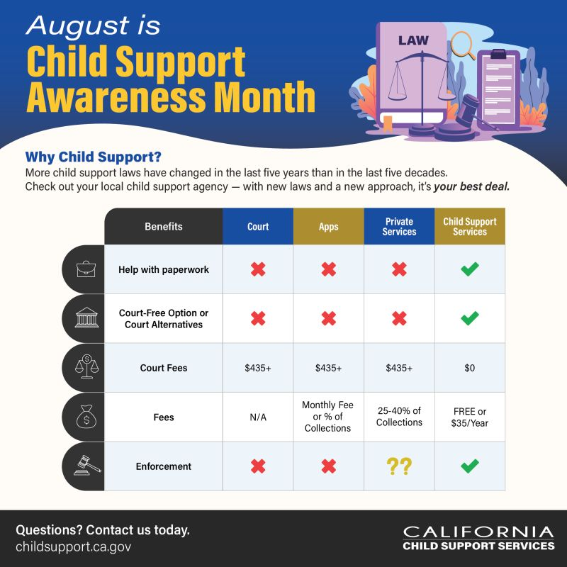
Contact Kristen for more information:
Kristen.Donadee@DCSS.CA.GOV

Slide 19
Michigan
Title IV-D Child Support Navigation Services Pilot Program
Prepared by: Erin Frisch, Michigan Department of Health and Human Services

Slide 20
Agenda
Introduction
County Pilot
Evaluation
Lessons Learned

Slide 21
Background
In 2021, the Office of Child Support Community Advisory Council published its first report which reported that participants often find the child support program confusing and complex.
Navigators are used successfully in various settings including mental health, child welfare, and veteran services throughout Michigan and the United States.
Programs increase participant knowledge and access to information and resources.
Notes:
In 2021, the OCS Community Advisory Council published its first report with the following findings and recommendations:
Council members reported that parents and non-parent custodians find the child support program confusing and stressful.
For example, it is difficult to locate and understand forms and to know who to call with questions
To address these challenges, the Council recommended child support advocates. Given concerns about the potential legal connotations of “advocates” and the emphasis on providing information, not advice, the Office of Child Support landed on the navigator approach.
These programs have been shown to increase participants knowledge about and access to critical resources and information.

Slide 22
Goals
  Increase
  Knowledge
  Engagement
  Trust
  Access
  Improve perceptions of child support
  Usefulness
  Fairness
  Helpfulness
Notes:
The goals of the program, developed in collaboration with the Community Advisory Council, are to increase knowledge about the child support program, engagement with the FOC, PA, and OCS, trust in the program, and access to child support resources.
We hope to improve perceptions (or how participants experience and describe) of the program (e.g., do they think they are treated fairly by program staff).
Navigators will also make referrals to non-child support resources such as food, employment, transportation and parenting and co-parenting resources.

Slide 23
Overview of Program
Structure
Four counties: Genesee, Calhoun, Kent, and Wayne
Structure varies by funding mechanism and staffing approach
Funding
W.K. Kellogg Foundation providing pilot funding for Calhoun, Genesee, Kent
Federal Office of Child Support Services (OCSS) which is providing matching funds through a section 1115 waiver
Eligibility
Anyone with IV-D case or deciding whether to open one can receive services
Referral Process
Participants can self-refer at any stage in the case
Participants can receive navigation services without consenting to study
W.K. Kellogg funded sites focused on Asset Limited Income Constrained Employed (ALICE) population

Slide 24
Timeline
Start: August/September 2024
Year 1
Year 2
Year 3
Planning
Navigation Services Delivery
Impact evaluation
Identify partners
Hiring
Training
PA/FOC and navigator collaboration
Implementation support
Site visits
Complete navigation services
Develop evaluation plan and tools
Training continues
Collect feedback from FOCs and PAs
Notes:
Year 1: Plan
Plan in collaboration with FOCs/PAs
Develop collection and evaluation tools
Identify host agencies
Hiring
Year 2: Provide navigation services
Training
Provide and track navigation services
Year 3: Evaluate

Slide 25
Navigator Activities
Can
Provide IV-D resources including MiChildSupport
Ensure participants have necessary forms and instructions
Refer to parenting, co-parenting, and community resources
Explain how child support is calculated
Orient to the IV-D program
Custody or parenting time
Provide legal advice (provide resources)
Take payments – provide information
Specific action on case (review and modification, enforcement remedies)
Cannot
Provide and track navigation services
Notes:
Navigators help child support program participants understand what is happening in their child support case, what might happen next, and how the choices they make will affect outcomes. Navigators also connect child support program participants to other resources such as parenting classes and employment programs.
Navigators will also make referrals to non-child support resources such as food, employment, transportation and parenting and co-parenting resources.

Slide 26
Existing IV-D Office Role
Share
Feedback about the process and navigation services with evaluators through interviews
Orient
Navigators to local office and provide county-specific training including shadowing and contacts
Help
Plan (working group, steering committee, county-specific meetings)
Receive and make
Referrals from and to navigators
Notes:
Provide local office-specific training
Host co-located navigators
Receive and make referrals
Share feedback about the process and navigation services with evaluators
Shadowing, contacts for offices
Provide local office-specific training
Host co-located navigators
Receive and make referrals
Share feedback about the process and navigation services with evaluators
Evaluation
Forms training
Additional trainings include safer Access and a new training on Information vs. advice
Opportunity for navigators to share ideas, problem solve
Provide additional training, guidance from OCS, evaluators

Slide 27
Community Partners
InvolvedDad
Black Impact Collaborative
Family Futures
ACCESS
Children’s Center
Detroit Justice Center
Focus HOPE
Supreme Transitions
Team Wellness Center (3 locations)
Wayne Metro Community Action Agency (3 locations)
Notes:
In some counties we contract with the organization and their staff provide the services. In Wayne County we have agreements with these folks to allow one of our staff space in their location.
We did an RFP process to ID partners and build agreements.
Currently have about 500 participants (cumulative)
These numbers are being tracked in various ways we’ll discuss further in the evaluation section
Navigators available ½ day or full day 2 to 3 days per week.
Participants can walk in or request to schedule an appointment.

Slide 28
Evaluation
Were the goals were reached?
Should we or others continue to build on this program?
What could be done differently to improve the program?
Sharing with funders, program leadership, community agencies, community members
Informing future efforts and initiatives
Navigation Services Delivery - 30 days after services completed
Post-participation survey
Navigation tracker – navigation services
Navigation Services Delivery
Consent form
Intake form
Navigation tracker – navigation services
Navigator tracker – recruitment
Recruitment
Individualized Service Plan
Notes:
The most important measure of success will be what participants think about the pilot.
Asking participants about their experience with navigation services before and after
Other ways of measuring success will include interviews with county FOC staff and community organizations providing navigation services.
Staff and navigators about their perceptions of the implementation process and pilot
While we hope participants will choose to participate in the study and services, they have the option of participating in services only. If they choose to participate in services only, their data will not be shared with the evaluation team. Other than that, the services navigators provide and track and the forms they complete will all be the same regardless of whether they participate in the study.
There are three phases.
Partnering with Mathematica-evaluation team-measuring the effectiveness of the program- conduct monthly visits with our county Supervisors/Directors. They will visit community sites, and there is a post survey that participants are asked to complete re: services. Participation in the study is voluntary but they can still receive services if they decide not to participate in study.

Slide 29
Lessons Learned
Highlights
  Navigators report that they enjoy working with people in the community
  Surprised by how the community welcomed navigators to talk about OCS services
Hurdles
  Early engagement can be challenging because of participants life stressors, schedules, and stigma surrounding child support
  Intake forms are long but services are short-term
  Timing marketing and balancing need for referrals with staffing and capacity
Define
Clearly define roles
Need for job aids, role descriptions
Discuss
Discuss progress and identify areas of need
Create regular opportunities for navigator and office supervisors to meet
Develop
Develop efficient, sustainable trainings
Rolling onboarding – challenges and opportunities
Produce in-person, virtual (live), and recorded trainings
Learning Communities among navigators
Notes:
We hold Navigator Learning Community meetings. These are opportunities for navigators from across the four pilot sites to exchange ideas, feedback, and problem. The first one took place six months into the pilot program.

Slide 30
Want more Info?
Contact Erin!
517-243-5998
Frische@michigan.gov

