Slide 1


Slide 2

Child Support: Brightening Futures and Budgets
Updated Insights on Cost Avoidance and Family Wellbeing

Slide 3

Speakers
Laura Wheaton, Senior Fellow, Urban Institute
Erin Frisch, Director, Michigan Office of Child Support
Michele Cristello, Deputy Commissioner, Massachusetts Department of Revenue, Child Support Services

Slide 4

Introduction

Slide 5
Cost Avoidance
Consistent child support brings brighter outcomes for families and relief for public programs.
  Research shows that regular child support payments help families rise above poverty while generating "cost avoidance“ - reductions in spending on means-tested benefits that result in significant savings for both state and federal budgets.
NCCSD collaborated with the Urban Institute to update cost avoidance estimates and build a user-friendly toolkit for states to use to make data-informed decisions, communicate with key stakeholders and maximize program impact.

Slide 6
Three Forthcoming Papers
  1
  2
  3
  Cost Avoidance:
  Child Support’s Effect on Reducing Expenditures in Government Benefit Programs
  The Anti-Poverty Effect of Child Support in 2023
  What are the Effects of Child Support on Child and Family Well-being? Evidence From a Scoping Review
  This work was funded by the California Department of Child Support Services (CADCSS). We are grateful to them and to all our funders, who make it possible for Urban to advance its mission. The views expressed are those of the authors and should not be attributed to the Urban Institute, its trustees, or its funders.

Slide 7

Cost Avoidance: Child Support’s Effect on Reducing Expenditures in Government Benefit Programs (Preliminary Findings)
2025 NCCSD Annual Conference
Amelia Island, FL
  Laura Wheaton
  Katherine Hueston

Slide 8
With appreciation to:
  California Department of Child Support Services
  Current and Former Child Support Directors: Michele Cristello (MA), Kristen Donadee (CA), James Fleming (ND), Erin Frisch (MI), David Kilgore (CA), and Barbara Lacina (VA)
  State staff in CA, MA, MI, ND, and VA for developing and providing data to the study
  State Directors and Staff for providing information on opt-in/opt-out and mandatory referral policies and medical support
  DeAnna Rice (CADCSS) for project coordination and support
  Urban Institute TRIM3 microsimulation model staff

Slide 9
Preliminary Findings:
  We do not expect major changes to findings at the national level
  Estimates for some states may change if further information is received regarding medical support
    Contact LWheaton@Urban.Org
  Anticipate release of final report by end of 2025

Slide 10
Cost Recovery and Cost Avoidance

Slide 11
Cost Recovery
  Child support collections retained by the government to help recoup TANF and Title IV-E Foster Care costs
  Reported in OCSS annual data reports, based on information provided by states

Slide 12
Cost Recovery
Cost Avoidance
  Child support collections retained by the government to help recoup TANF and Title IV-E Foster Care costs
  Reported in OCSS annual data reports, based on information provided by states
  Reduction in means-tested benefits that occurs when child support income:
    Renders family ineligible
    Reduces benefit amount
    Causes eligible family to not apply
  Estimated based on survey and/or administrative data

Slide 13
Cost Recovery
National Cost Recovery and Cost Avoidance, FY 2023*
Cost Avoidance
$893 million
  Source: OCSS FY 2023 Preliminary Data Report and Tables
  $2,917 million
  Source: Wheaton and Hueston, forthcoming
*estimates exclude Guam, Puerto Rico, and the Virgin Islands

Slide 14
Programs Included in Cost Avoidance Estimate
  Supplemental Security Income (SSI)
  Temporary Assistance for Needy Families (TANF)
  Child Care Subsidies through the Child Care and Development Fund (CCDF)
  Public and Subsidized Housing
  Supplemental Nutrition Assistance Program (SNAP)
  National School Lunch Program (NSLP)
  Special Supplemental Nutrition Program for Women, Infants, and Children (WIC)
  Low Income Home Energy Assistance Program (LIHEAP)
  Cash medical support forwarded as reimbursement for Medicaid (estimate based on OCSS data and information provided by 19 states)

Slide 15
Outline of Cost Avoidance Presentation
Approaches to cost avoidance estimation
Estimating cost avoidance ratios
Applying cost avoidance ratios to OCSS data
Cost avoidance “calculator”
    Developed for state use
    Applies our methodology to state data
Cost avoidance estimates going forward

Slide 16
Approaches to Cost Avoidance Estimation

Slide 17
Two Approaches to Estimating Cost Avoidance
    1
    State administrative data
    2
    Microsimulation

Slide 18
Two Approaches to Estimating Cost Avoidance
    1
    State administrative data
    2
    Microsimulation
      Uses IV-D administrative data merged with administrative data from other government agencies
      Directly calculates the benefit savings in each program arising from child support income
      Often does not capture savings when child support is enough to keep a family off a benefit program entirely

Slide 19
Two Approaches to Estimating Cost Avoidance
    1
    State administrative data
    2
    Microsimulation
      A 2000 report from Barnow et al. documented state cost avoidance estimates produced for Iowa, Texas, Washington, and New York.
      We would be interested in learning of any current state cost avoidance estimation work.
Notes:
The Potential of the Child Support Program to Avoid Costs to Public Programs: A Review and Synthesis of the Literature, Final Report. April 2000. Prepared by Burt S. Barnow, Timothy M. Dall, Mark W. Nowak, Barbara E. Dannhausen

Slide 20
Two Approaches to Estimating Cost Avoidance
    1
    State administrative data
    2
    Microsimulation
      Apply a microsimulation model to Census Bureau survey data to estimate the cost avoidance ratio (average savings to benefit programs per dollar of child support)
      Multiply cost avoidance ratio by amount of child support distributed according to the OCSS Annual Data report to get total estimate of cost avoidance

Slide 21
Estimating Cost Avoidance Ratios with the TRIM3 Microsimulation Model

Slide 22
TRIM3 Comprehensive Microsimulation Model
We estimate cost avoidance ratios using the Transfer Income Model, Version 3 (TRIM3).
Primary funding and copyright: HHS/ASPE
Maintained and developed at the Urban Institute
Data Source: Current Population Survey Annual Social and Demographic Supplement (CPS ASEC)

Slide 23
TRIM3 Microsimulation Process
  Determine if the people in the household are eligible for the benefit being simulated.
Add up results by state and subgroup using the survey weight.
  Read in the survey data (CPS ASEC) one household at a time.
  If they are eligible, determine the amount they are eligible for and if they participate.

Slide 24
TRIM3 Applies the Detailed Rules of Each Program
Defines appropriate “filing unit” for the program
Applies rules of the benefit program
Rules are updated each year
  Detailed state-specific rules are modeled, may include:
    Categorical eligibility
    Income definition, deductions, and eligibility limits
    Asset limits
    Age restrictions
    Restrictions on benefits for noncitizens
    Work requirements

Slide 25
Calculate the Cost Avoidance Ratio
Alternative simulation: Zero out child support
Calculate cost avoidance ratio
Sum results for all households
Baseline simulation

Slide 26
Calculate the Cost Avoidance Ratio
Alternative simulation: Zero out child support
Calculate cost avoidance ratio
Sum results for all households
Baseline simulation
Calculate each household’s eligibility and benefits.
Count child support according to the rules of each benefit program.

Slide 27
Calculate the Cost Avoidance Ratio
Alternative simulation: Zero out child support
Calculate cost avoidance ratio
Sum results for all households
Baseline simulation
Calculate each household’s eligibility and benefits without child support.

Slide 28
Calculate the Cost Avoidance Ratio
Alternative simulation: Zero out child support
Calculate cost avoidance ratio
Sum results for all households
Baseline simulation

Slide 29
Calculate the Cost Avoidance Ratio
Alternative simulation: Zero out child support
Calculate cost avoidance ratio
Sum results for all households
Baseline simulation
= (Alternative benefits – Baseline benefits)
Child Support

Slide 30
Data for this Study
We combine 5 years of data to build the sample size needed for state estimates.
2016 to 2020 CPS ASEC, reflecting income and policies in 2015 to 2019
  Avoids years affected by the COVID-19 Pandemic
  We apply cost avoidance ratios to data from the OCSS FY 2023 Preliminary Data Report and Tables.

Slide 31
National Cost Avoidance Ratios, 2015-2019
  Current assistance families
  $1 of child support transferred to family = 39.1 cents avoided in other programs
  Former and never assistance families
  $1 of child support to family = 11.5 cents avoided in other programs
  Non-IV-D Families
  $1 of child support to family = 7.3 cents avoided in other programs

Slide 32
Cost Avoidance Ratios, 2015-2019
 | Current Assistance | Former and Never Assistance | Non-IV-D
SSI | 0.111 | 0.012 | 0.011
TANF | 0.038 | 0.016 | 0.007
CCDF | 0.000 | 0.002 | 0.001
Housing | 0.064 | 0.016 | 0.009
SNAP | 0.183 | 0.064 | 0.040
NSLP | 0.000 | 0.005 | 0.004
Total | 0.391 | 0.115 | 0.073
*WIC and LIHEAP included in the estimates but have no measurable effect.

Slide 33
State Cost Avoidance Ratios
We use state specific cost avoidance ratios for former/never assistance cases and for non-IVD families in most states.
Due to sample size limitations, we use national average cost avoidance ratios for:
  Current assistance families in all states
  Non-IVD families in CT, DE, DC, HI, KY, ME, NH, RI, and SD

Slide 34
Applying Cost Avoidance Ratios to OCSS Data

Slide 35
Applying the Cost Avoidance Ratios to OCSS Data
  Obtain data from OCSS FY 2023 Preliminary Data Report and Tables, adjusted to remove:
    Lump sum/occasionally distributed child support (e.g., tax offsets and administrative enforcement)
    Cash medical support assigned to Medicaid
  Multiply by cost avoidance ratio
  Calculate separately by state and current assistance, former/never assistance, and non-IVD status

Slide 36
Why remove occasional/lump sum income?
  Occasional/lump sum income is typically not counted as income in government benefit programs.
  A lump sum amount might temporarily increase family assets which might cause them to lose eligibility for some programs under an asset test.
  Effect is not captured in these estimates:
    Many states have dropped the SNAP assets test.
    Some of the benefit savings would be offset by administrative costs in closing and reopening the case.

Slide 37
How do we remove irregular/lump sum child support?
We estimate the share that is irregular/lump sum using data from:
  California and Virginia (fiscal year 2022 data)
  Massachusetts, Michigan, and North Dakota (fiscal year 2023 data)
  We use the average shares from these states to “back out” irregular/lump sum distributions from OCSS totals for other states:
    Pass-through amounts (13% is irregular/lump sum)
    Distributed to current assistance families (25% is irregular/lump sum)
    Distributed to former/never assistance families (8% is irregular/lump sum)

Slide 38
Why remove cash medical support assigned to Medicaid?
    The OCSS annual report includes the total amount distributed as cash medical support.
      Does not separate assigned medical support forwarded to Medicaid or the General Fund from medical support sent to families
    We count medical support forwarded to Medicaid or the General Fund as 100% cost avoidance.
    Medical support forwarded to families is counted as “income” and treated the same as child support income in our estimates.

Slide 39
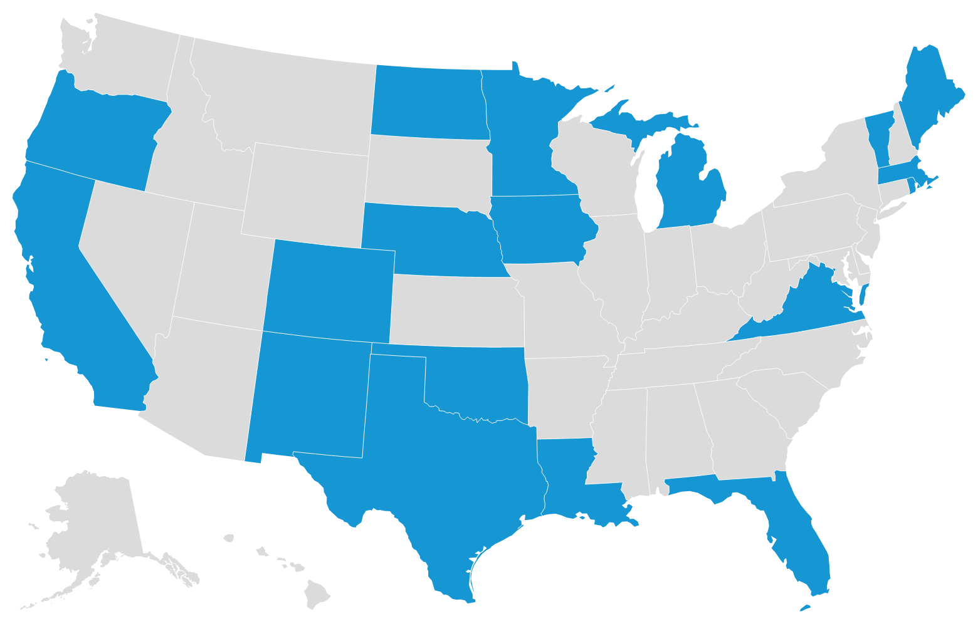
How do we estimate what share of Medical support goes to Medicaid or the General Fund?
    We use information provided by 19 states to disaggregate the OCSS medical support total into shares that are forwarded to Medicaid, regularly received, and irregular/lump sum
    We apply the average shares from these states to all other states

Slide 40
How do we estimate what share of Medical support goes to Medicaid? (continued)
    Average shares
    50%
    Medicaid/General Fund
    1%
    regular support to current assistance families
44%
regular support to former and never assistance families

Slide 41
National Cost Avoidance, FY 2023
(Thousands of dollars)
 |  |  | Current Assistance | Former and Never Assistance | Non-IV-D Families | All Families
Collections Distributed to Families (excluding lump sum) |  |  | 180,843 | 22,948,955 | 2,921,687 | 26,051,485
Cost Avoidance |  |  |  |  |  | -
 | SSI |  | 19,079 | 282,272 | 30,678 | 332,029
 | TANF |  | 6,782 | 369,478 | 20,452 | 396,712
 | CCDF |  | 163 | 36,718 | 2,922 | 39,803
 | Housing Subsidies |  | 11,628 | 371,773 | 25,419 | 408,820
 | SNAP |  | 33,094 | 1,464,143 | 120,374 | 1,617,611
 | SNAP offset (CS payment deduction) |  |  |  |  | (375,757)
 | NSLP |  | - | 119,335 | 12,563 | 131,898
 | Total |  | 70,746 | 2,643,720 | 212,407 | 2,551,115
Estimated Medicaid Reimbursement |  |  |  |  |  | 365,780
Total cost avoidance |  |  |  |  |  | 2,916,896

Slide 42
State Cost Avoidance Estimates
    For each state we include:
    Cost avoidance on distributions within state
    Assistance reimbursement (from OCSS annual report)
    Cost avoidance and assistance reimbursement on distributions sent to other states
        Estimated based on national share distributed as assistance reimbursement and regularly distributed support
    Total (including within state and to other states)

Slide 43
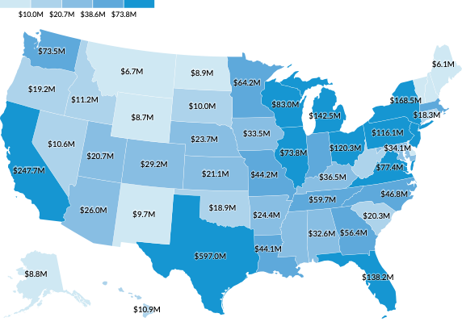
Cost Avoidance on Distributions Within State
$60.1M
$38.6M

Slide 44
Cost Avoidance on Distributions Within State
$5.6M
$5.9M
$62.1M
RI: $18.1M
NJ: $77.6M
DE: $7.9M
DC: $4.4M
$60.1M
$14.1M

Slide 45
State Cost Avoidance Calculator

Slide 46
What does the Calculator Do?
Applies cost avoidance ratios from this study to user-entered state child support aggregate data
Can be applied to a more recent data year
Can enable more refined estimates by using actual information on regular versus irregular support and medical support (instead of the assumptions used in our analysis)
“Basic” calculator estimates within-state cost avoidance
“Enhanced” calculator estimates cost avoidance on child support distributed within the state and to other states (or families within other states)

Slide 47
Basic Calculator Applied to Massachusetts

Slide 48
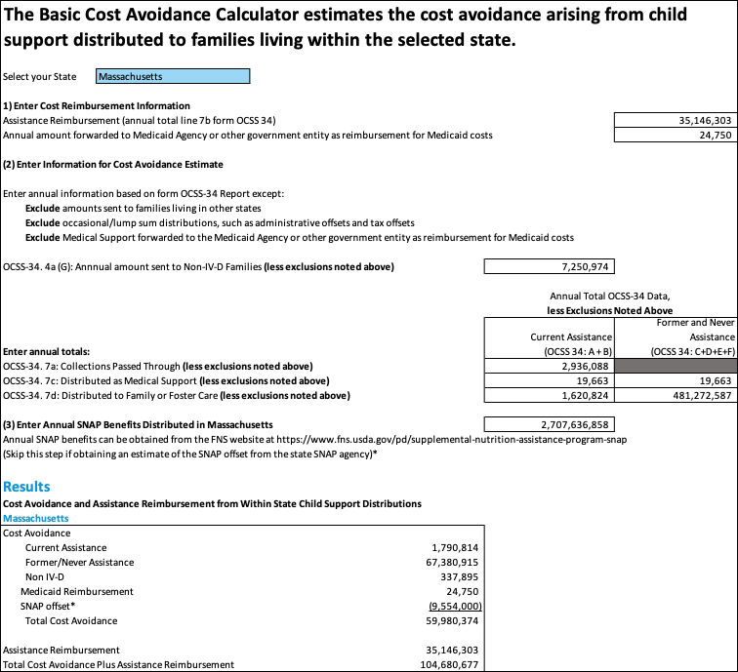

Slide 51
Enhanced Calculator Applied to Massachusetts

Slide 52
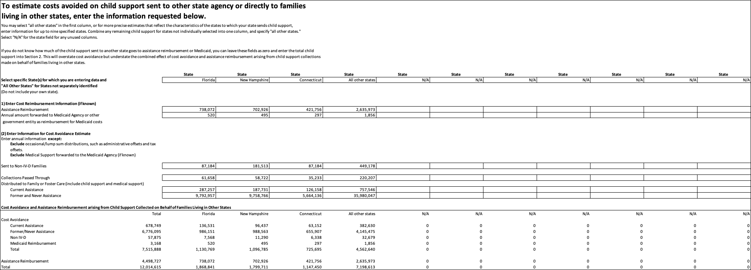

Slide 55
Basic Calculator Applied to Massachusetts

Slide 56
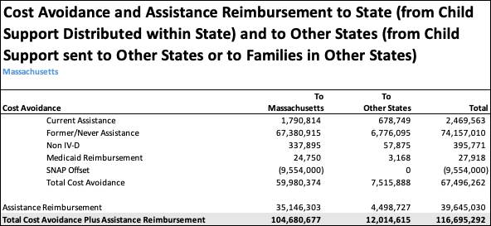

Slide 57
Going forward, and Questions?

Slide 58
What does the future hold?
The One Big Beautiful Bill Act (OBBBA) enacted substantial changes to SNAP and Medicaid. Changes to other benefit programs may be forthcoming.
If program participation among families with children substantially falls, cost avoidance may likewise fall.
With fewer benefits received, child support would be even more critical as a resource to families, though the total dollars of cost avoidance might fall.
OBBBA requires states with a SNAP error rate over 6% to pay a share of SNAP benefit costs, and so SNAP cost avoidance will reduce state costs.

Slide 59
Contact
We’d welcome information from additional states about medical support for inclusion in the study.
Please reach out with comments and questions.
LWheaton@urban.org

Slide 60
The Anti-Poverty Effect of Child Support in 2023
2025 NCCSD Annual Conference
Amelia Island, FL
  Laura Wheaton
  Christin Durham

Slide 61
How Much does Child Support Reduce Child Poverty?
The Census Bureau’s annual poverty reports include an estimate of the effect of child support on poverty.
Data are from the Current Population Survey Annual Social and Economic Supplement.
A person is counted as being raised above poverty by child support if they would be below the poverty threshold if child support is not counted and are above the poverty threshold when child support is counted.
In 2023, the Census Bureau estimates that 574,000 people, including 345,000 children, were raised above poverty by child support income.
Notes:
https://www2.census.gov/library/publications/2024/demo/p60-283.pdf

Slide 62
We drill down further…
We use the Census Bureau’s publicly released data to drill down further, showing antipoverty effects among:
  Children in families receiving child support
  Race and ethnicity
  Child age
  Metropolitan or Nonmetropolitan status
  Census Division (region of US)

Slide 63
Child Support reduces child poverty across subgroups:

Slide 64
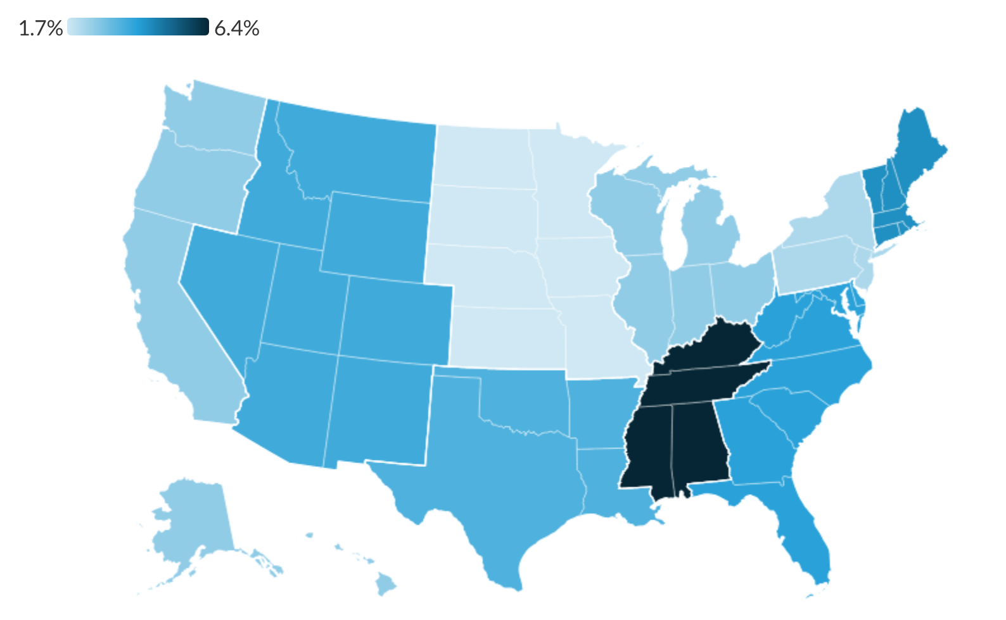
East South Central States have the largest reductions

Slide 65
What are the Effects of Child Support on Child and Family Well-being? Evidence From a Scoping Review
2025 NCCSD Annual Conference
Amelia Island, FL
  Anne Farrell
  Margaret Todd
  Jordan Hardenburgh
  H. Elizabeth Peterson

Slide 66
Why a scoping review?
Child support distributed by the IV-D program affects the lives of millions of children.
What are the effects – beyond increasing income?
Two prior comprehensive reviews (Amato and Gilbreth 1999) and (Huang and Han 2012) found:
  Effects on child well-being, nonmarital fertility, sexual behavior among adolescent males, welfare use, and father involvement.
We use a formal “scoping review” to produce an updated summary of research findings from 1995-2024

Slide 67
Scoping Review: Considerations and Steps
Develop research question
Identify relevant policies and policy changes across time
Develop inclusion/exclusion criteria
Exhaustive search of research and policy databases
Selection of studies/reports
Extract salient information and code (abstract and full text)
Analysis & synthesis: findings, trends, themes
Reporting

Slide 68
Scoping Review: Study Factors & Outcomes of Interest
  Study factors
  US only
  Age/date of study
  Population
  Type of study
  Family/parent factors
  Enforcement
  Outcomes of Interest
Public assistance
Maltreatment/abuse
Parental relations/conflict
Employment and wages
Housing instability
Food insecurity
Child development and well-being
Labor market participation

Slide 69
Scoping Review: Methodology
5,692
reports
located
We retrieved 5,692 reports, reviewed 3,843, and coded 95 that met rigorous criteria required for inclusion in the analysis.
3,843 screened
(once duplicates removed)
Preferred Reporting Items for Systematic Reviews and Meta-Analyses (PRISMA)
330
reviewed
95
included studies

Slide 70
Five Key Findings
Finding #1: There is strong evidence of child support’s effects in promoting child, maternal, and family well-being.
Finding #2: More stringent child support policies and enforcement are associated with consistently higher collections (some exceptions, e.g. incarceration).
Finding #3: Evidence of the effects of child support on labor force participation is mixed, but evidence shows positive effects on TANF participation
Finding #4: Fathers and joint custody arrangements are understudied.
Finding #5: There is a healthy dialogue across child support policy and research.
We find ample evidence that child support “works,” yet there is more to learn.

Slide 71
Gaps identified
Although fathers are a growing segment of custodial parents, we found no studies examining child and family experiences and outcomes.
Evidence on joint custody is mixed (some negative outcomes) and better understanding is called for.
Need a deeper understanding of how child support interacts with family factors (e.g., ethnoracial identity, nativity, education, gender, age) and community characteristics (e.g., employment opportunities, housing stock, digital access, education, health care).
Rapidly evolving national policy environment and changes in family economic supports – what are the implications for child support?

Slide 72
Next Steps for States

Slide 73

What do states do with this valuable information?
Suggested Strategies:
Strategy 1: Use Cost Avoidance Data to Defend Against Budget Cuts
Strategy 2: Use Cost Avoidance to Justify Targeted Investments
Strategy 3: Equip Allies and Champions with the Message

Slide 74
Closing Call to Action
Three things you can do:
Add a cost avoidance line to every budget and policy request.
Meet with your agency fiscal team to model ROI locally.
Start building stories that show how regular support prevents deeper system involvement.

Slide 75
Final Message
“Cost avoidance research proves that child support is not just a collection program. It’s a fiscal strategy — and a family-strengthening investment.”

Slide 76
Thank You!
Laura Wheaton - lwheaton@urban.org
Erin Frisch - FrischE@michigan.gov
Michele Cristello – cristellom@dor.state.ma.us

